Slide 1
PN 19-182: Lakeside Memorial Lawn Crematorium Conditional Use Permit Appeal
Notes:
Tonight, I’ll be presenting the appeal by Igor Semenyuk of the HDC’s denial of the Lakeside Memorial Lawn Crematory CUP

Slide 2
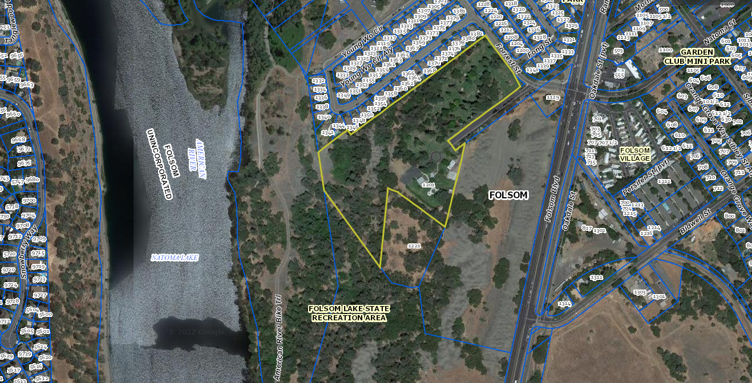
Project Vicinity
Notes:
Project is located on the Lakeside Memorial Lawn cemetery, which is located within the Open Space/Public Area of the HD. It is adjacent to the Preserve subdivision (aka Lake Natoma Shores) to the north, mining tailings & Folsom Blvd. to the East, the Chung Wah cemetery to the south and the Folsom Lake State Recreation Area, American River Bike Trail and American River to the west. The area outlined in yellow here represents the property lines of the Lakeside Memorial Lawn and the small area in red is the location of the structure in which the crematorium facility is proposed. The structure is located approximately 450 feet from nearest residential uses

Slide 3
Applicant’s Proposal
Conditional Use Permit application
Operation of a crematory facility inside an existing metal structure within maintenance area
Two 250-gallon propane tanks next to the metal structure
Stack located above roofline of structure
Up to four cremations per day
No more than 500 cremations per year
Notes:
The applicant applied for a CUP from the HDC to operate a crematory facility inside an existing metal structure within the fenced maintenance area of the cemetery. Outside of a single exhaust stack located above the roofline of the structure, the only site modifications would consist of two 250-gallon propane tanks on a pad next to the structure. The applicant proposes to perform up to 4 cremations per day (which take around 90 minutes each) and a maximum of 500 cremations per year.

Slide 4
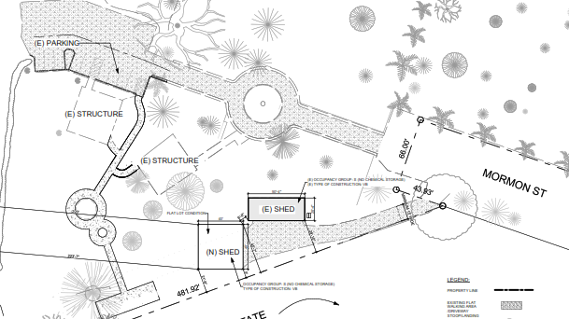
Site Plan
Notes:
Now looking at the site plan. Here we see that there are two structures in the maintenance area, the rectangular structure that has been around since the 90s where the crematorium is proposed, and the larger square storage shed that was recently constructed and is not associated with this project.

Slide 5
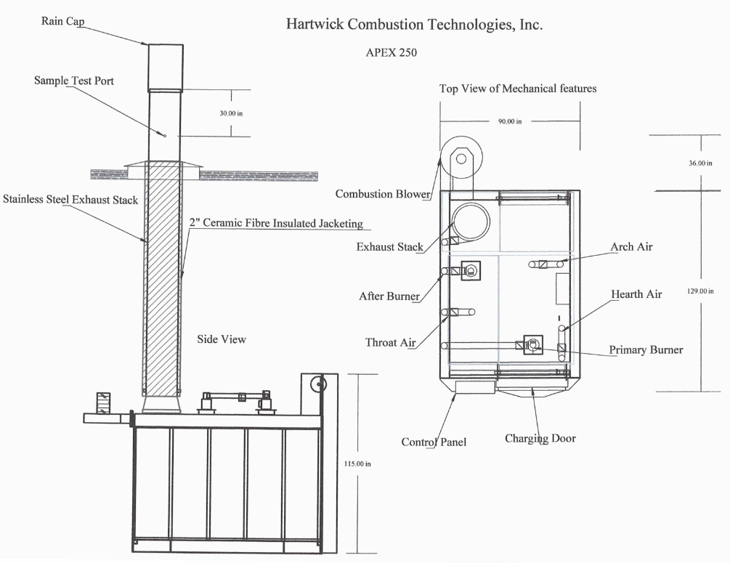
Cremator Elevation With Metal Structure’s Roofline
Notes:
And here we have some manufacturer specifications of the cremator with exhaust stack and rain cap.

Slide 6
Major Factors Studied
Zoning and Land Use Compatibility
Air Quality
Fire/Life Safety
Visual Impacts
Cultural, Archaeological, Paleontological and Historical/Tribal Resources
Notes:
So in the staff report, staff looked at multiple areas of potential concern. Here are the major factors that were studied
For zoning, cemeteries are allowed in this zone with the issuance of a CUP and staff considered the proposed crematory to be an accessory use to the cemetery operations given the fact that it would be operated ancillary to the existing cemetery and ran by the same group that owns the cemetery. Staff also found that there were several crematories in Sac Co. operating ancillary to cemeteries and funeral homes, so it is common to have a crematorium operating ancillary to a main use.
Staff had an initial study prepared that included a full project-specific Air Quality and Greenhouse Gas analysis done by technical professionals in consultation with the Sacramento Metrop Air Quality Management District. That analysis found that the operational emissions and community incremental excess cancer, chronic and acute health risks were shown not to exceed the Air District’s daily or annual thresholds based on the location of the houses and the technology of the cremator. Staff notes that the project would also be subject to future permitting, regular reporting to and annual inspections from the air district
For Fire & Life Safety, the IS confirmed that impacts would be LTS and the Fire Chief verified that the current access is adequate and that the stack and propane tanks do not result in substantial elevated fire risks

Slide 7
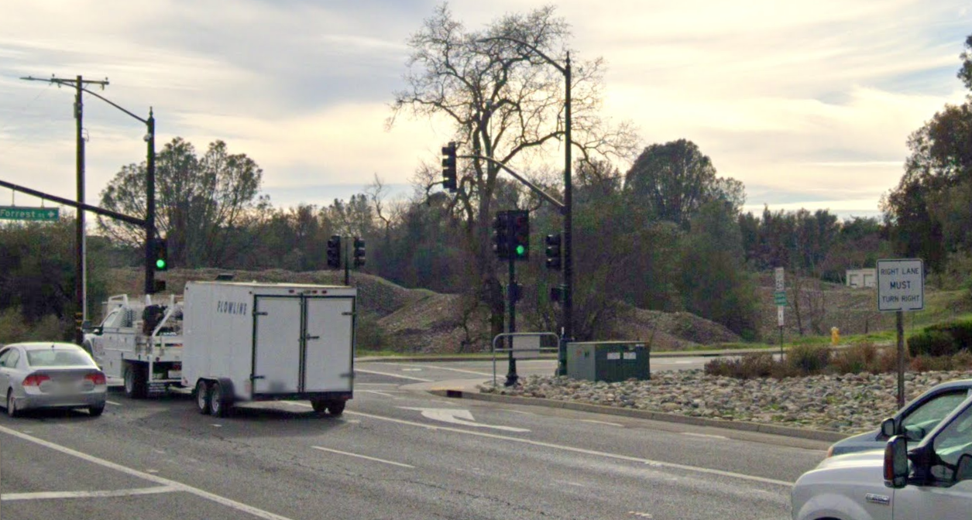
View of Project Site from Folsom Blvd.
Notes:
And now looking at the visual impacts. Here’s a view of the tailings and project site from the right. This is about the only area outside of the project site that staff could find where the structure is clearly visible.

Slide 8
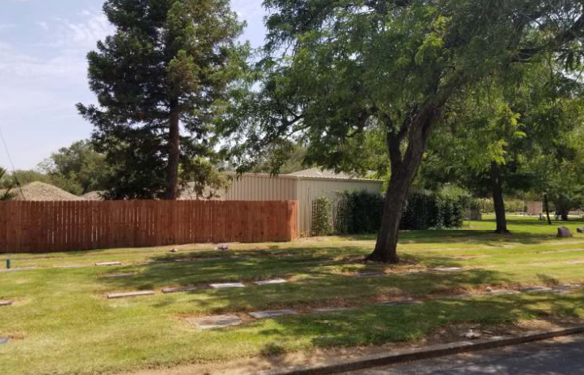
View of Project Site From Inside Cemetery
Notes:
Here we see a view of the metal structure where the crematory is proposed. You can see that there is a wooden fence surrounding the area where the propane tanks are proposed, so the tanks are not anticipated to be visible outside of the maintenance area.

Slide 9
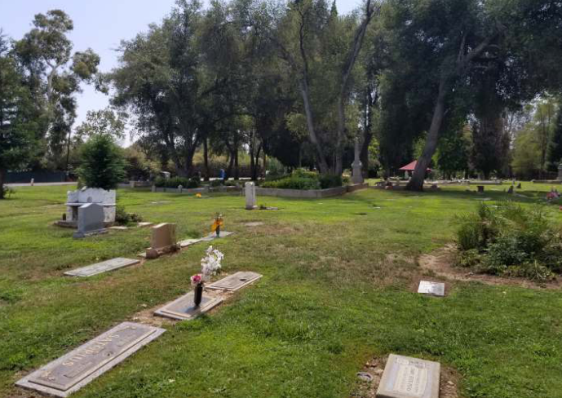
View of Maintenance Area From Edge of Cemetery (closest to Preserve/LNS)
Notes:
And here we have a view of that maintenance area from the edge of the cemetery closest to the Preserve Subdivision. As shown here, the existing tree canopy mostly shields the maintenance area from the subdivision and inclusion of the new stack on top of the building would not significantly alter this view. Staff originally concluded through consultation with the contracted archaeologist that the visibility of the proposed stack does not have a direct effect on the historical significance of the historic cemeteries from a CEQA perspective, especially as there is no ash that could spread to gravesites.

Slide 10
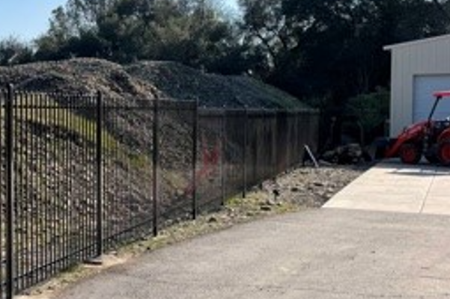
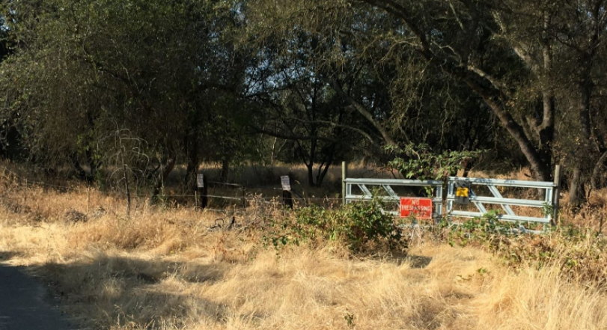
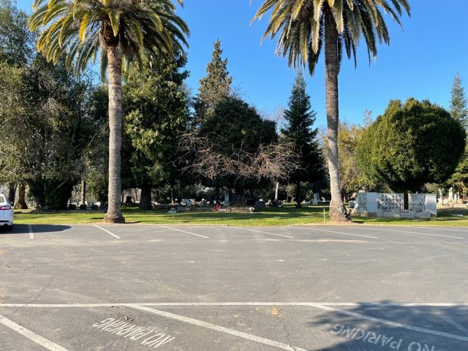
Cultural, Archaeological, and Paleontological Resources
Notes:
And finally, looking at Cultural, Archaeological, and Paleontological Resources. I’m going to get into a little more detail here, as this is what the commission based their finding for denial on. So the Lakeside Cemetery, which includes the Odd Fellows and Mason’s Cemeteries, and the adjacent Chung Wah Cemetery and dredge mining tailings all appear on the City of Folsom’s Cultural Resources Inventory and Chung Wah and Lakeside appear on historic county cemetery inventories as well. Here we see the tailings, the entrance to the Chinese cemetery and the view of the Lakeside cemetery from the maint. Area. Staff had a Cultural Resources Inventory report prepared by a registered Archeologist at ECORP due to the cultural sensitivity of the area. The qualities that make the historic cemeteries significant are the aspects of integrity of setting, feeling, and association (according to the National Registration Form for Chung Wah) and the archeo consultant concluded that the project would not significantly impact these qualities from a CEQA standpoint. As part of the original 2003 Initial Study process, the Sac. Co. Cemetery Advisory Commission sent a letter expressing concern for a crematory to be located in the vicinity of the historical resources described here. Staff recommended approval in 2022 however in part based on the additional cultural resources and AQ studies performed by experts as part of the new IS. After publication of the staff report, the Cemetery Commission sent a new letter re-stating their concerns from 2003. Staff shared these letters as well as a letter from the Chinese Historical Society of America with the archeological & enviro consultant, and found that the conclusions of the IS/MND did not change based on these comments and that impacts would remain LTS from a CEQA perspective.

Slide 11
Public Comments
140 public comments regarding the project and/or IS/MND
Online and hand-signed petition with 650 signatures
Over 300 signed form letters
35 speakers at the HDC hearing opposing the project
Major concerns:
Air quality, traffic, parking, wildfire, life safety, cultural/archeological resources, land use, aesthetic, economic and psychological concerns
Notes:
And now on to public comments. Throughout the life of the project, staff has received or has been forwarded over 140 unique public comments regarding the project and/or environmental document, all but one of which expressed concerns about or opposition to the project and environmental document. There was also an online petition with over 160 signatures, a hand-signed petition with almost 500 signatures and over 300 signed form letters all expressing opposition to the proposed project that were submitted to staff. Finally, there were 35 speakers at the HDC hearing opposing the project. Staff read and attempted to summarize each of the unique points of the public comments in the original staff report and HELIX provided a response letter to the general points that were made in several of the letters regarding environmental issues addressed in the IS. Major issues brought up in those letters included air quality, traffic, parking, wildfire, life safety, cultural resources, land use, aesthetics, economic and psychological concerns.

Slide 12
HDC Finding for Denial
Finding
“The use applied for is detrimental to the health, safety, or general welfare of persons residing or working in the neighborhood, detrimental or injurious to property and improvements in the neighborhood and the general welfare of the City because introduction of this use will impact the historical character of the existing cemetery and historical use of the area.”
Notes:
While the commission expressed confidence in the air quality analysis from a CEQA perspective, they ultimately had cultural resources concerns that led to their decision to deny. During deliberation, they stated that they were not convinced that a crematory was a historically appropriate use the and that the Cemetery Advisory Commission maintained that the crematorium would have a negative impact on the historical significance of the cemetery. Ultimately, the finding for denial of the CUP was made based on the use being detrimental to the general welfare of people in the neighborhood and detrimental to property and the City due to impacts on the historical character of the cemetery and historical use of the area. The commission denied the CUP 6-1. Because it was a denial of the entitlement rather than the CEQA document, a CEQA finding was not made.

Slide 13
Applicant Appeal
HDC based denial on the residents’ concerns rather than data from the staff report and IS/MND
Crematorium would not impact the historical character of the cemetery since it is being placed in a modern area of the cemetery
Existing historic regional cemeteries have crematories
No significant impact to neighborhood property values
No industrially zoned areas in Folsom with a neighborhood more than 500 feet away
Notes:
After the denial, the applicant submitted a timely appeal of the decision and later submitted supplemental information explaining additional reasons for the appeal. They claimed that the denial was based on the residents’ concerns rather than the data in the staff report and initial study and that the crematory would not impact the historical character of the cemetery due to it being placed in the modern maintenance area. Staff notes that the commission’s denial finding did not cite the Initial Study specifically, but rather was based on the letters from the Cemetery Commission and Chinese Historical Society that expressed concern about the impacts to historical character of the area. While these letters did not change the CEQA conclusions, they were used as substantial evidence to deny the CUP. The applicant states that there are other historic cemeteries in the region that have crematories. Staff’s research indicated that this was not the case, at least for the historic cemeteries in Sac County. The applicant brought up the issue of property values, which was a subject the public had several concerns about. However, the denial finding was not based on property values directly. Finally, the applicant states that there are not any industrially zoned areas in Folsom with a neighborhood more than 500 ft away that could accommodate his proposed crematory. Staff found four industrial properties with land that was over 500 feet form residential uses, but their availability and practicality for what the applicant is proposing is not known.

Slide 14
Conditional Use Permit
Finding
“The establishment, maintenance, or operation of the use or building applied for will or will not, under the circumstances of the particular case, be detrimental to the health, safety, peace, morals, comfort, and general welfare of persons residing or working in the neighborhood of such proposed use, or be detrimental or injurious to property and improvements in the neighborhood, or to the general welfare of the City”
Notes:
So with all that in mind, I’ll turn to the CUP finding. The text here is taken directly from the FMC section on use permits, and it describes what Council would have to find to either approve or deny the CUP. You’ll note that it’s a bit different than the finding that was made by HDC in that it includes some additional language about the use “under the circumstances of the particular case” and whether the use would be detrimental to not only the health and safety and general welfare, but the “peace, morals and comfort” of those in the area as well. Staff believes that while the environmental documentation does not show a significant environmental impact from a CEQA perspective, that there is substantial evidence in the record from the HDC hearing to show that these findings can be met for denial.

Slide 15
Staff Recommendation
Staff recommends denial of the applicant’s appeal of the Historic District Commission denial of PN 19-182 for a Conditional Use Permit for the Lakeside Memorial Lawn Crematorium Lawn.
Notes:
So, based on the commission’s decision and the analysis in the CC SR, staff is recommending denial of the appeal, again based on the impacts to cultural resources.
We do have several folks here that will be able to answer a variety of questions. We have Folsom Fire Chief Ken Cusano here to answer any questions about fire danger, fire access and life safety as it relates to the project. Robert Edgerton from HELIX is here to field any environmental questions about the analysis and conclusions of the IS, Victor Ortiz from HELIX is on the line to answer any questions about the air quality analysis specifically and Lisa Westwood from Ecorp Consulting is on the line to further assist with questions about the cultural resources inventory report that the IS used for its analysis. Finally, we have Brian Krebs from the Air District who can answer any questions about their permitting and enforcement process. So with that, I can take any questions for staff or the consultants.

