Slide 1
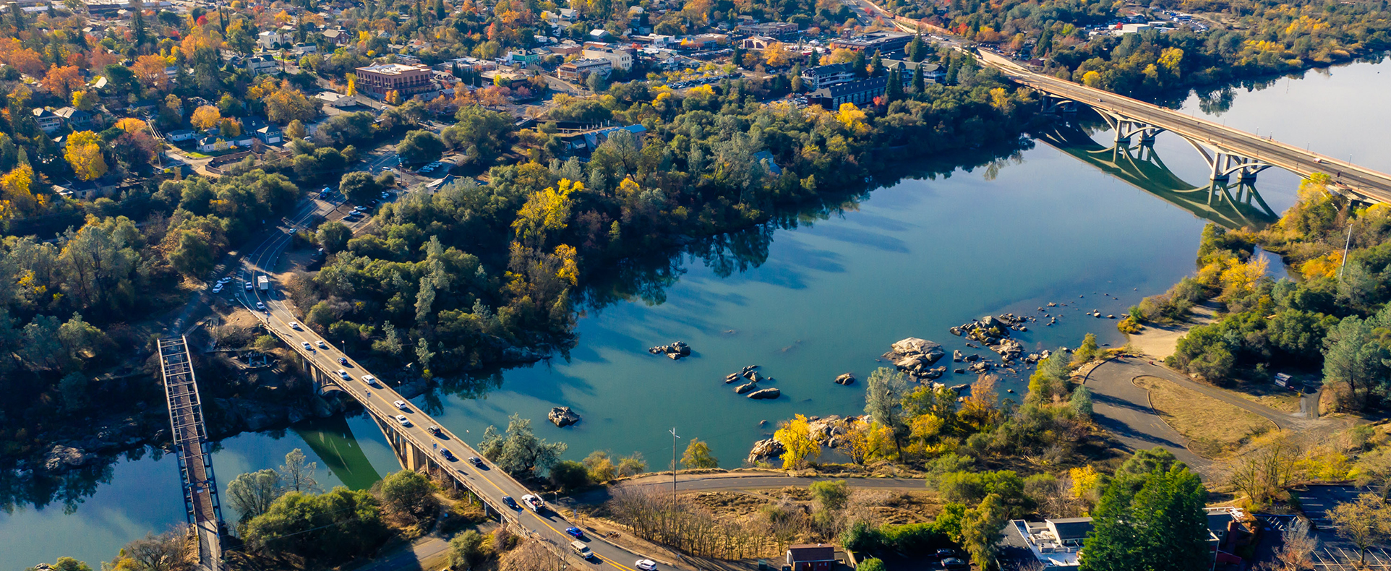
FY 2021-22 Third Quarter Financial Report
Presentation to the Folsom City Council - May 10, 2022

Slide 2
General Fund Summary

Slide 3
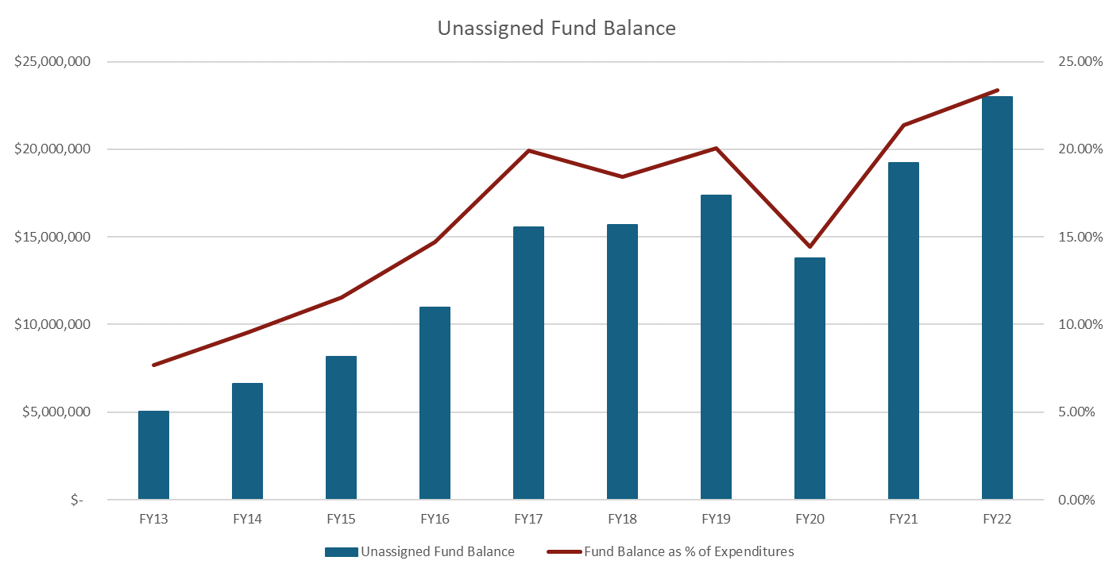
General Fund Summary

Slide 4
Fund Balance Summary

Slide 5
General Fund - Revenues

Slide 6
General Fund - Expenditures

Slide 7
General Fund - Expenditures

Slide 8
Internal Service Fund

Slide 9
Risk Management Fund

Slide 10

Enterprise Funds

Slide 11
Water Enterprise Fund

Slide 12
Wastewater Enterprise Fund

Slide 13
Solid Waste Enterprise Fund

Slide 14
QUESTIONS / COMMENTS

