Slide 1
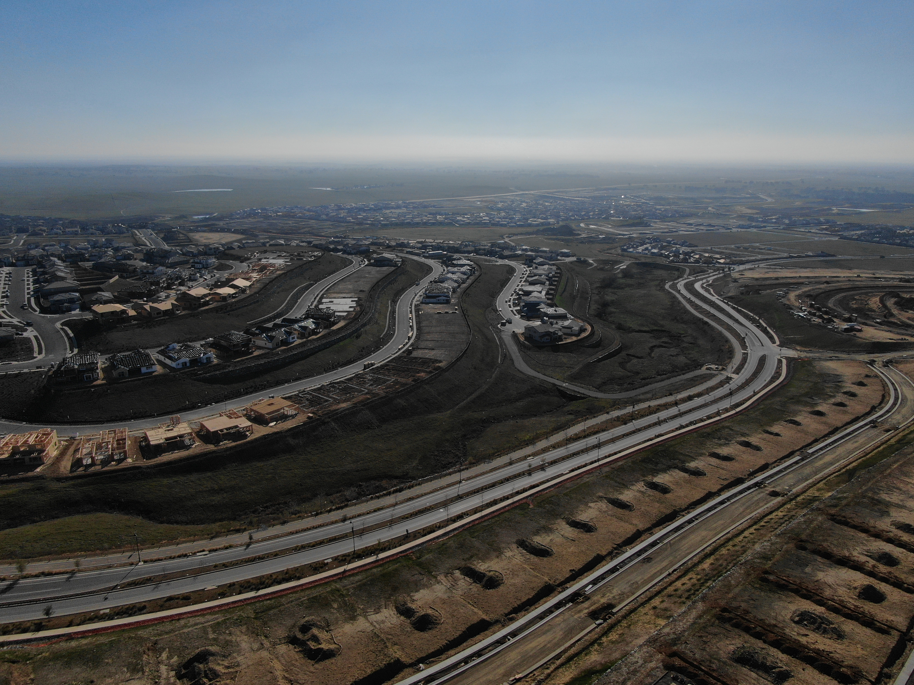
AB 481 Military Equipment Funding, Acquisition and Use
Lt. Brian Lockhart, Folsom Police

Slide 2
What is AB 481?
On September 30, 2021, Governor Newsom signed Assembly Bill 481 to address the funding, acquisition and use of ‘military’ equipment.
This bill is designed to increase transparency, accountability, and oversight for acquisition and use of ‘military’ equipment
City Council must approve funding, use, and acquisition by ordinance, specifically adopting a military equipment use policy and equipment list on an annual basis.
Requires an annual report to summarize usage, complaints, internal audits, cost, etc.
Create public forum for input and engagement prior to adoption

Slide 3
AB 481 Initial Approval and Annual Reporting
Governing body approval requirement for continued use of equipment purchased prior to January 1, 2022
Approval process must begin by May 1, 2022
If not approved FPD must cease usage of ‘military’ equipment within 180 days
Annual Report must be submitted to the governing body.
Annual Report must be publicly available on the website for as long as the equipment is available for use.
Annual Report to Include:
How equipment is being used, maintenance, and cost to use
Internal audits
Community feedback/complaints on use

Slide 4
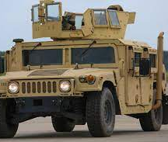
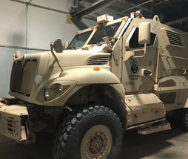
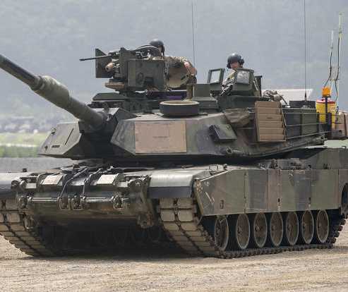
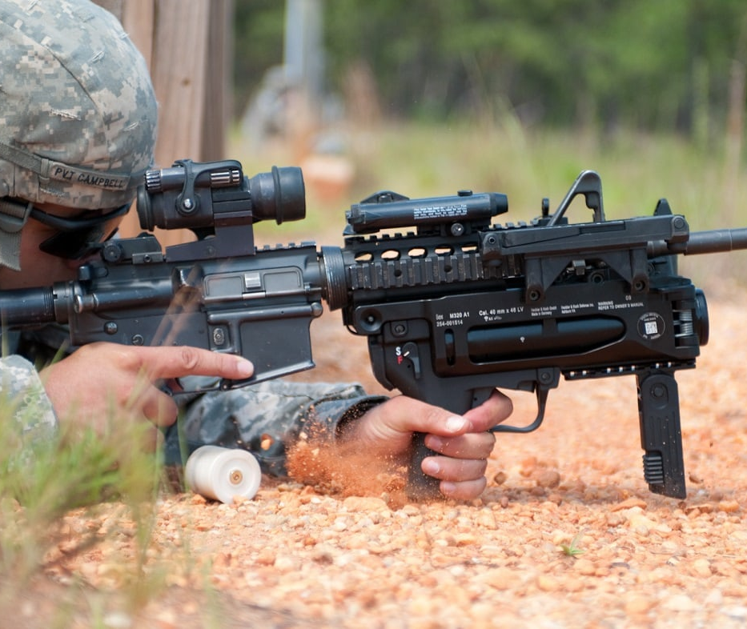
Military Equipment
FPD has no military surplus equipment
FPD is not trying to acquire any surplus military equipment

Slide 5
Military Equipment Categories Per AB 481 FPD currently has items in 8 categories
Equipment Category 1 - Unmanned, remotely piloted, powered aerial or ground vehicles.
Equipment Category 2 - Mine-resistant ambush-protected vehicles or armored personnel carriers.
Equipment Category 3 - High mobility multipurpose wheeled vehicles (HMMWV), two-and-one-half-ton trucks, five-ton trucks, or wheeled vehicles that have a breaching or entry apparatus attached.
Equipment Category 4 - Tracked armored vehicles that provide ballistic protection to their occupants.
Equipment Category 5 - Command and control vehicles that are either built or modified to facilitate the operational control and direction of public safety units.
Equipment Category 6 - Weaponized aircraft, vessels, or vehicles of any kind.
Equipment Category 7 - Battering rams, slugs, and breaching apparatuses that are explosive in nature.
Equipment Category 8 - Firearms and ammunition of .50 caliber or greater, excluding standard-issue shotguns and standard-issue shotgun ammunition.
Equipment Category 9 - Specialized firearms and ammunition of less than .50 caliber, including firearms and accessories identified as assault weapons in Penal Code § 30510 and Penal Code §30515, with the exception of standard-issue handguns.
Equipment Category 10 - Any firearm or firearm accessory that is designed to launch explosive projectiles.
Equipment Category 11 - Noise-flash diversionary devices and explosive breaching tools.
Equipment Category 12 - Munitions containing tear gas or OC, excluding standard, service-issued handheld pepper spray.
Equipment Category 13 - TASER® Shockwave, microwave weapons, water cannons, and long-range acoustic devices.
Equipment Category 14 - Kinetic energy weapons and munitions.
Equipment Category 15 - Any other equipment as determined by a governing body or a state agency to require additional oversight.

Slide 6
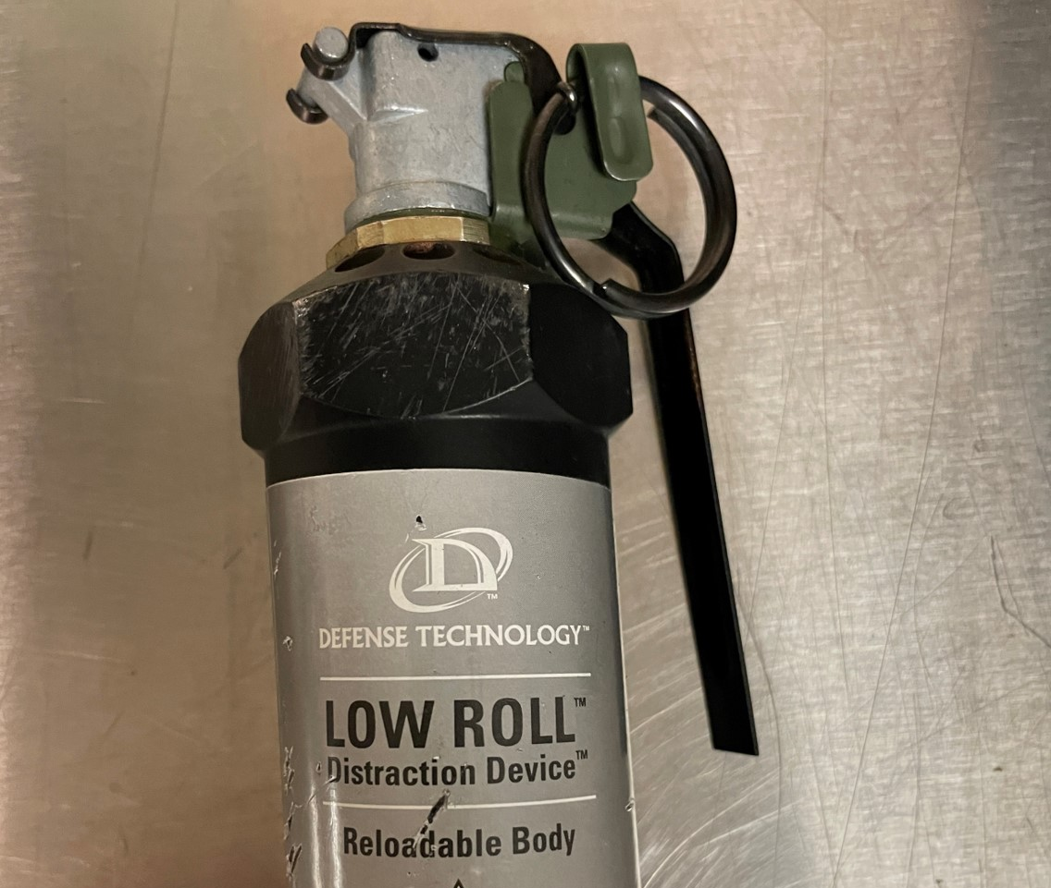
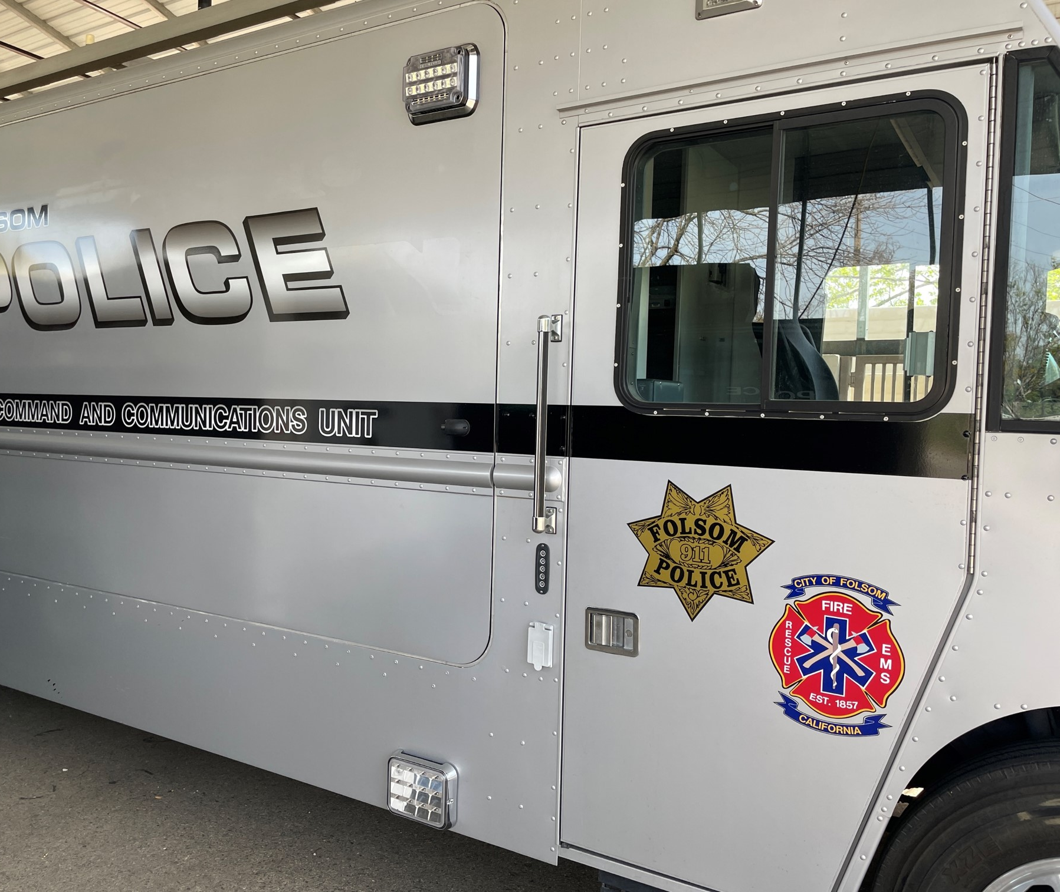
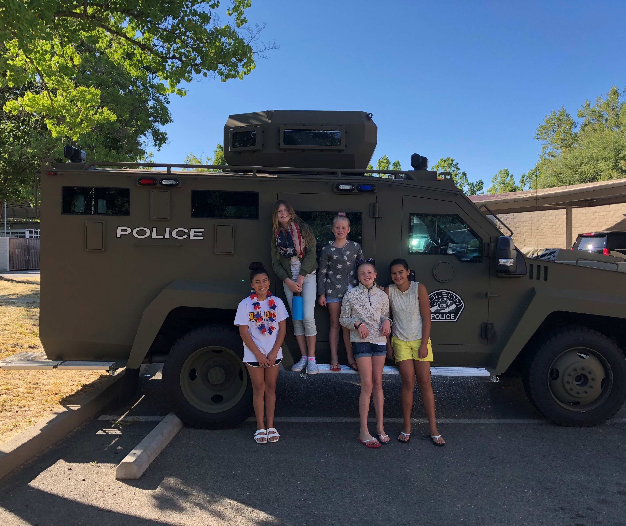
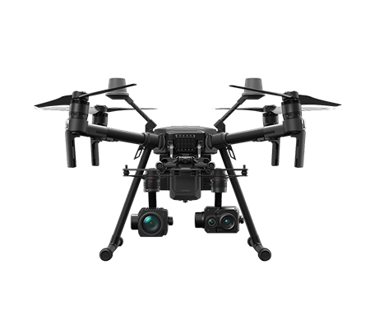
What “Military” Equipment Does FPD have?
Lenco Bearcat G2, Qty 1
Mobile Command Vehicle , Qty 1
Unmanned Aerial Vehicle, Qty 11
Diversionary Devices, Qty 35

Slide 7
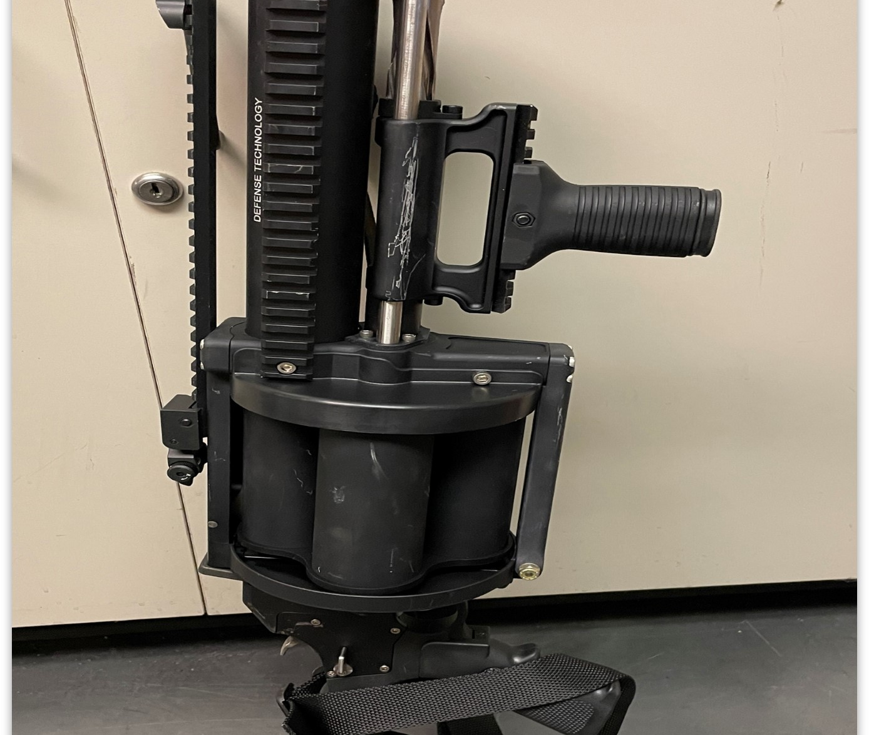
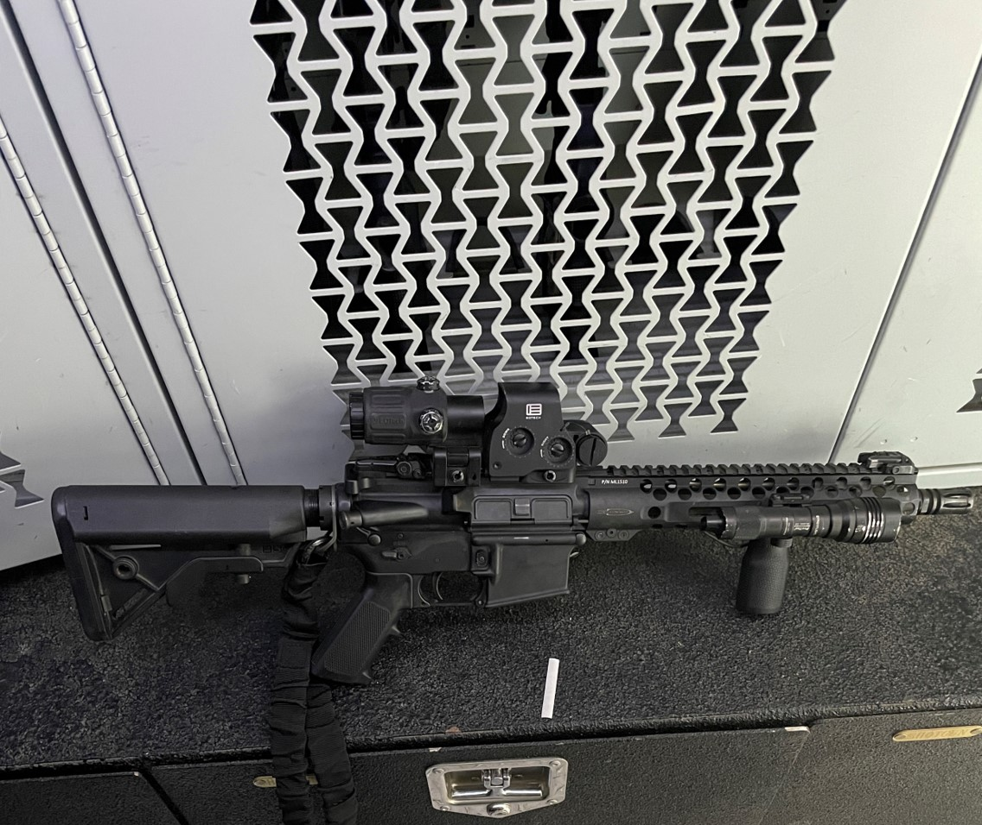
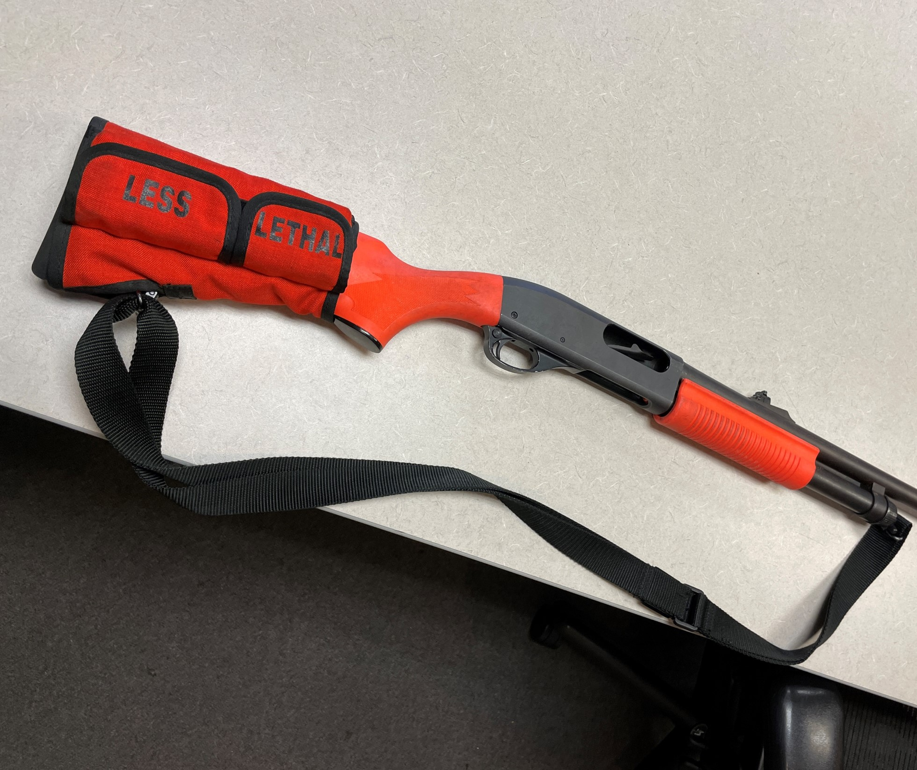
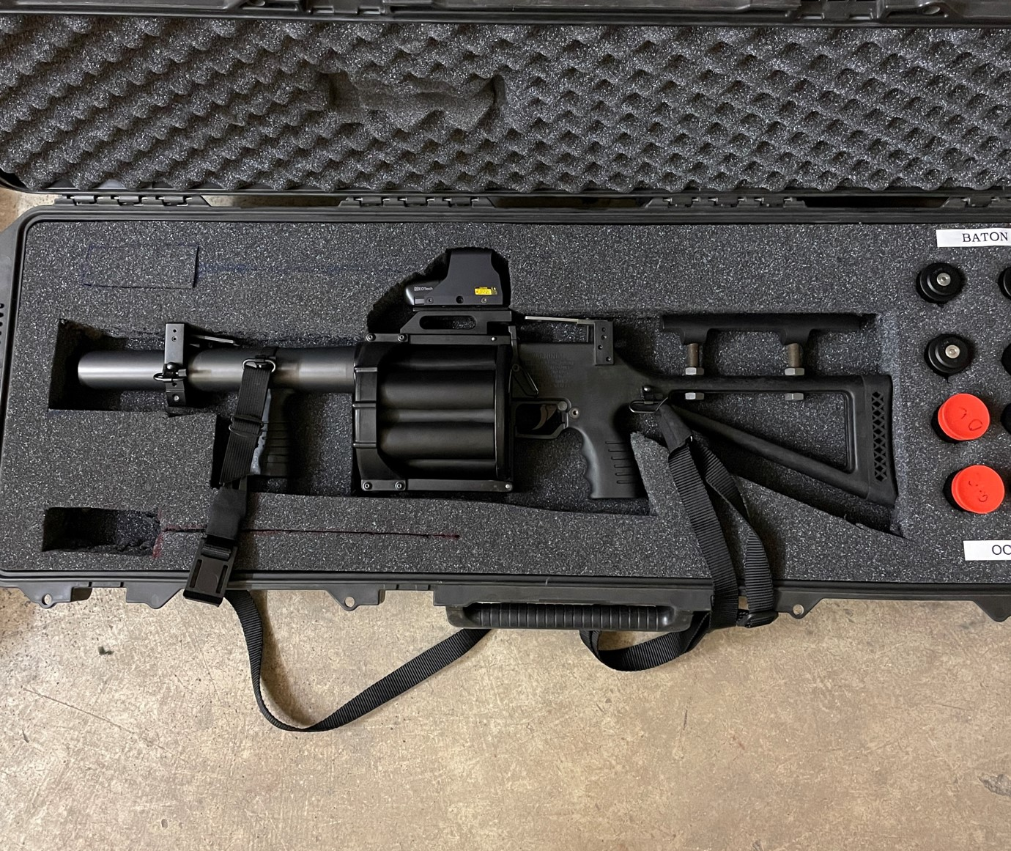
What “Military” Equipment Does FPD have?
Remington 870 Shotgun-Less Lethal, Qty 10
Specialized Firearms, Qty 60
40mm Chemical Agent Launcher, Qty 2
37mm Launcher-Less lethal, Qty 2

Slide 8
Sample Inventory List

Slide 9
“Military Equipment” Use and Needs
What we use it for?
Why we need it?
To safely resolve volatile situations which otherwise might rise to the level of lethal force encounter
Critical Incidents
Planned Events
Preparedness
Equipment is necessary because there is no reasonable alternative that can achieve the same objective of officer and civilian safety
Will Safeguard the Public’s welfare, safety, civil rights, and civil liberties
As many options available to safely resolve any incident

Slide 10
FPD Training
Approximately 80 hours per year (minimum) training on various disciplines
Bound by Policies, Laws, Peace Officer Standards and Training (POST)
FPD Operational Procedures
All officers are trained prior to use of any ‘military’ equipment
Specialized training sometimes necessary.

Slide 11
Approval and future acquisition
The Folsom Police Department seeks City Council adoption
Military Equipment Use Policy – FPD Policy 707
In order to allow FPD to continue to use the vital equipment specified and already in place

Slide 12
Funding
No direct financial impact caused by adoption of the ordinance or approval of the policy.
All equipment is currently owned by FPD
Future acquisition must be approved prior to purchase

Slide 13
Timeline
3/25/2022
3/31/2022
4/26/2022
Publicized on the Website (AB 481 info, inventory list, draft policy)
Community Event at FPD
City Council Meeting (first reading)

Slide 14
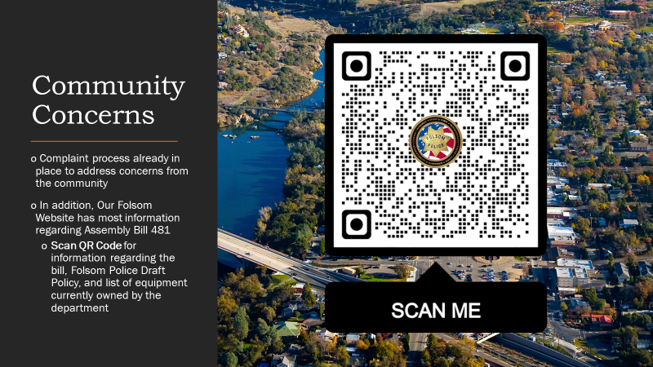

Slide 15
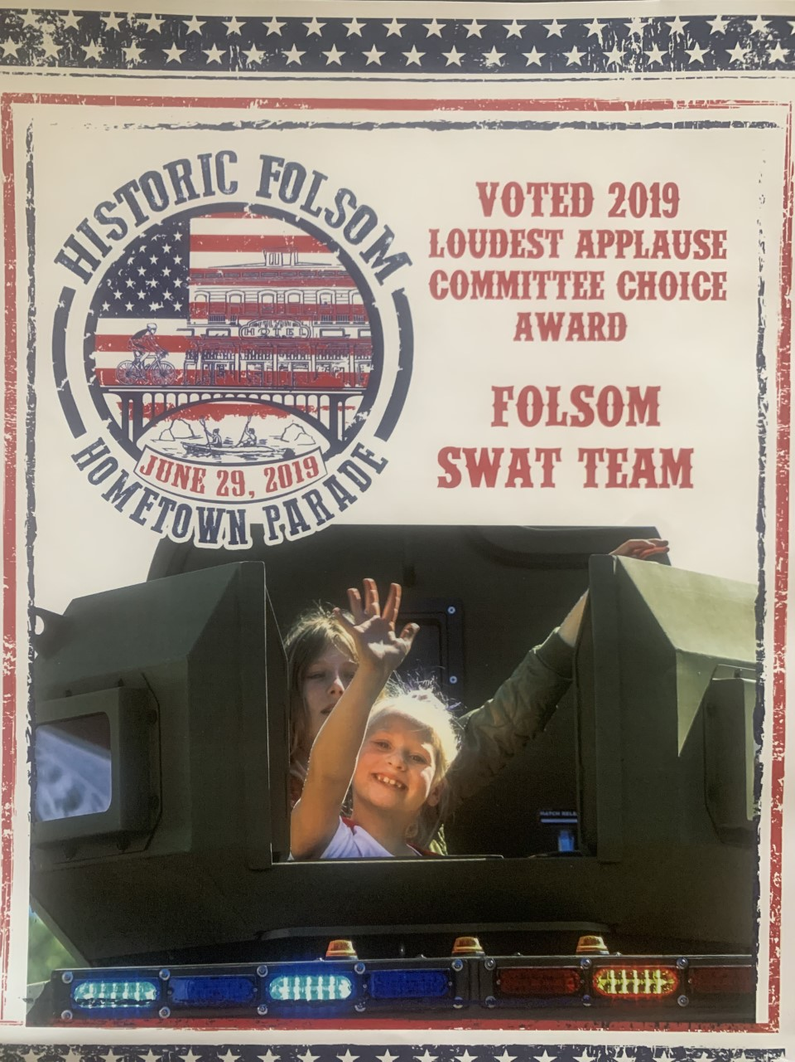
Community Support
2019 ‘Loudest Applause’
at Hometown Parade…..
FPD Bearcat

