Slide 1
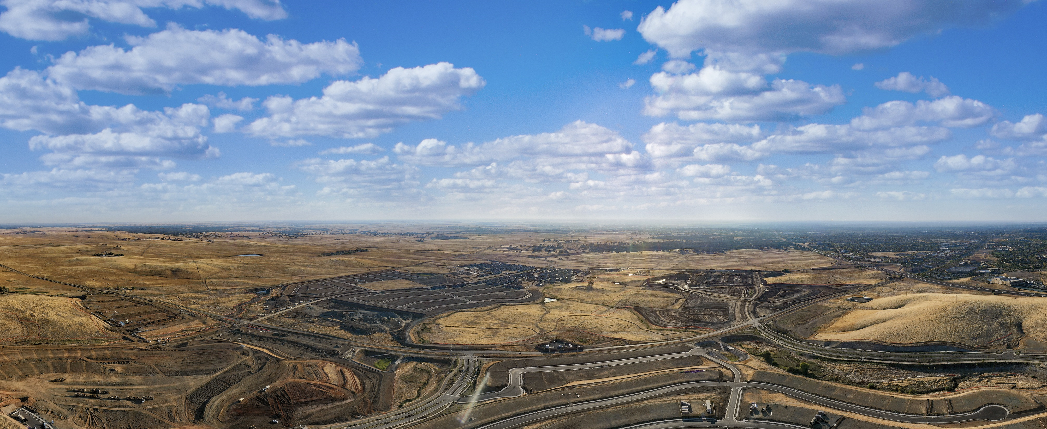
CFD No. 23 (Folsom Ranch)
Amended Improvement Area No. 2
City Council Presentation -March 28, 2023

Slide 2
CFD No. 23 IA No. 2
Facilities Special Tax Amendment
Landowners within the Folsom Plan Area previously requested to form Community Facilities District No. 23 (Folsom Ranch) (CFD No. 23) in 2020.
CFD No. 23 includes seven separate Improvement Areas, designated as Improvement Area (“IA”) No. 1 through IA No. 7.
Landowners have requested to amend the Rate and Method of Apportionment for IA No. 2.

Slide 3
CFD No. 23 IA No. 2
Facilities Special Tax Amendment
Rate and Method of Apportionment for IA No. 2 amended to adjust the maximum facilities special tax rates on certain land use categories.
There are no proposed amendments to the maximum services special tax rates.
Proposed development within IA No. 2 includes:
291 units zoned multi-family low density
5.1 acres of non-residential land use

Slide 4
CFD No. 23 IA No. 2
Facilities Special Tax Amendment
  CFD No. 23 IA No. 2 Amended Facilities Special Tax
  Levied thru 2079-80 at City Council discretion.
  Will be increased annually by 2%.
  Amended maximum facilities special tax ranges from $2,124 to $2,560 for all residential units.
  Property tax as a % of estimated assessed value is 1.80%
  CFD No. 23 IA No. 2 Services Special Tax
  Levied in perpetuity at City Council discretion.
  Increased annually by the annualized change in the Consumer Price Index for all Urban Consumers, for the San Francisco-Oakland-San Jose area, not to exceed 4%.
  Maximum services special tax ranges from $110 to $215 for all residential units.

Slide 5
CFD No. 23 IA No. 2
Facilities Special Tax Amendment
On February 14, 2023, the City Council previously approved Resolution No. 10988, a Resolution of Consideration to Amend the Rate and Method of Apportionment IA No. 2 and Related Matters

Slide 6
CFD No. 23 IA No. 2
Facilities Special Tax Amendment
Recommended City Council Action:
Conduct the Public Hearing
Approve Resolution No. 11010 - A resolution calling for a special mailed-ballot election for IA No. 2
Approve Resolution No. 11011 - A resolution of change for IA No. 2
Introduce and provide the first reading of Ordinance No. 1338 - levying a special tax within IA No. 2

