Slide 1
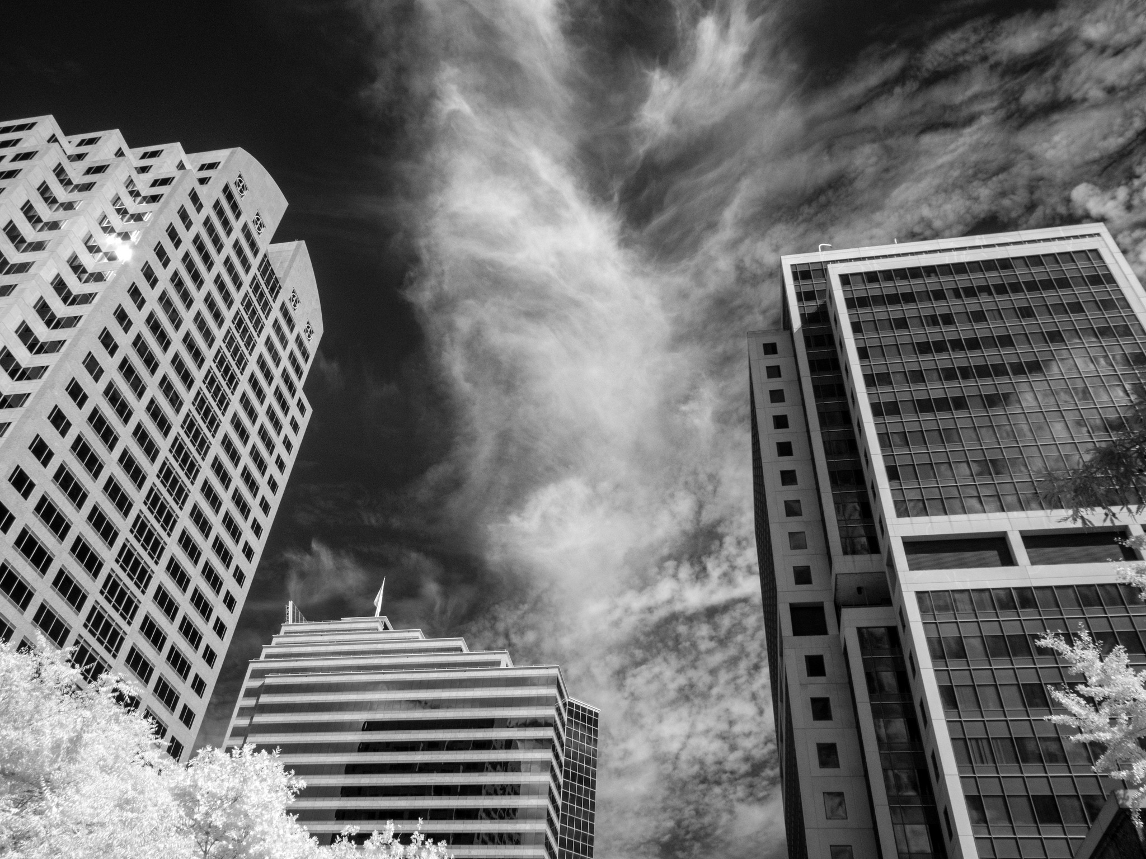
Historic Folsom
Property Business Improvement District Renewal
Folsom City Council
March 28, 2023

Slide 2
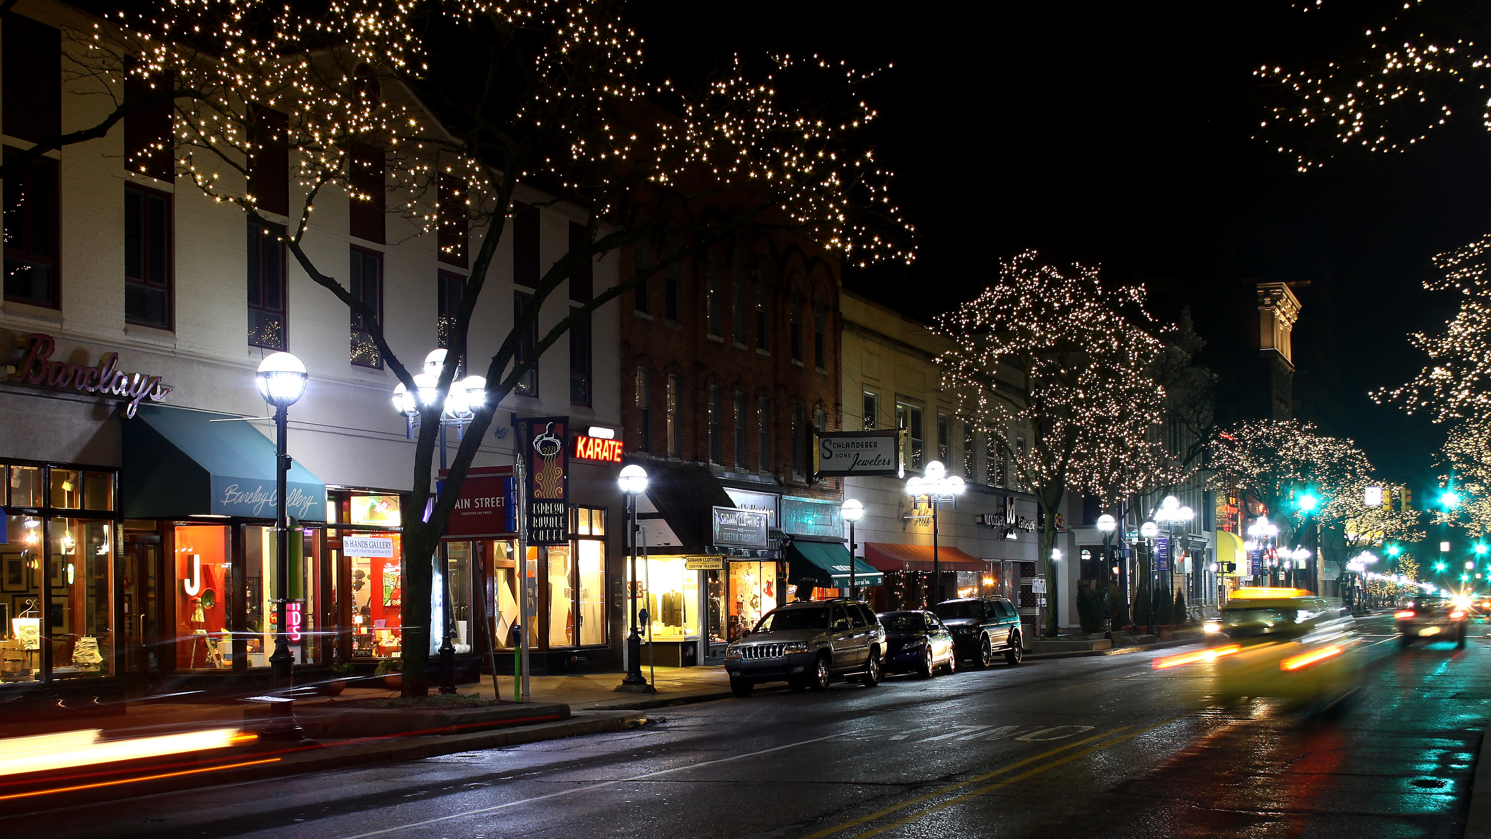
What is a
Property and Business Improvement District?

Slide 3
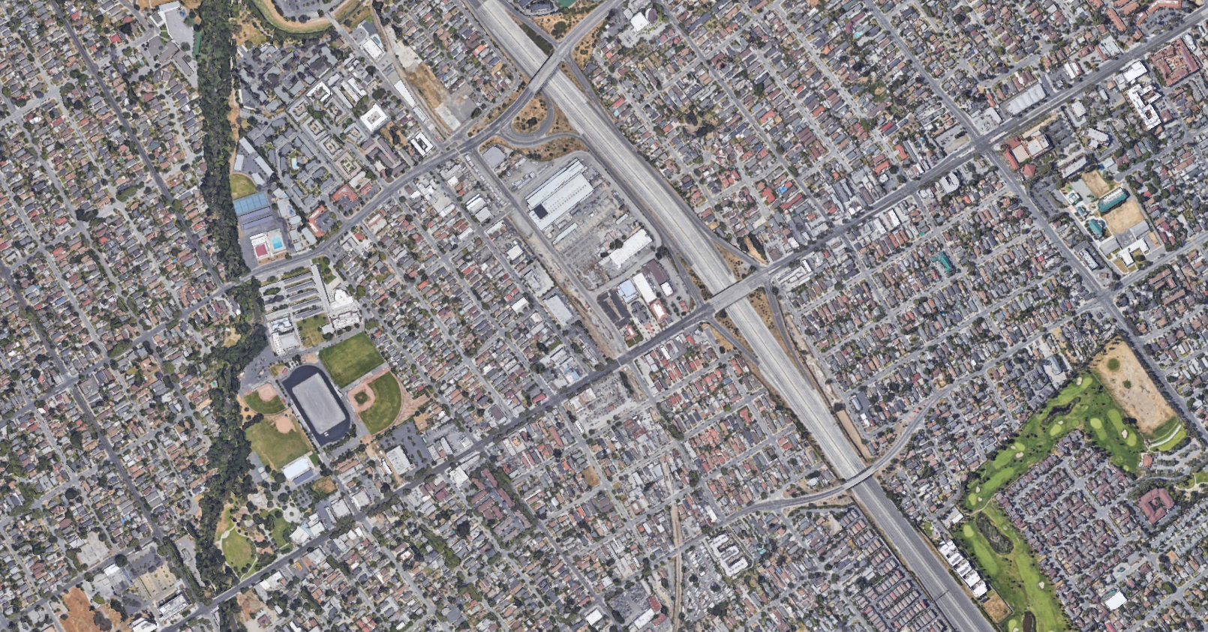
A property and business improvement district (PBID) is a stable funding source for organizations of property owners working to improve their commercial corridor.
Owners within the district work together to make significant improvements, attract consumers, new businesses, and develop the area.

Slide 4
How Does a PBID work?
Collected by the County on the property tax bill…
Property Owner pays an assessment…
And managed by a nonprofit corporation.

Slide 5

Historic Folsom PBID
History & Services
Formed in 2008 for an initial term of 5 years
Renewed in 2013 for 10-year term
Current district will sunset on December 31, 2023
Services:
-Advocacy and Program Coordination
-Image Enhancement and Marketing
-Enhanced Maintenance

Slide 6
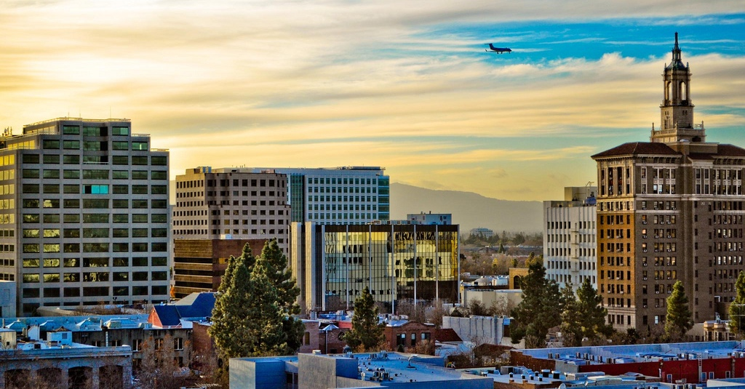
Steps to Renewal
Outreach & Consensus Building!
A crucial step to renewing the PBID is gathering support from property owners within the proposed district
Since June 2022:
Newsletters to property owners
Community meetings
One-on-one stakeholder meetings

Slide 7
Steps to Renewal
Management District Plan
The Management District Plan (MDP) is the back-bone and legal framework for the PBID
District Parameters
District boundaries
Services
Budget
Assessment methodology
Term
Governance

Slide 8
Steps to Renewal
Petition
The law requires petitions must be signed by property owners who will pay more than 50% of the total assessment; petitions are weighted by assessment
The steering committee (AKA Folsom Historic District Association) drives this effort
Once enough petitions are collected, the district can proceed with the hearing and ballot process

Slide 9
Steps to Renewal
Hearings & Balloting
A ballot is sent to all property owners within the proposed district after a Resolution of Intention at City Council
45 days later, the ballots are counted – if there are more YES than NO ballots, weighted by assessment amount, Council may renew the PBID

Slide 10
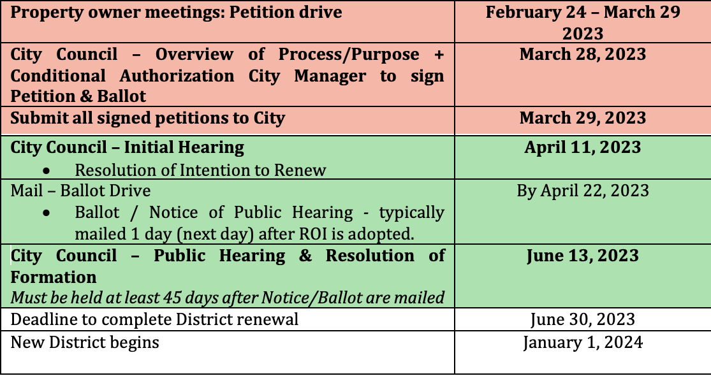
Steps to Renewal
Timeline

Slide 11

Q & A
Emily Brown
ebrown@civitasadvisors.com
916-437-4300

