Slide 1
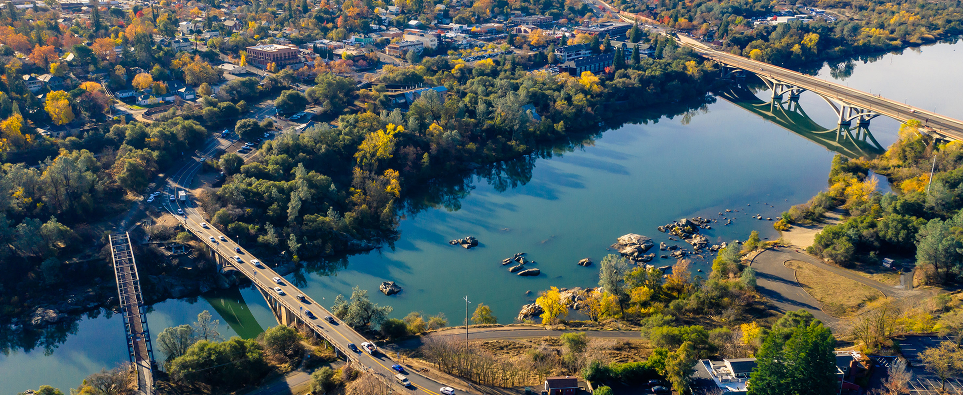
Resolution No. 11015 – A Resolution Adopting the City of Folsom Strategic Plan, FY2023-24 through FY2027-28

Slide 2
Background
Desire by City Manager and City Council to develop a City strategic plan to provide a road map to capture opportunities and address challenges over the next five years.
City Manager worked with the City Council on foundational strategic planning activities throughout the last year, with a commitment to delivering the strategic plan for adoption by the end of the third quarter of FY2022-23.
The strategic planning process included gathering input from City Council Members, the City’s Executive Management Team, residents, other community stakeholders, and businesses.

Slide 3
Outreach Measures
Individual Meetings with Each Council Member
Special Workshop with City Department Heads
Business Survey (125+ respondents)
“Folsom Listens” Community Survey (12,750 total comments and 4,858 surveys received)
  28,926 City mailers
  43,070 City e-messages
  785,453 City-sponsored digital ad impressions
  45,000 reached with social media campaign
  Mailed newsletter and e-newsletter articles distributed citywide
  Feature column in the Folsom Telegraph
  Informational website and frequently asked questions (FAQs)
Public Opinion Research (775+ responses in community satisfaction survey)
Three Special City Council Meetings

Slide 4
Opportunities
Abundant historic and recreational amenities
Strong interest in the River District and Central Business District
Strong interest in creating a Folsom Plan Area town center
Prominent healthcare and high-tech industries
Capacity for revenue enhancement
Strong community sense of volunteerism
Greater efficiency through use of new technologies
Grow public-private partnerships

Slide 5
Challenges
Lack of financial capacity to provide existing and future needed services and infrastructure
Outdated technology
Need for greater planning for future needs
Employee retirements and turnover
Lack of affordable housing
Growing population with new needs
Inability to maintain current service levels

Slide 6
Major Factors Influencing Folsom’s Future
Financial capacity
Effects of the pandemic
Tight labor market
Rising housing costs
Folsom Plan Area
Threat of wildfires
Unfunded State mandates

Slide 7
Vision
The City of Folsom serves as a role model and regional leader that blends its rich historical roots
and diverse cultural, recreational, and business resources into a great community.

Slide 8
Mission
The City of Folsom provides a safe, healthy, and vibrant community through innovative, responsive,
and effective delivery of public services to maintain and enhance the quality of life of our residents.

Slide 9
Values
Integrity: Demonstrating honesty and strong ethical principles in all actions and decisions.
Professionalism: Delivering high-quality services based on the skills and competence of trained
employees, and best industry practices.
Financial stability: Planning for the long term and making decisions in the short term to ensure
the necessary resources are available to deliver City services and achieve goals established by
the Council.

Slide 10
Goals
Goal A: Financial Stability and Sustainability:
Support fiscal health through long-term planning, cost control, heightened efficiency, increased revenue, and cost recovery.
Goal B: Public Safety and Infrastructure:
Enhance provision of public safety resources, invest in technological solutions, and maintain, repair, and improve public facilities and infrastructure.
Goal C: Economic and Community Development:
Promote effective use of existing amenities and resources to create future opportunities that enrich the community.
Goal D: Organization Effectiveness:
Build strong connections and support for the community and employees through a commitment to local government best practices and employee development, support, and retention to meet community needs.

Slide 11
City Council Priorities
(First Two Years)
Identify a funding plan to expand police department facilities to meet department needs. (Goal B, Strategy 3)
Identify funding to increase police department staffing to meet community needs. (Goal B, Strategy 4)
Initiate technology solutions to streamline organization and improve efficiency. (Goal B, Strategy 9)
Complete the River District Master Plan to enhance the City’s waterfront and waterfront-adjacent recreation and development opportunities. (Goal C, Strategy 1)
Develop funding/sponsorship plan for the Johnny Cash Trail (JCT) art trail to increase tourism focused on Lake Natoma. (Goal C, Strategy 5)

Slide 12
Next Steps
Implementation Action Plan:
An Implementation Action Plan, contained in a separate document, provides further information. This includes the starting year, lead person and key tasks for each strategy. Timelines may be adjusted based on changing priorities, budget and personnel availability.
Tracking and Reporting Progress:
Progress reports will be provided to the City Council on a regular basis.
Our Road Map:
The Strategic Plan will guide financial, operational, and policy decisions starting from adoption through FY2027-28, with oversight by the City Manager in partnership and cooperation with the City Council and staff.
Updates/Changes:
Each fiscal year, the City Manager will bring the Strategic Plan to the City Council for review, updates, and changes as needed.

Slide 13
Staff Recommendation
Staff respectfully requests that the City Council approve Resolution No. 11015 – A Resolution Adopting the City of Folsom Strategic Plan, FY2023-24 through FY2027-28

