Slide 1
2023 Specific Plan Infrastructure Fee (SPIF) Adjustment
Presentation to the Folsom City Council – August 22, 2023

Slide 2
Folsom Plan Area Specific Plan Infrastructure Fee
The Folsom Plan Area Specific Plan Infrastructure Fee (SPIF) program is the mechanism to equalize the costs of the Infrastructure, Public Lands and Community Parkland in the Folsom Plan Area (FPA).
The program includes public infrastructure improvements such as roadways, sewer facilities, potable water facilities, recycled water facilities, storm drainage facilities, and habitat mitigation and other costs in the FPA as provided in the PFFP.

Slide 3
Background
On September 8, 2015, the City Council established the Folsom Plan Area Specific Plan Infrastructure Fee (SPIF).
On January 9, 2018, the Nexus Study Fiscal Year 2017-2018 update was approved and set the updated amount of the SPIF fees.
On June 11, 2019, the City Council adopted Ordinance No. 1293 which changed the Off-Site Roadway Improvement fee to a Set-Aside Fee to be collected at building permit issuance rather than prior to final map approval.
On July 28, 2020, the City Council approved the Nexus Study Fiscal Year 2020-21 Update, setting the updated amount of the SPIF Fees and introduced Ordinance No. 1307 pertaining to the Set-Aside Component of the Folsom Plan Area Specific Plan Infrastructure Fees. On August 25, 2020, the City Council adopted Ordinance No. 1307.
In addition to these adjustments, there have been periodic Construction Cost Index (CCI) updates. The most recent update was July 1, 2023.

Slide 4
2023 Fee Adjustment
This 2023 SPIF Fee Adjustment was done at the request of the SPIF Administrator, the City, and the landowners to update the construction cost estimates used to calculate the SPIF Infrastructure Fees.
This 2023 SPIF Adjustment alters the fee amounts based on updated construction costs and the amount of development remaining in the FPA.
The updated cost estimates are in addition to the Construction Cost Index (CCI) update that occurred on July 1, 2023, and will ensure the fees are reflective of the cost of SPIF backbone infrastructure construction.
The Adjusted Folsom Plan Area SPIF Fees, if approved, will become effective October 23, 2023.

Slide 5
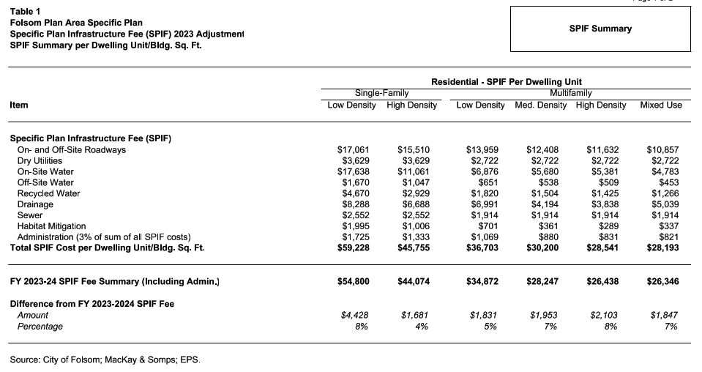
2023 Fee Adjustment
The SPIF Fee increased between approximately $1,830 to $4,430 per unit for residential uses

Slide 6
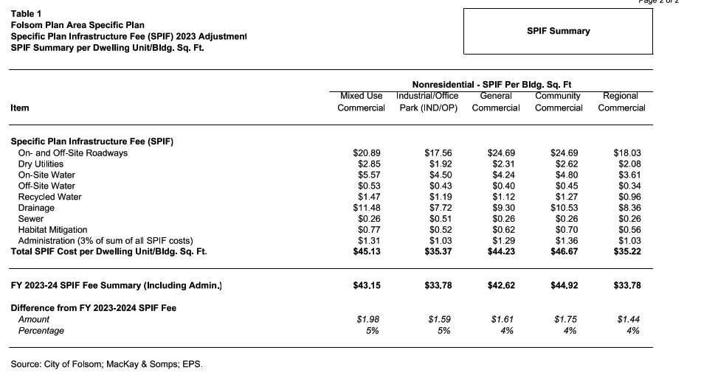
2023 Fee Adjustment
The SPIF Fee increased between $1.44 and $1.98 per building square foot for nonresidential uses

Slide 7
Staff Recommendation
Staff recommends the City Council conduct the public hearing and then adopt Resolution No. 11096 – A Resolution Adopting the August 2023 Adjustment for the Folsom Plan Area Specific Plan Infrastructure Fees (SPIF) and Setting the Updated Amount of the SPIF Fees.

