Slide 1
Notes:
Hello Mayor Rodriquez and Councilmembers
I am Justin Raithel, Chair of the Community Service Day Steering Committee and am excited to be here tonight.
Add additional thoughts you may have

Slide 2
Committee Members
Mayor Rosario Rodriguez, Folsom City Council Chair Justin Raithel, Symmetry for Health Tom Hellmann, City of Folsom Derik Perez, City of Folsom Jen Thiot, City of Folsom
Liz Vaage, City of Folsom
Gina Silvernale, City of Folsom
Lesley Miller, City of Folsom
Ted Ocampo, City of Folsom
Brett Bollinger, City of Folsom Anna Ballard, Intel
Lisa Hausman, Dignity Health Alisha Wilson, Lakeside Church
Christina Hunt, Lakeside Church
Mark Bahouth, Church of Jesus Christ LDS
Joe Cortes, Twin Lakes Food Bank
Stephen Costello, Century 21
Shara Dzerigian, Century 21
Angela Griffin-Ankhelyi, Folsom Cordova Unified School District
Sally Buchanan, Choose Folsom Brit Kelleher, Safe Credit Union Anthony Retodo, M.D., Kaiser Permanente Buena Tan, Kaiser Permanente
Breanna Stambuk, Folsom Prison Darnell Dumas, Habitat for Humanity of Greater Sacramento
Bill Sullivan, Folsom Times Adam Frick, Folsom Times Brian Wallace, Parks & Recreation Commissioner Sandy Econome, Community Member
Notes:
These individuals have stepped forward and up to prepare, plan and organize this event. All of them have contributed greatly to this event and it could not be done with everyone contributing.
*I would like to acknowledge and thank the City of Folsom for the city staff members that have been involved and leading to ensure event success
Add additional comments

Slide 3
Saturday, September 16
Lakeside Church
Kick-off Celebration to begin at 8:00am
2,000+ Volunteers
93% of volunteer spots filled
Folsom’s Largest Day of Volunteerism
Notes:
This slide highlights when and where CSD is Approximate number of total volunteers that are contributing with projects, day of event logistics, and planning
This is Folsom’s largest one day event of volunteerism in the City

Slide 4
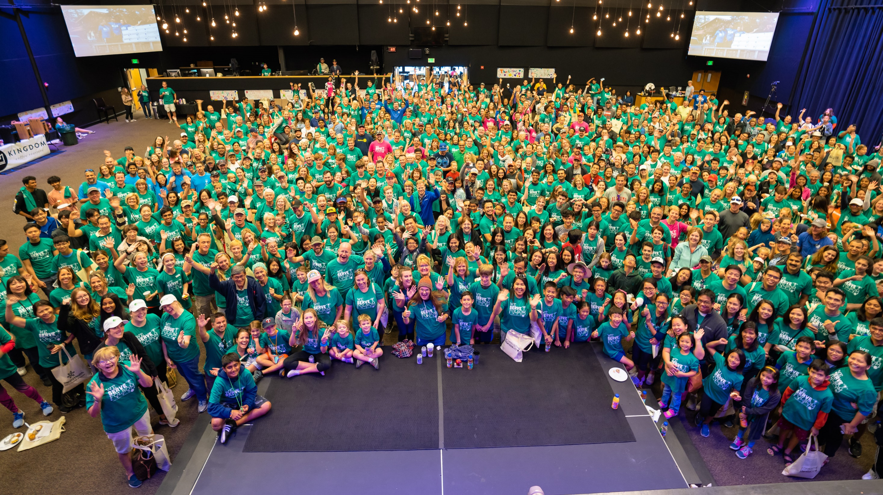
Notes:
Before the pandemic we hosted the opening celebration inside of Lakeside Church. This year, we will be back inside Lakeside Church to kick off the morning, gather, celebrate, and prepare for the 10th annual Folsom Community Service Day!

Slide 5
Presenting Sponsors - $15,000
Notes:
Thank you to our Presenting Sponsors who have contributing $15,000 each. Intel has been a Presenting sponsor for all 10 years and is such a critical partner to the success of this event.
Dignity Health is back as a Presenting Sponsor, and we appreciate their commitment to the community. Thank you to Anna Ballard with Intel and Lisa Hausmann with Dignity Health for ensuring community success with their contributions.

Slide 6
Visionary Sponsors - $10,000

Slide 7
Leader Sponsors - $5,000

Slide 8
Partner Sponsors - $3,000

Slide 9
Good Neighbor Sponsors - $1,500

Slide 10
Sponsors
$114,000+
Cash and In-Kind Sponsorships
Notes:
This year the Folsom Community Service Day sponsors and partners will provide over $112,000 in cash and in-kind dollars to make the 10th annual event successful
This accounts for organizations that have contributed time and people power along with organizations that assist with marketing.

Slide 11
35 Projects
Trail Clean-up:
Folsom Rail Trail
Hancock Drive Trail
Trail Stenciling
Wayfinding
Folsom Police Department
Fence Repairs for Mounted Patrol
PSVRR
Railroad Superintendent House Clean-up and Rail Fest Prep
Waterway’s Clean-up:
Willow Spring Reservoir
Black Miners Bar
Powerhouse Ministries
Market Street Refresh
Folsom Library Shelf Cleaning
Snowline Hospice Cleaning & Support
Mulching at FCUSD School Sites:
Mangini Ranch Elementary
Sutter Middle School
Theodore Judah Elementary
Mulching Beautification Projects:
Murer House
Journey Church
Tree Management in the Parkway
Military Care Packages & Girls Love Mail
Improvements at City Parks/Facilities:
Lembi Park
Natoma Station Pond
Ernie Sheldon Youth Sports Park
BT Collins Disc Golf
Young Wo Cemetery
Notes:
These are a highlight of some of the projects. You can share details about a couple or highlight 1 to share.

Slide 12
Neighbors Helping Seniors Projects
73 Projects Identified
Providing help to our senior residents
Notes:
You can talk about this as you know it best ☺

Slide 13
Citywide Food Drive
If every Folsom household donates ONE bag of groceries, we can feed Folsom’s hungry for ONE year.
30,000 Donation Bags Delivered

Slide 14
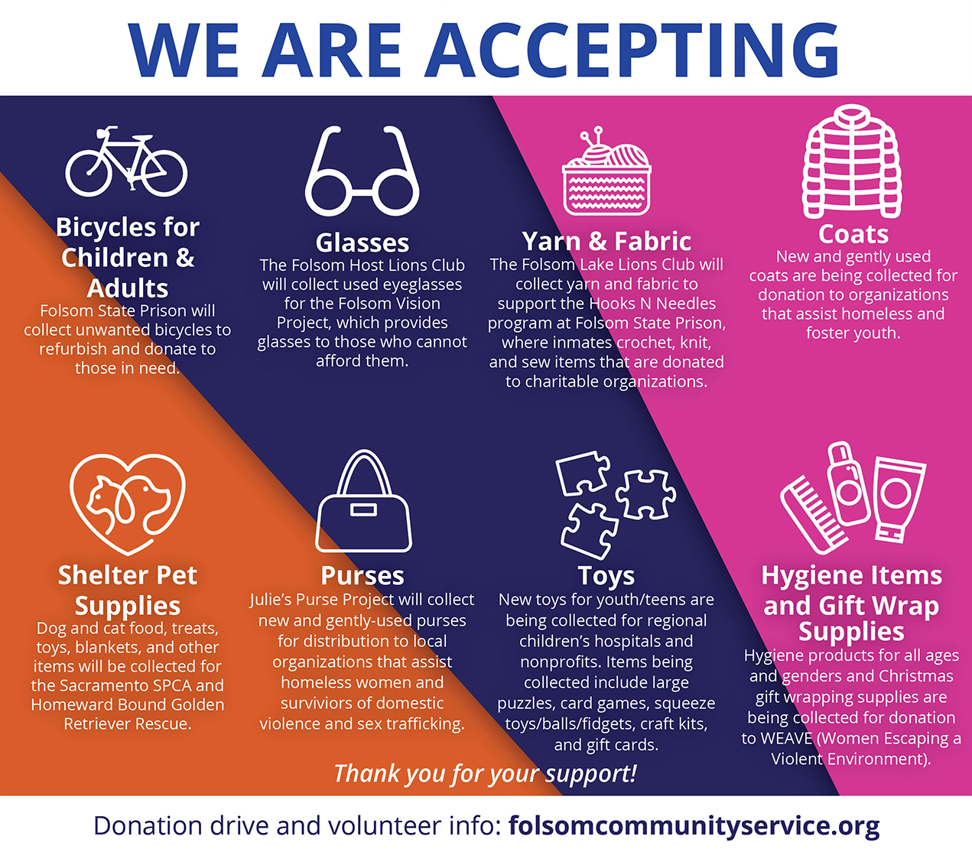
D
O
N
A
T
I
O
N
D
R
I
V
E
Notes:
I will have a new graphic to insert here next week that is under development.
You can share what we are collecting on September 16.

Slide 15
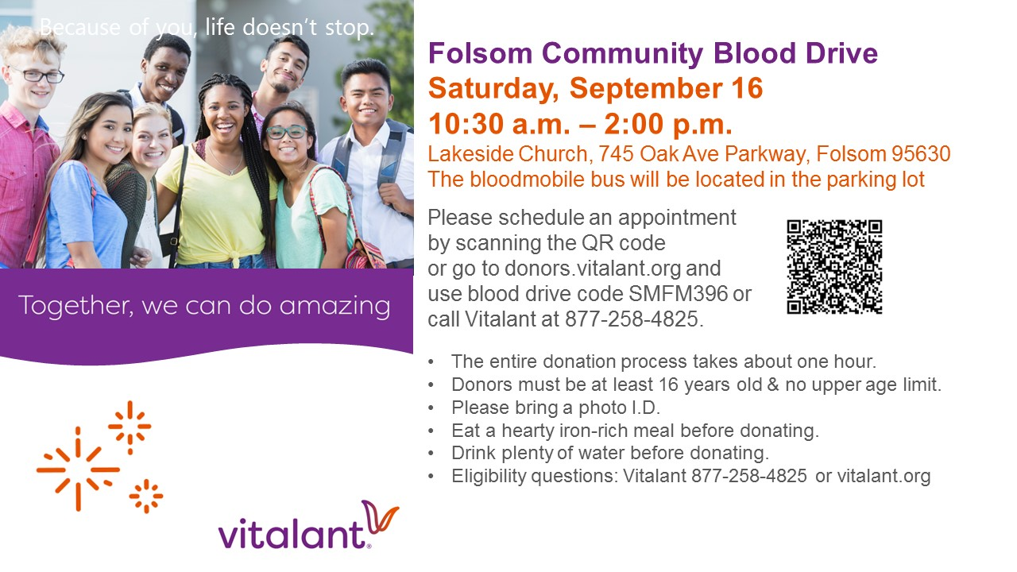
Notes:
Click the QR code to schedule an appointment to donate blood on September 16.
All donors must be 16 years and older.
Thank you to Vitalant for partnering with us and providing this opportunity to give blood and help save a life.

Slide 16
Notes:
Celebrating 10 years of #WE SERVE FOLSOM
* You can elaborate on the decade of service and how CSD has helped make Folsom great!

Slide 17
Saturday, September 16
www.folsomcommunityservice.org
Notes:
You all (City Councilmembers) have received an invitation to attend on Saturday, September 16 with arrival by 7:30am. I look forward to kicking off the 10th Annual event with you all and thank you for your support.
*Add anything more you wish

