Slide 2
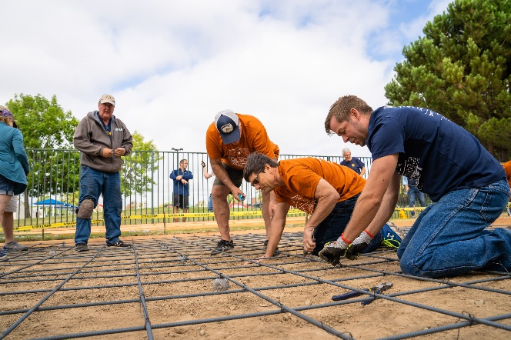
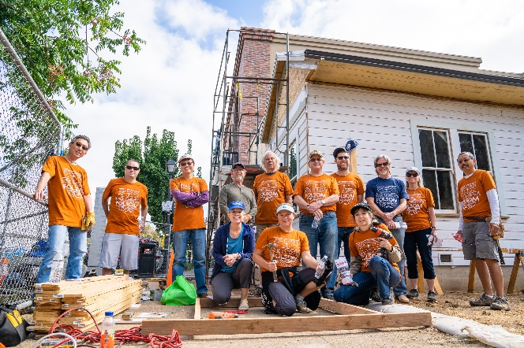
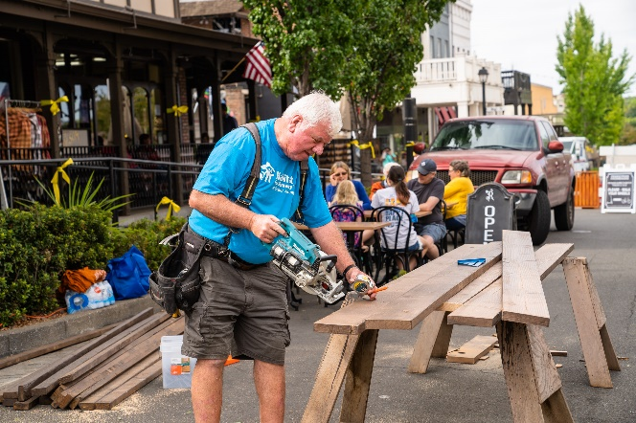
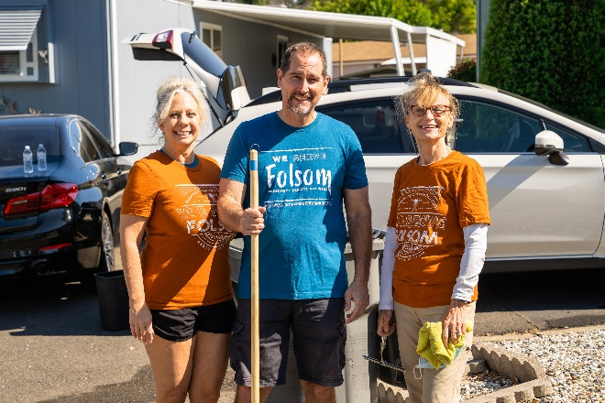
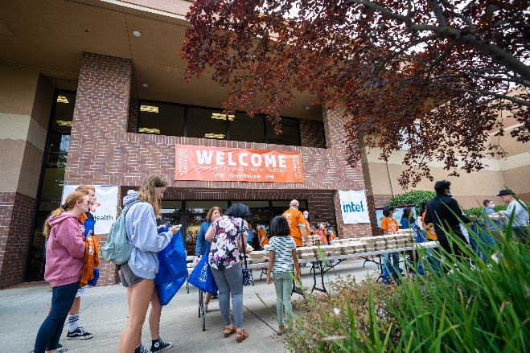
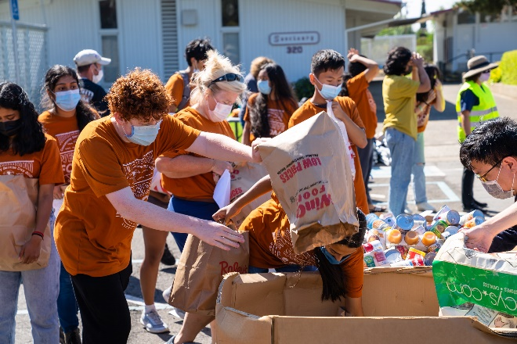
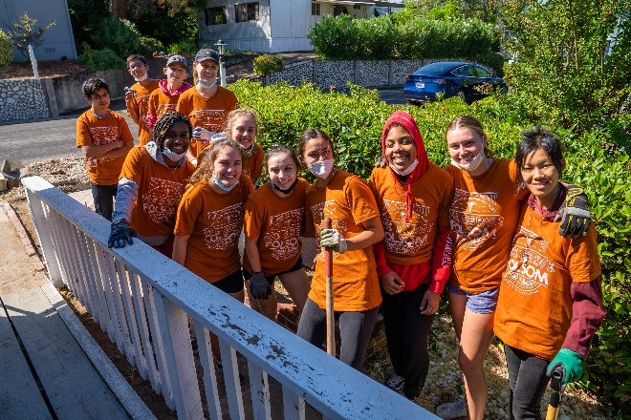
2,500 Volunteers
100 Projects Citywide

Slide 3
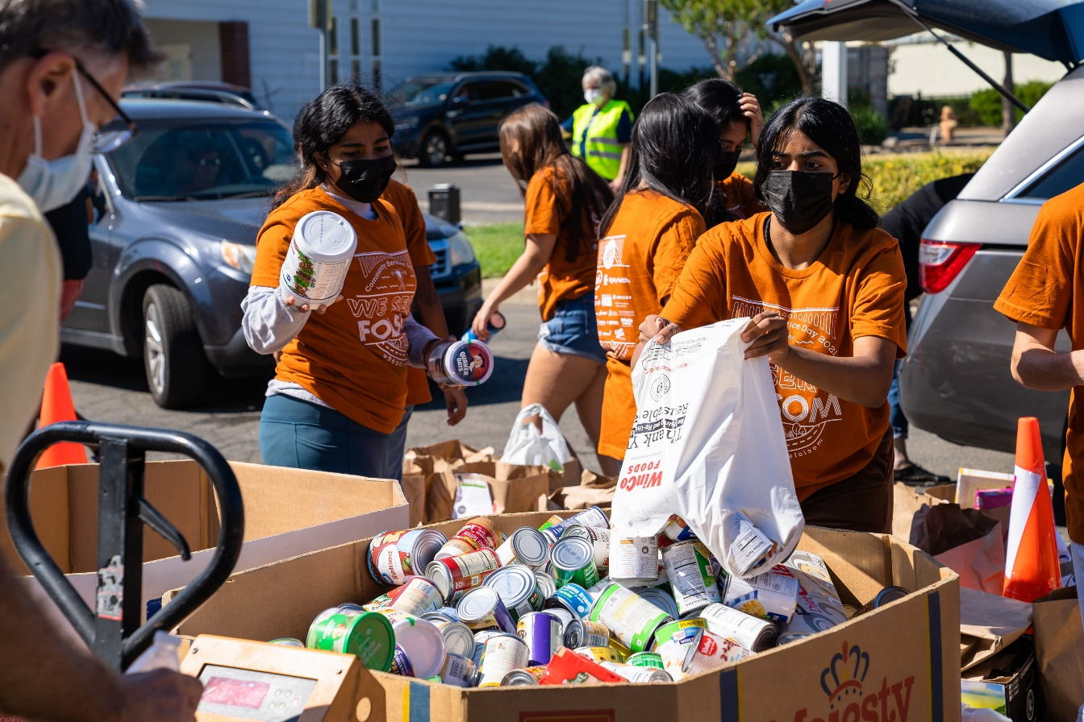
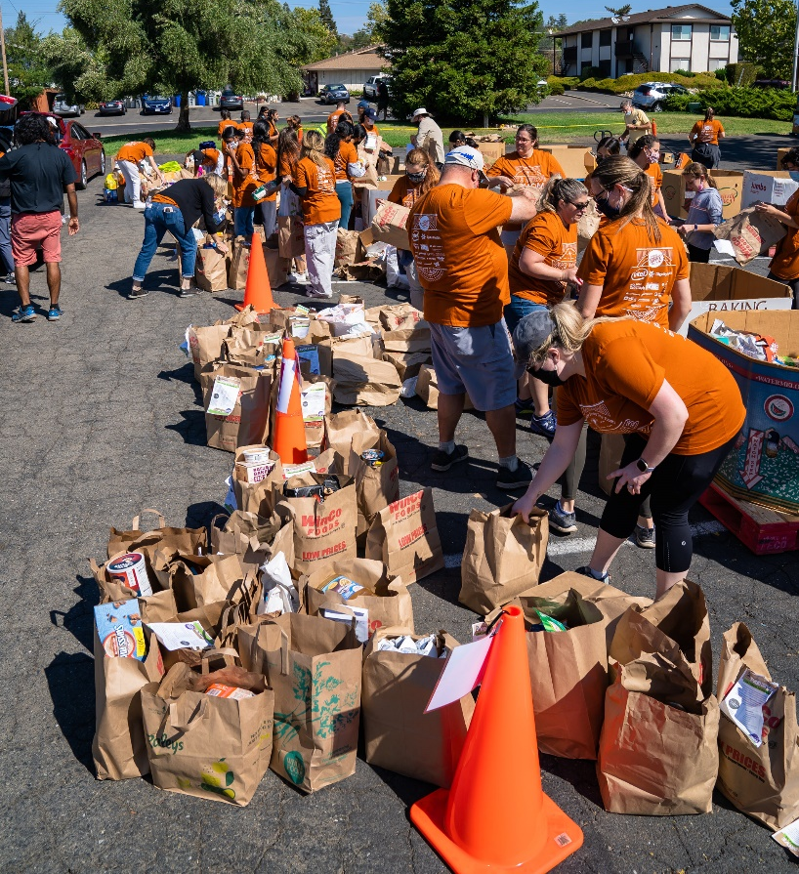
Community Food Drive
80,000 Pounds of Food

Slide 4
Donation Drive
67 Bikes
138 Purses
141 Letters for the Military
10 Boxes of LEGOs
15 Large Bags of Yarn and 12 Bags of Fabric
4 Large Boxes of Toys and Gifts

Slide 5
BLOOD DRIVE
33 Pints of Blood

Slide 6
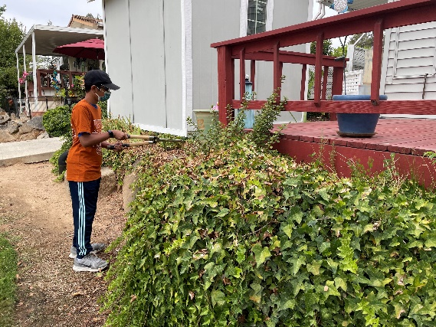
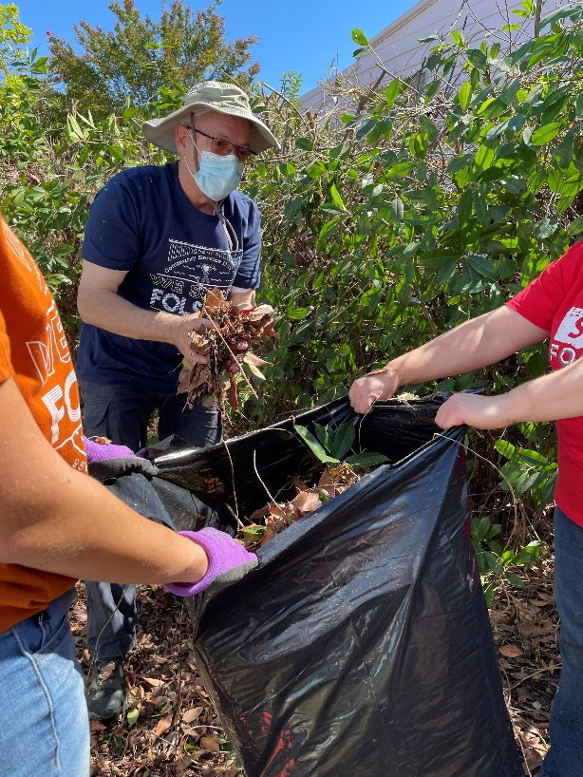
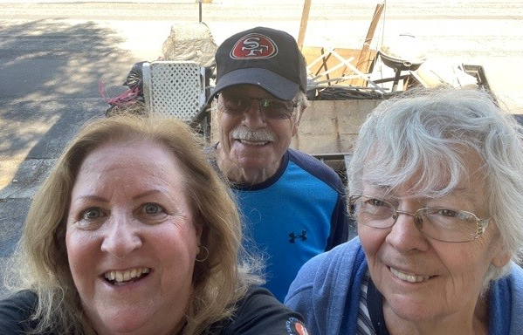
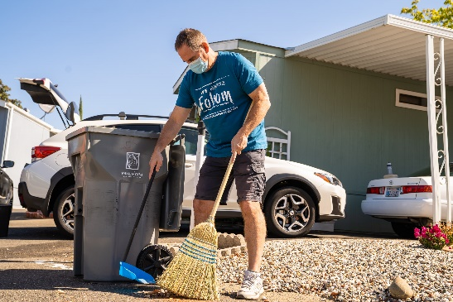
Neighbors Helping Seniors
54 Projects

Slide 7
Presenting Sponsors

Slide 8
Sponsors
Platinum
Gold
Silver
Bronze

