Slide 1
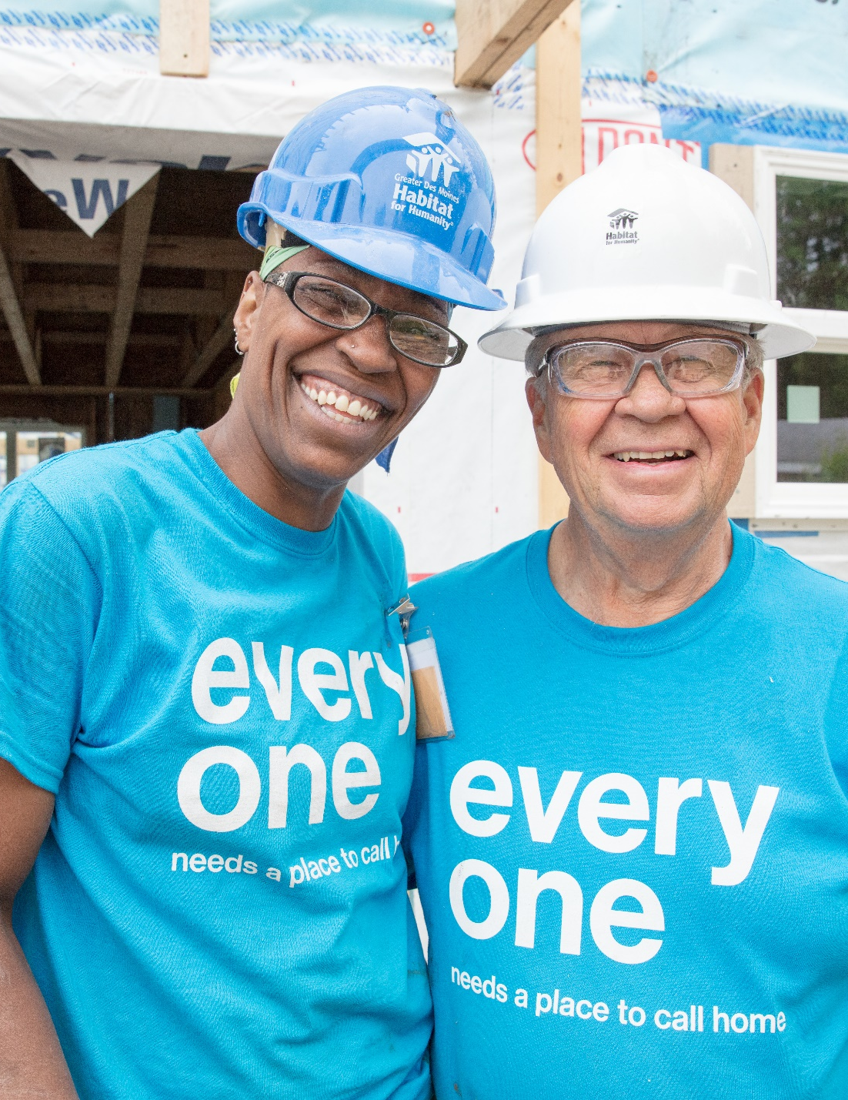
Proposed Developer Partnership
300 Persifer Street
Folsom, CA

Slide 2
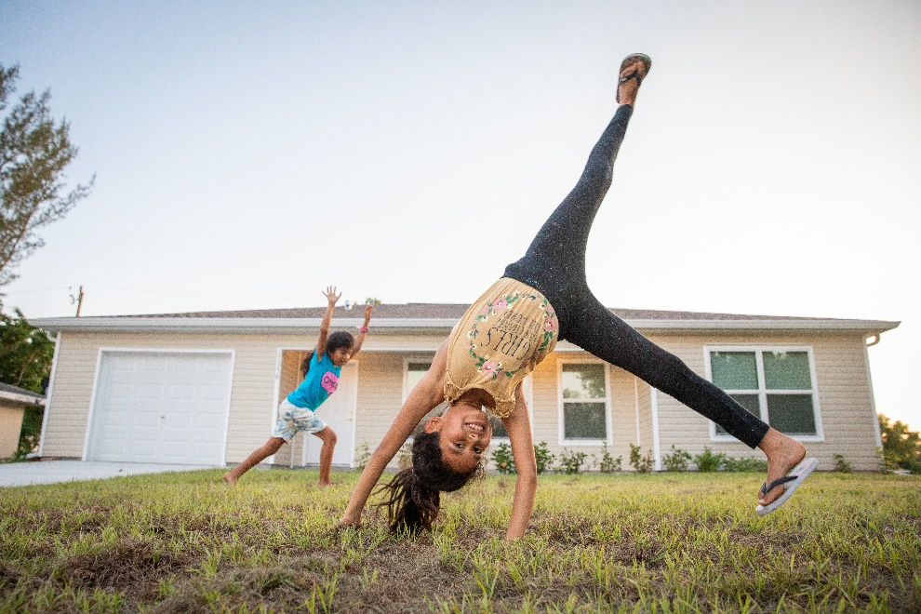
Who We Are
Community based non-profit organization dedicated to building and repairing hope, homes and community.
Serving Sacramento and Yolo Counties for 36 Years

Slide 3
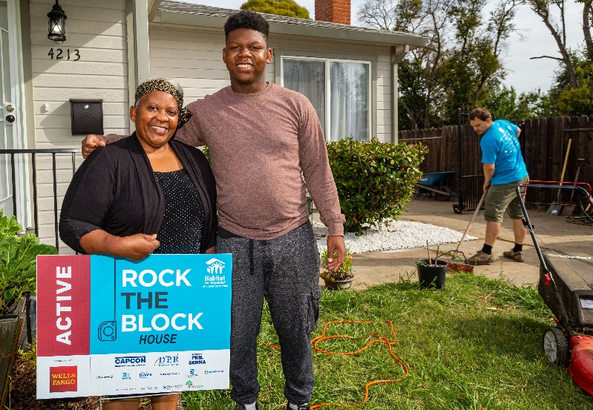
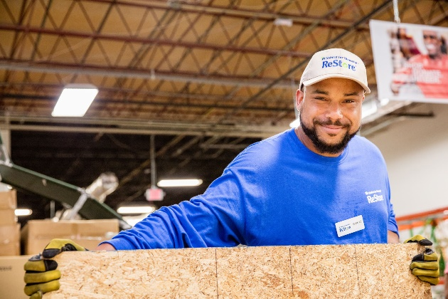
What We Do
Community Based Programs Include:
Affordable Homeownership – through new builds and rehabs
Neighborhood Revitalization – through home repairs and Community Projects
ReStore Retail Outlet

Slide 4
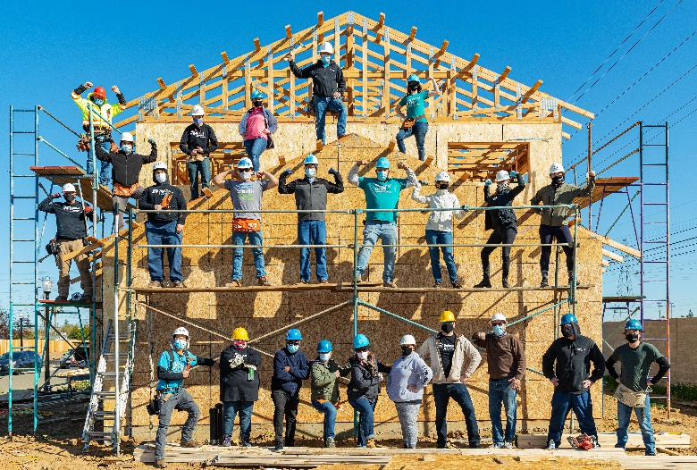
Our Impact
Built and repaired over 300 homes in 36 years
Annually serve over 8,000 individuals through build, repair and community projects
Engage annually over 2,000 volunteers who put in more than 25,000 hours

Slide 5
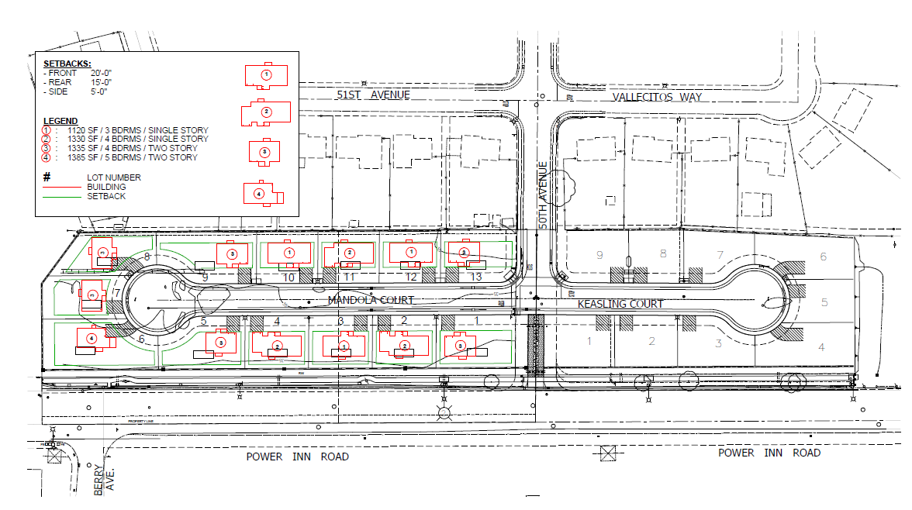
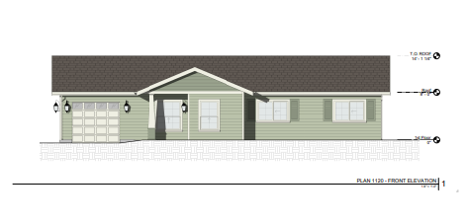
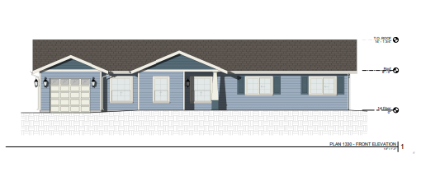
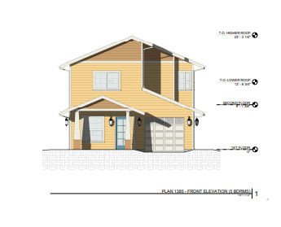
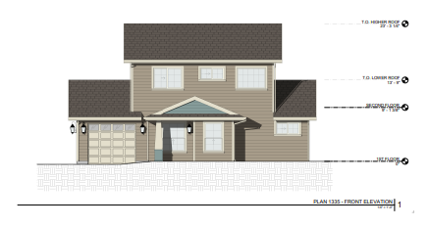
Relevant Developer Experience Mandolin Estates
Current development in progress
South Sacramento
13 single-family homes
Construction cost per home: $185,000
Total development cost: $3 million
Timeline to build: 2 years
Scheduled completion: November 2022

Slide 6
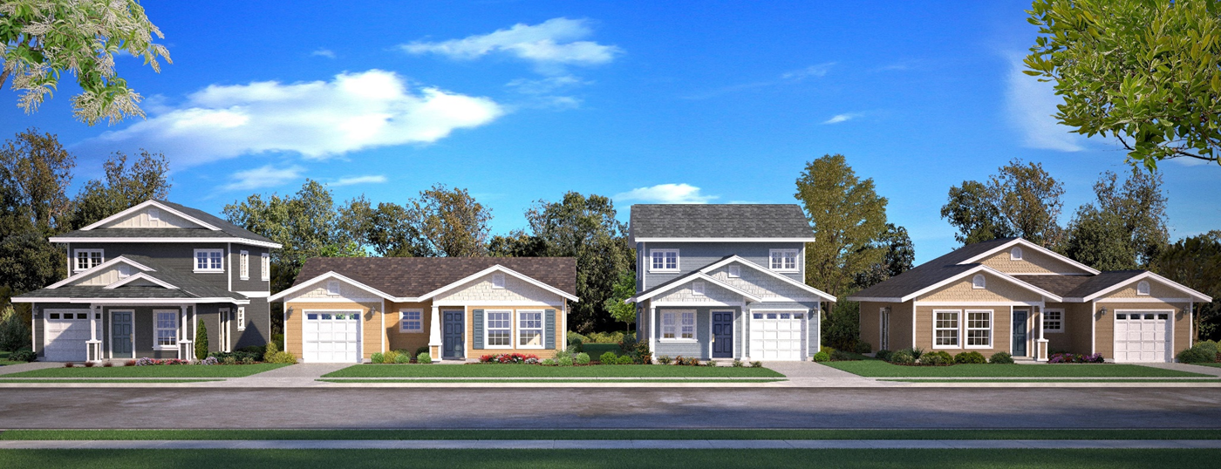
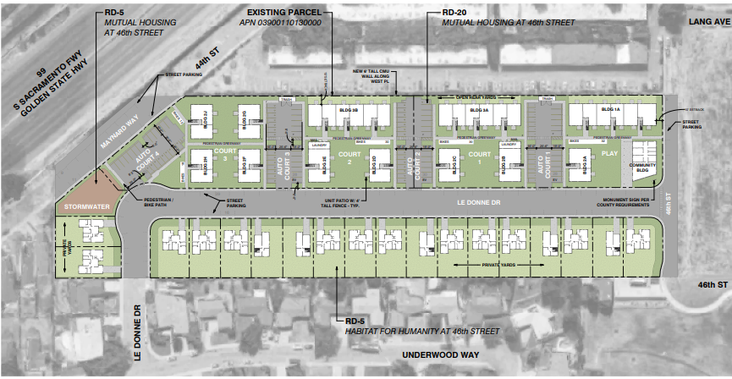
Relevant Developer Experience Cornerstone
Starting infrastructure Feb 2022, Construction July 2022 – Feb 2025
South Sacramento
18 single-family homes
Construction cost per home: $200,000
Development Partners - Mutual Housing, SHRA
Total development cost: $4.5 million (Habitat portion)
Timeline to build 3 years

Slide 7
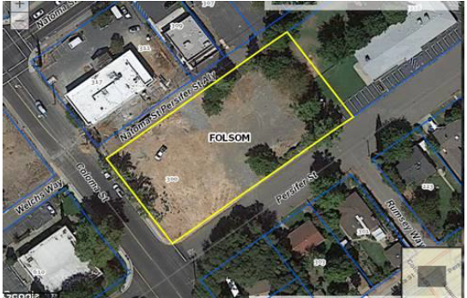
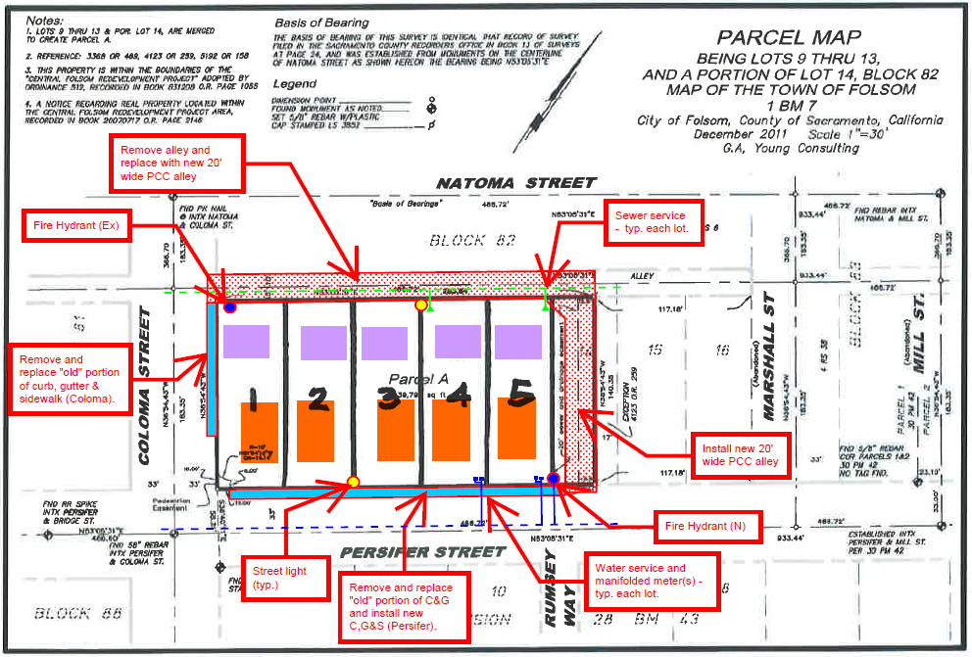
Proposed Development 300 Persifer Street, Folsom
5 single-family & 5 ADU homes
All affordable homeownership
Qualified families within 30%-80% of Sacramento County AMI range

Slide 8
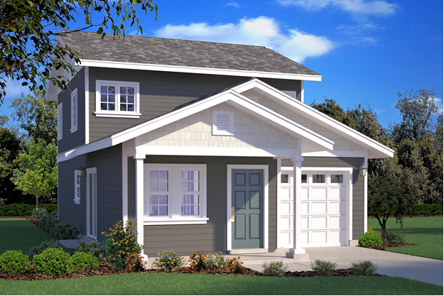
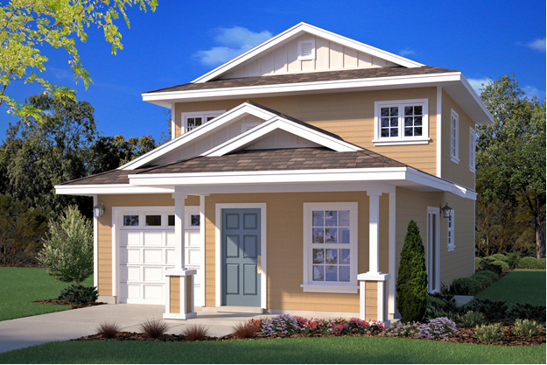
Proposed Development 300 Persifer Street, Folsom
Sample elevations
Development of single-family and ADU with separate ownership successfully developed by sister affiliate in Butte County
Total approximate cost per home: $282,500
Total development cost $2.8 million
Timeline to build: 2 years
Estimated start of infrastructure- Q3 2024
Estimated construction- Q4 2024 – Q3 2026

Slide 9
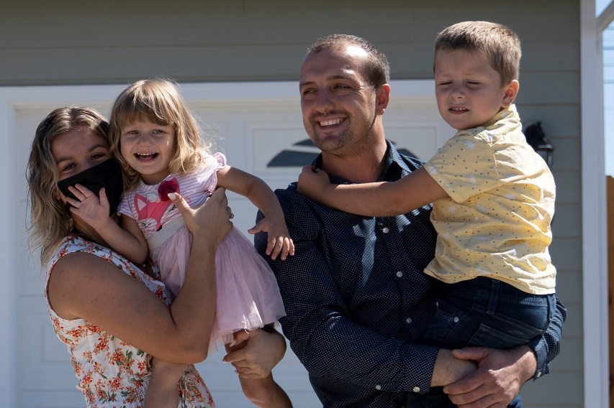
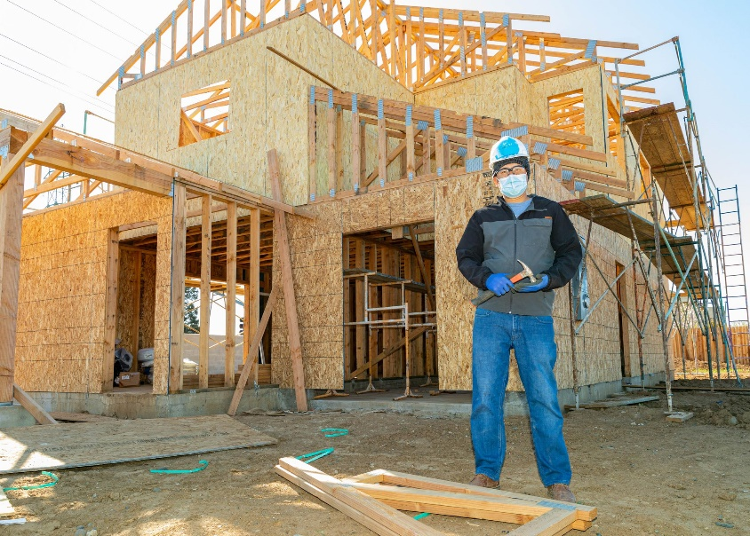
Our Model Who We Serve
Qualified Families
Demonstrate Need
Living in substandard or overcrowded conditions
Paying more than 50% of income on rent
Willingness to Partner
Contribute 500 of sweat equity
Share their story
Participate in financial education courses

Slide 10
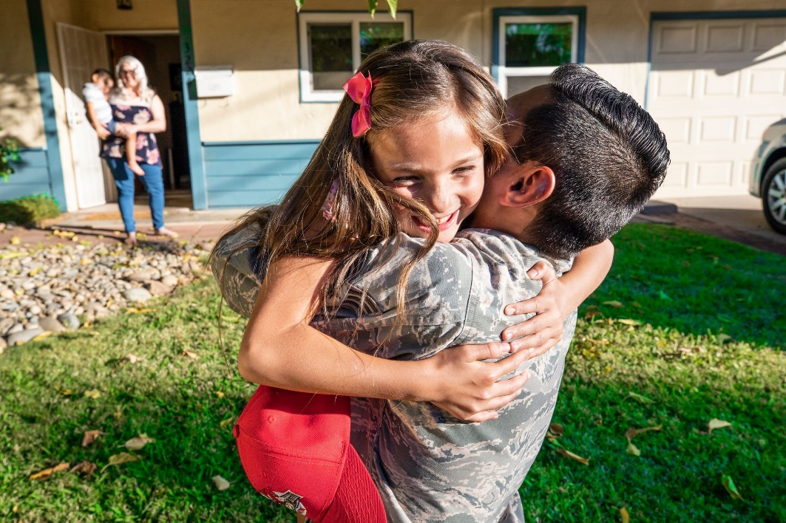
Our Model Who We Serve
Qualified Families (cont)
Ability to Pay
Demonstrate ability to afford an affordable mortgage
Homeowners purchase their home with a 30-year, fixed rate, affordable mortgage
Mortgage payments include principal, property taxes and insurance
Stable income within 30%-80% of Area Median Income
Habitat Homeowner Example
Family of 4 with income 30%-80% of AMI earns between $27,200-$72,000

Slide 11
Our Model How We Build
It Takes a Community to Build a Community
Generous community support
Funding from corporations, grants, individuals, events, faith communities and our Revolving Fund for Humanity
Volunteer muscle!
On average it takes over 350 volunteers and approximately 3,000 volunteer hours to build a Habitat home

Slide 12
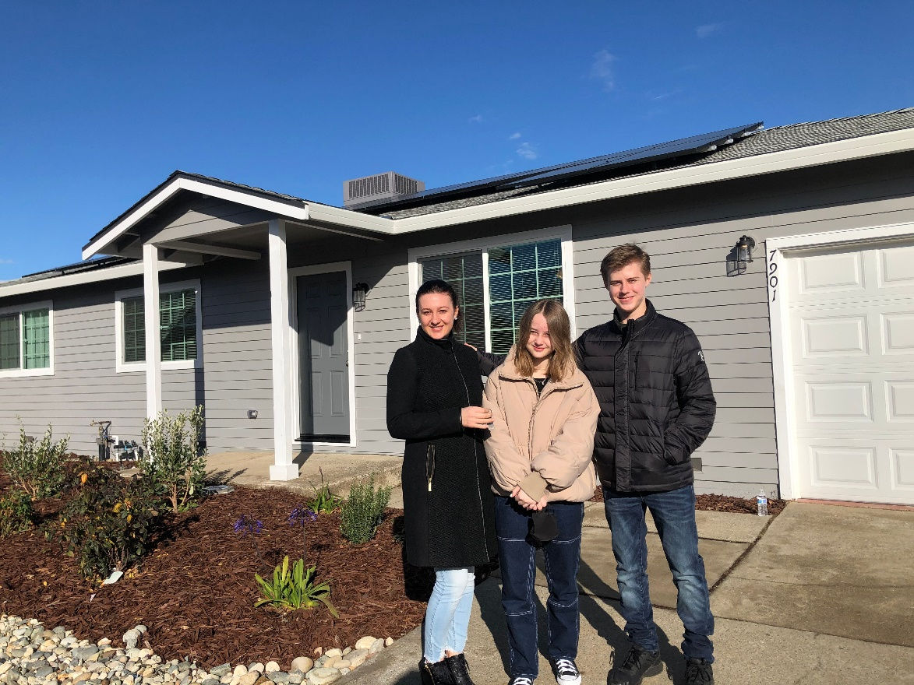
Our Model What We Build
Habitat homes are built to ensure that both the mortgage and the utilities are affordable for the long-term
Energy Efficient
Solar, all-electric, EV ready
Drought tolerant front yard landscaping

Slide 13
Our Model How Homes are Sold
Habitat homes are sold at appraised value to ensure it reinforces values of the neighborhood
Zero interest equivalent
Mortgage payment structured to be affordable
Secured by a deed of trust

Slide 14
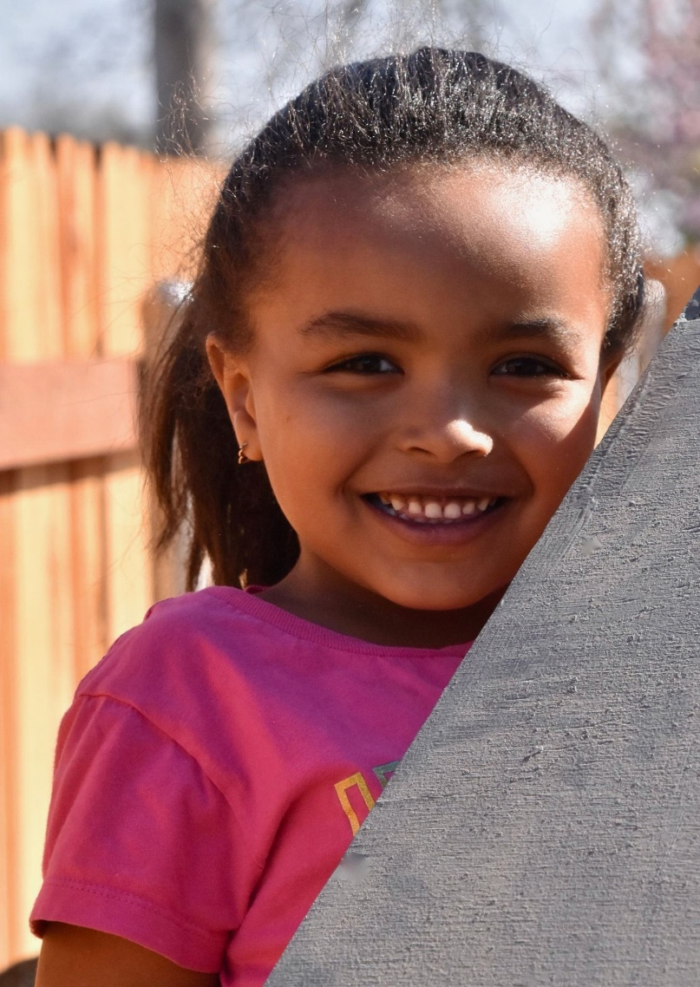
Our Model We Build More Than a House
Financial Stability and Empowerment
Physical and Mental Health
Equity Building
Positive Educational Outcomes
Workforce Development Opportunities

Slide 15
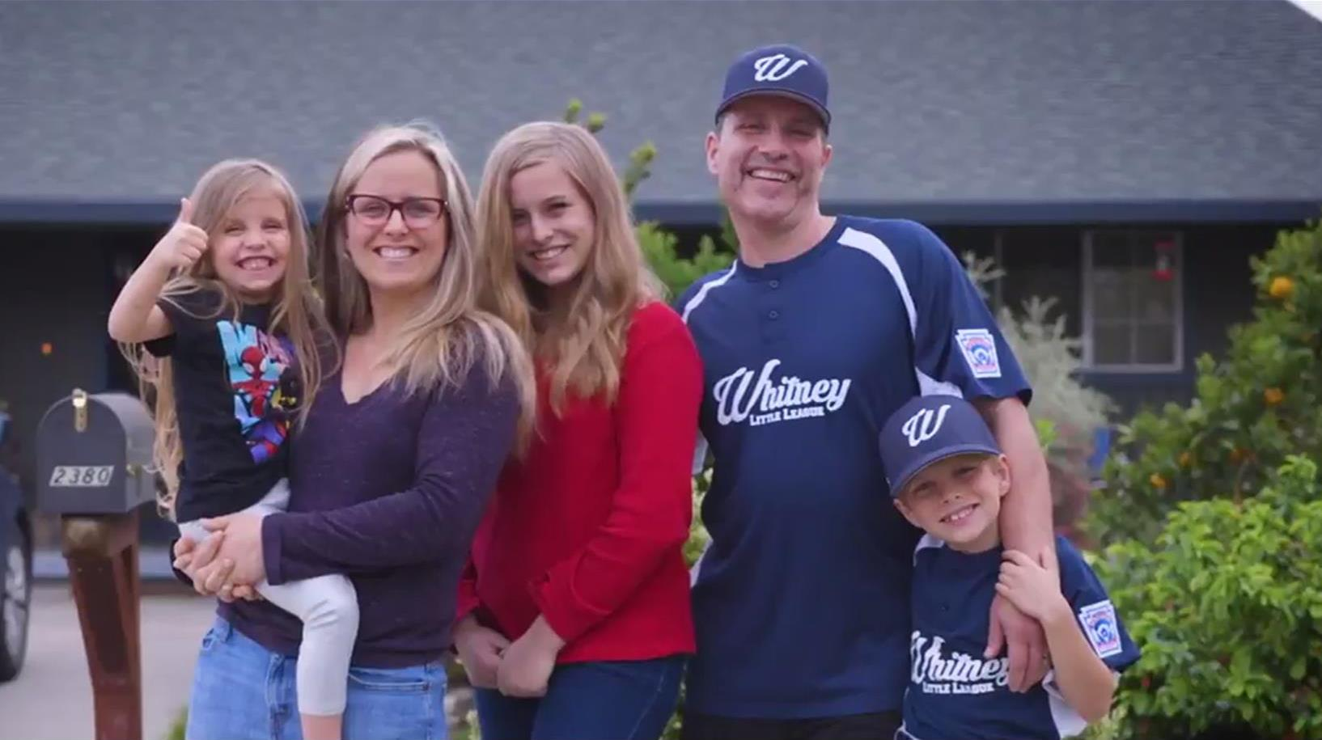
What if…
the homeowner wants to sell?
Habitat has the first right of refusal
Habitat Equity Sharing Agreement – Silent Second
Helps to prevent family from selling the home and receiving a windfall from proceeds
FACT
Only 6 Habitat homeowners have sold their home in the past 20 years

Slide 16
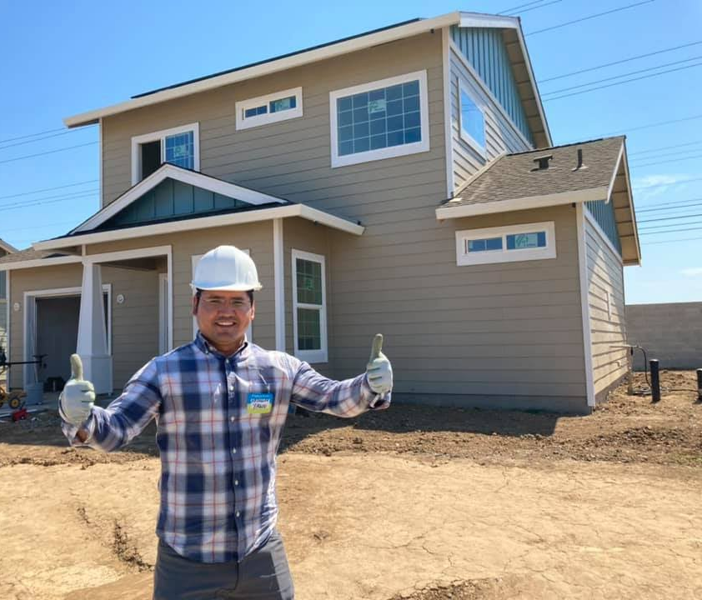
What if…
the homeowner wants to sell?
Proceeds Habitat captures in a resale or when a mortgage is paid off go towards building more Habitat homes
Folsom regulatory agreement in place for 55 years
Deed restriction for affordability – 30%-80% of AMI for future homeowners

Slide 17
Persifer Project Timelines
2022
2023
2024
2025
2026
HfH/City work to
fill $1.1M funding gap
Fundraising Parcel Map & Lot Split
HfH fundraising commences for $1.6M
Raised in phases
City manages parcel map and lot split
HfH works with architect and civil engineer to develop a site plan, house plans and elevations
Design & Entitlement Phase
HfH hosts community design workshops
Submit plans to Building Dept for approval
Future Homeowner Outreach
Community outreach – mailings, events, partner with other Folsom orgs
Host orientations& open application period
Review apps received &
approval of future homeowners
Project plans approved
Secure sub bids for infrastructure
Secure sub bids for infrastructure
Predevelopment & Construction
Infrastructure work - Q3 2024
Secure sub & supply bids for construction
Construction commences – 2024 Q4 – Units built in phases - estimated completion 2026 Q3

Slide 18
Contact Information
Leah Miller
916-440-1215
LMiller@HabitatGreaterSac.org

