Slide 1
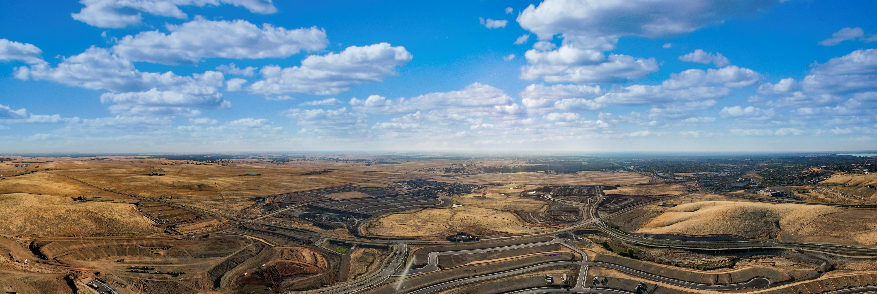
CFD No. 23 (Folsom Ranch) Amended Improvement Area No. 3 and New Improvement Area No. 7 City Council Presentation - December 14, 2021

Slide 2
CFD No. 23 - Amended IA No. 3 and New IA No. 7
Landowners requested to amend IA No. 3 boundaries to exclude property expected to be developed into traditional market rate single-family residences.
Property remaining within the amended IA No. 3 boundaries will only include property to be developed into active adult single-family residences.
Property removed from IA No. 3 boundaries will be designated as the new IA No. 7.
1

Slide 3
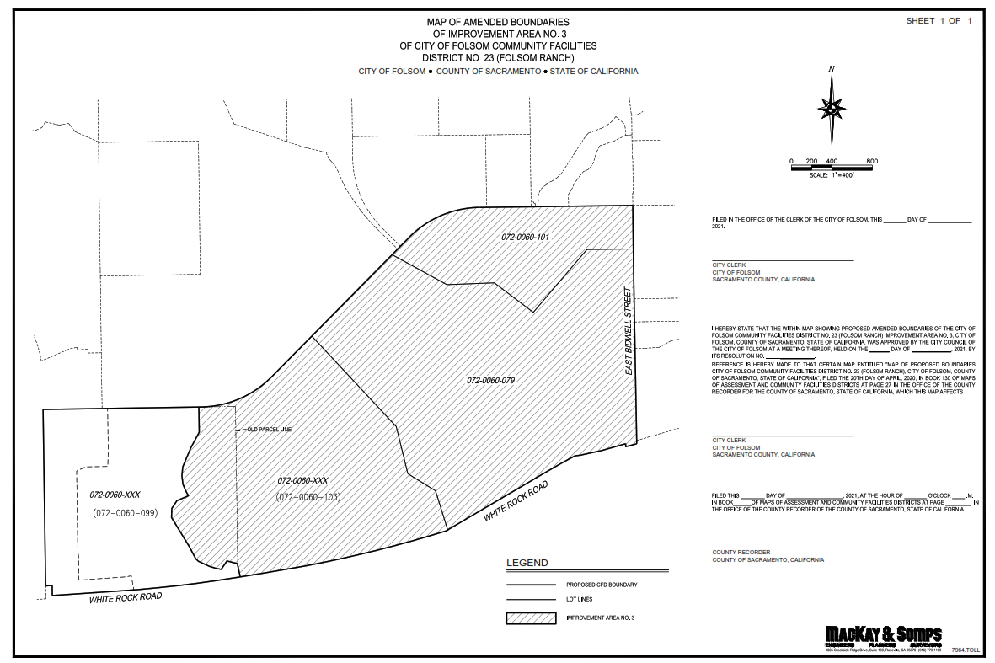
CFD No. 23 - Amended IA No. 3 and New IA No. 7
Amended IA No. 3 Boundaries
3

Slide 4
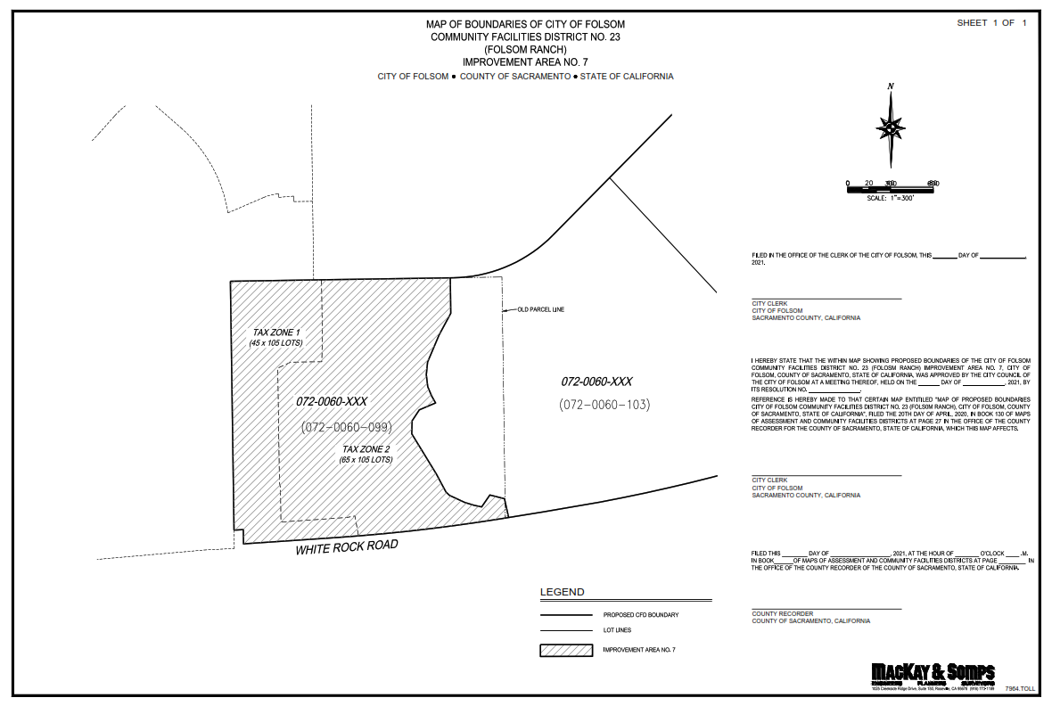
CFD No. 23 - Amended IA No. 3 and New IA No. 7
New IA No. 7 Boundaries
4

Slide 5
CFD No. 23 - Amended IA No. 3 and New IA No. 7
On November 9, 2021, the City Council previously approved:
Resolution No. 10747, to (1) Amend the Boundaries; (2) Amend the Rate and Method of Apportionment; and (3) Amend the Appropriations Limit and Bonded Indebtedness for IA No. 3 and Related Matters.
Resolution No. 10748, Approving a Proposed Boundary Map and Designating IA No. 7 and to Levy Special Taxes therein.
Resolution No. 10749, Declaring the Necessity for Incurring Bonded Indebtedness in and for IA No. 7 and Calling for a Public Hearing thereon.
5

Slide 6
CFD No. 23 - Amended IA No. 3 and New IA No. 7
Proposed development and total property tax as % of estimated assessed value:
Amended IA No. 3
919 active adult single-family residences
Property Tax %: 1.65% - 1.68%
New IA No. 7
211 traditional market rate single-family residences
Property Tax %: 1.87% - 1.88%
6

Slide 7
CFD No. 23 - Amended IA No. 3 and New IA No. 7
Recommended City Council Action:
Conduct the Public Hearing
Approve Resolution No. 10767 - calling for a special mailed ballot election for IA No. 3
Approve Resolution No. 10768 - the resolution of change for IA No. 3
Approve Resolution No. 10769 - the resolution designating IA No. 7
Approve Resolution No. 10770 - the resolution deeming it necessary to incur bonded indebtedness for IA No. 7
Approve Resolution No. 10771- the resolution calling for a special mailed ballot election for IA No. 7
Approve Resolution No. 10772 - the resolution declaring results of the special mailed ballot election for IA No. 7
Introduce and provide the first reading of the ordinances levying a special tax (Ordinance Nos. 1321 and 1322)
8

