Slide 1
PG&E Vegetation Management
City of Folsom
December 14, 2021

Slide 2
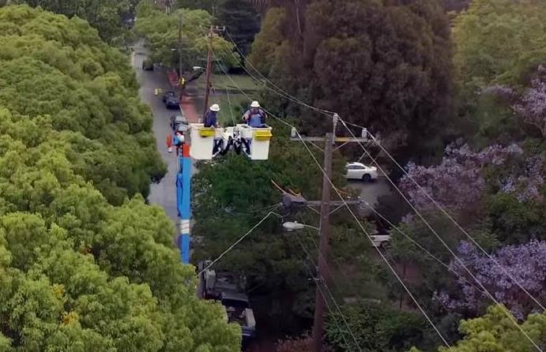
Our Vegetation Management Program
PG&E is taking steps every day to improve the safety and reliability of our electric system, which serves nearly 16 million people in Northern and Central California.
This includes working with our customers and communities to manage trees and other vegetation located near power lines that could cause a wildfire or power outage.
PG&E’s vegetation management program:
Inspects approximately 100,000 miles of overhead power lines every year
Prunes or removes more than 1 million trees annually
Addresses dead and dying trees in areas affected by drought and bark beetles
Notes:
In just the last 7 years, the area served by PG&E that is designated by the state to be at a high risk of wildfire has increased from 15 to 52 percent – an increase of more than 300 percent.

Slide 4
Vegetation Management – Regulations
Notes:
The Vegetation Management Laws and Regulations - FAC 003-4
Mandatory NERC standards apply to all utilities across the United States and reflect FERC’s zero-tolerance policy for tree-caused outages.
The purpose of the standard is to eliminate transmission outages and resulting blackouts due to vegetation contact.
The standard directs utilities to manage vegetation so that clearances between power lines and trees ensure the reliable operation of the transmission system.
PG&E’s removal/pruning methodologies
Vegetation management in line corridors
Timeline: December 15th – December 31st

Slide 5
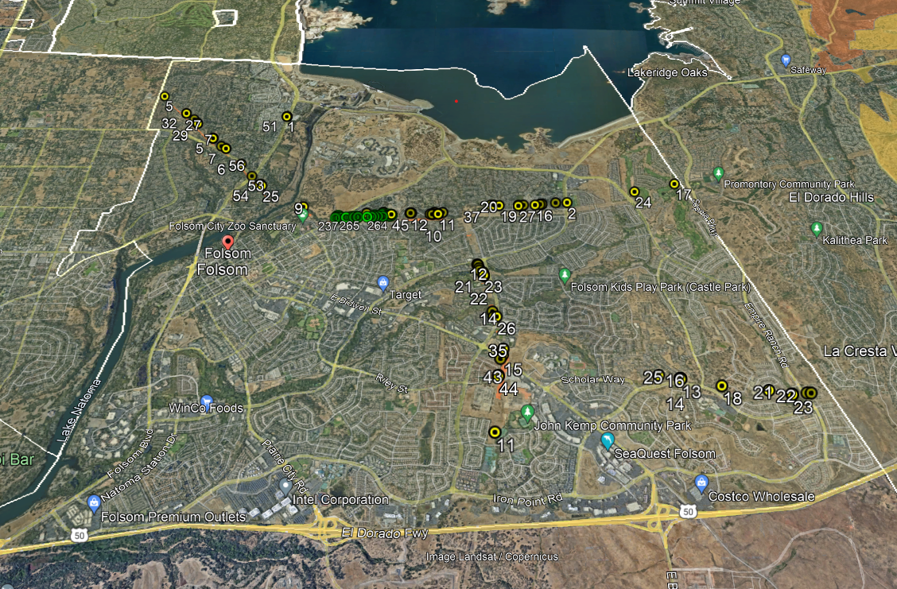
City of Folsom: Previously Identified Work
City of Lafayette

Slide 6
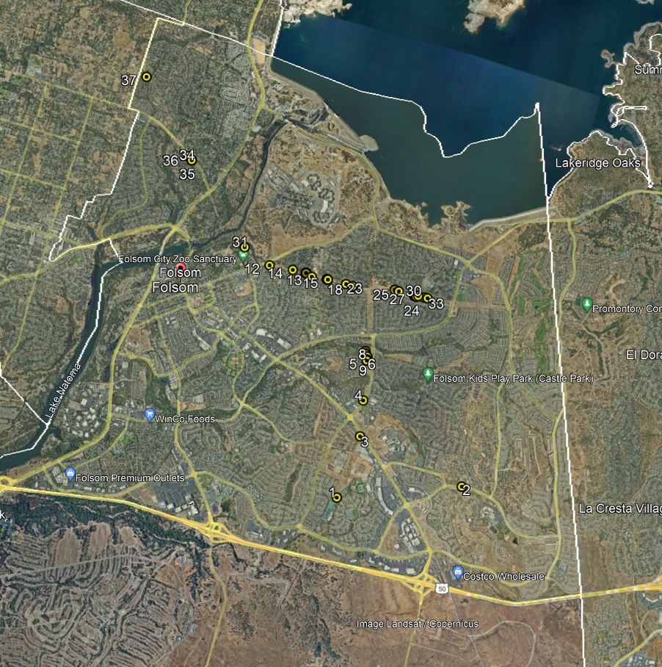
City of Folsom: Proposed Vegetation Work
Notes:
50 Total trees identified within City of Folsom
14 for prune
Oaks - 12
Tallow - 1
Willow - 1
36 for removal
8 removals are oaks (removal approved in collaboration with City Arborist)
28 remaining removals are incompatible species (removal approved in collaboration with City Arborist)
Redwood - 1
Pear – 6
Willow - 3
Misc. Brush – 4
Cottonwood – 3
Palm - 1
Pistache -4
Eucalyptus – 2
Poplar – 1
Walnut -1
Bay Laurel – 1
Pine – 1

Slide 7
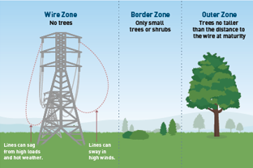
Vegetation Management: City of Folsom
Annual Routine Vegetation Management work will be taking place in in the City of Folsom to ensure compliance with state and federal vegetation and fire safety standards.
This work will include pruning approximately 14 trees and removing 36 trees (8 are oak trees approved by City Arborist)
Customers can expect to see PG&E crews and contractors conducting this important vegetation work throughout December.
For illustrative purposes only

Slide 8
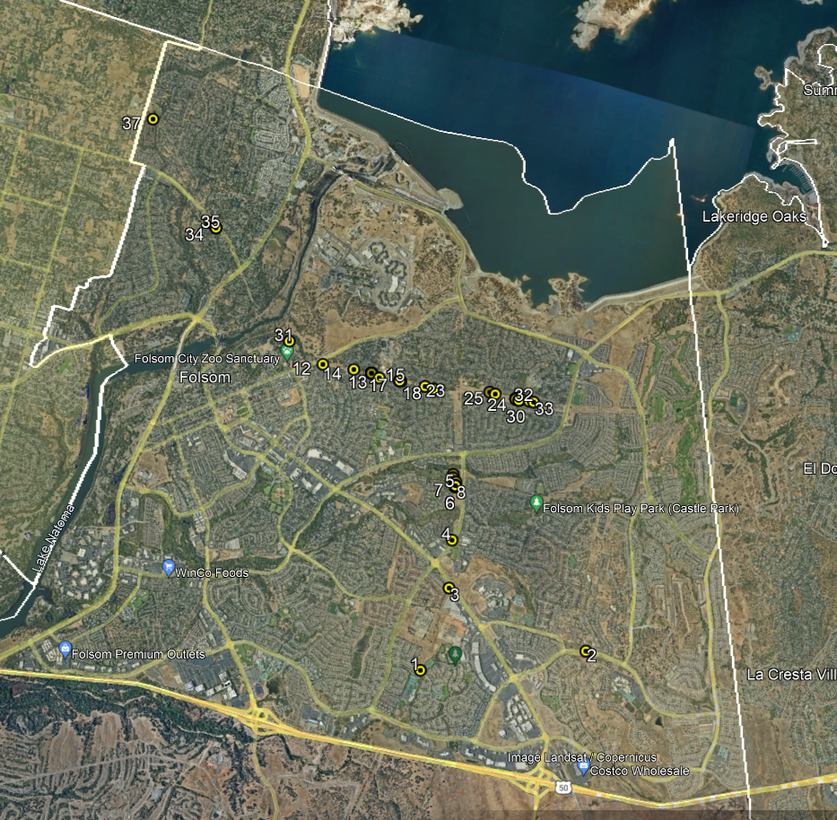
Next Steps
Joint Press Release
Work will begin December 15th
2022 Work – Early Communication and Coordination with the City staff

