Slide 1
Resolution 10776 Mangini Place Affordable Housing Loan

Slide 2
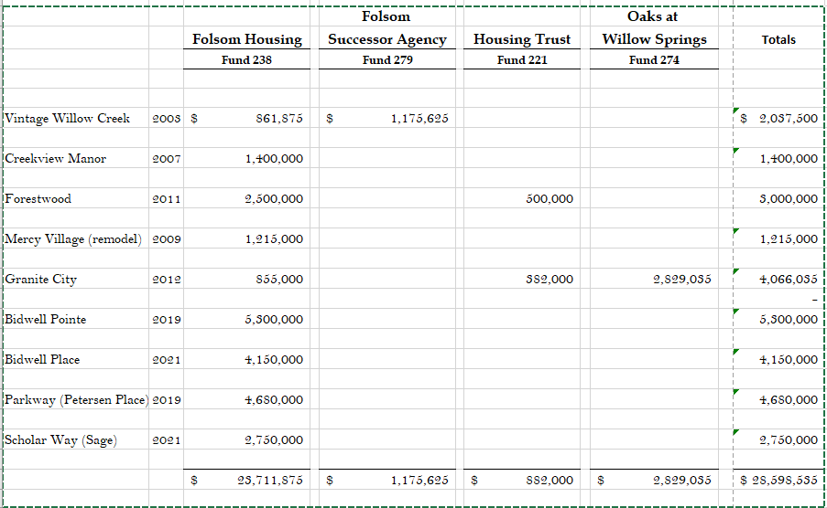
Affordable Housing Loan Summary
Nine affordable housing loans
Totaling $28.6 million
Producing 814 units

Slide 3
Background
January 26, 2021 | Preliminary loan request presented to CC along with request for Sage project
August 11, 2021 | Project received private activity bond allocation from the California Debt Limit Allocation Committee
August 18, 2021 | Project approved by Planning Commission
November 2021 | City’s total unencumbered housing fund balance available for affordable housing projects is $9.97 million
 | Housing Fund Name | Source | Fund Balance
 | Housing Trust Fund (Fund 221) | Commercial Fees | $1,265,283
 | Folsom Housing Fund (Fund 238) | Inclusionary In-lieu Fees | $8,538,583
 | Oaks at Willow Springs (Fund 274) | Willow Springs Inclusionary Fee | $24,059
 | Bonds Fund (Fund 280) | Former Redevelopment Bonds | $140,293
 | Total |  | $9,968,218

Slide 4
Project Details
First proposed affordable project in the Folsom Plan Area
5.02-acres site
152 multifamily affordable one-, two-, and three-bedroom units
Project will provide 152 additional units toward RHNA
Affordable to low-, very-low-, and extremely-low-income households
Pedestrian focus - walking distance of elementary school
Requesting $6,860,000 loan from City’s Housing Fund
Project Site

Slide 5
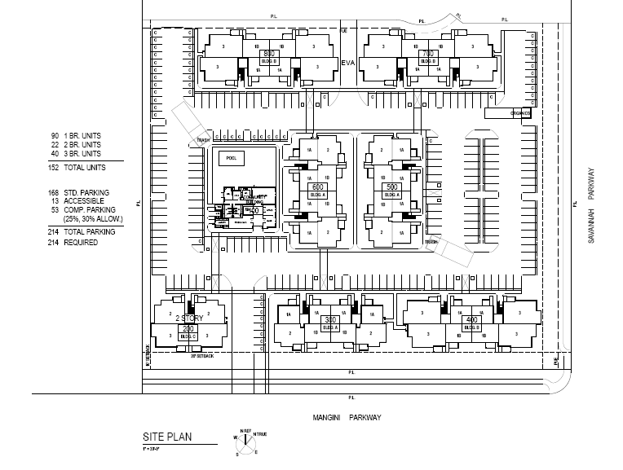
Mangini Place Site Plan and Rendering

Slide 6
Funding Analysis
Developer Pro Forma analyzed by City’s consultant (TDA) for reasonableness and accuracy of assumptions, methods, and calculations
TDA found the requested $6.86M loan is reasonable based on project details, but recommended adding a net cost savings provision to the Term Sheet
Lower per unit price comparable to other City loans
Mangini Place Project: $45,733 per affordable unit
Bidwell Place Project: $55,333 per affordable unit
Bidwell Point Project: $53,000 per affordable unit
Forestwood Apartment Project: $54,545 per affordable unit
Granite City Apartment Project: $51,000 per affordable unit

Slide 7
Loan Terms
Loan Amount $6.86 million
3% simple interest
35-year repayment term
Repayment equal to 50% of residual cash flow
City’s loan will be deferred until the earlier of i) 15 years following Permanent Loan Conversion or ii) repayment of the Deferred Developer Fee, provided further that the Deferred Developer Fee note shall carry no interest
100% of principal balance + accrued interest due at expiration of loan term
Net cost savings provision in the event project sources are in excess of uses for the project

Slide 8
Development Impact Fee Deferral
Folsom Municipal Code Chapter 16.60 allows City Council to approval deferral of up to 75% of City-imposed development impact fees qualified residential projects.
Project is a qualified residential project with 100% affordable units
Total estimated development impact fee is ~$8.37M (75% is ~$6.27K)
Max fee deferral period is 15 months from building permit issuance

Slide 9
Recommendation
Adopt Resolution No. 10776 - A Resolution of the City of Folsom Approving an Affordable Housing Loan in the Amount of $6,860,000 from the City’s Housing Funds to Mangini Place Affordable, LP, Authorizing the City Manager to Execute Loan Agreement and Related Documents for the Construction of 152 Affordable Housing Units at the Mangini Place Multifamily Affordable Housing Development, and Appropriation of Funds

