Slide 1
Financial Update
1st Quarter Fiscal Year 2021-22
Presentation to the Folsom City Council
November 9, 2021

Slide 2
Unaudited General Fund Results

Slide 3
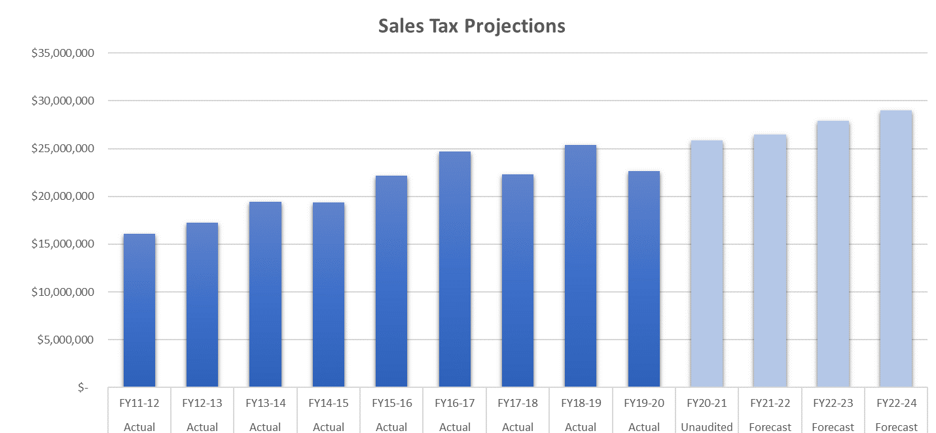
Sales Tax Update

Slide 4
General Fund - Expenditures

Slide 5
General Fund - Expenditures

Slide 6
General Fund – Revenues

Slide 7
FY 21-22 General Fund Totals

Slide 8
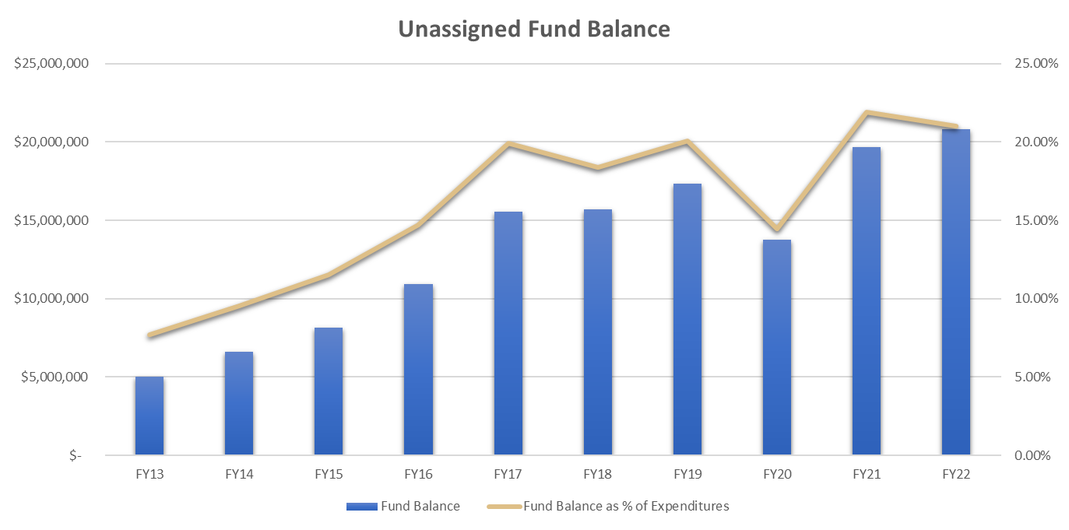
General Fund Summary
Unaudited
Projected

Slide 9
Internal Service Fund

Slide 10
Risk Management

Slide 11
QUESTIONS

