Slide 1
Ordinance No. 1318
Historic District parking management was focus of 2020 Ad Hoc committee
Compliance with parking limits is integral to success of parking management strategies
Section 10.20.510 last updated 1994
$25 not the deterrent it used to be
Notes:
Currently residential participation in recycling and yard waste collection is optional. Even those who elect to participate may still throw yard waste or recyclables into their grey trash can at their discretion. In accordance with SB 1383, after the adoption of the new ordinance, placing items in the wrong can will be a violation of Folsom Municipal Code and subject to enforcement.
State law already requires businesses to have organics and recycling collection and SB 1383 expands on those requirements. The code revisions require containers to be used in accordance with program guidelines.
8.32.191 Sufficient service required.

Slide 2
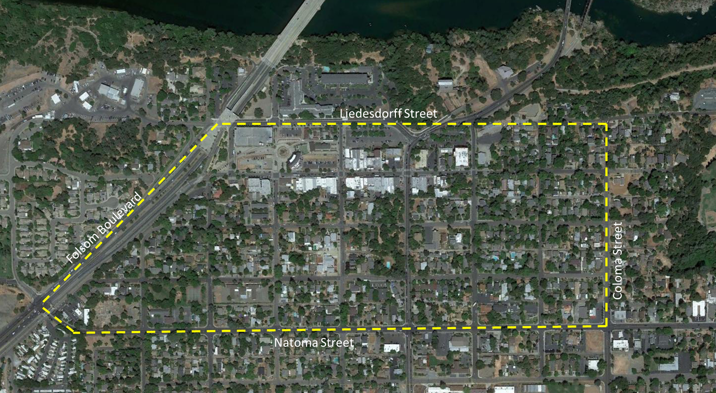
Proposed Boundary

