Slide 1
City of Folsom Draft Map Presentation
Doug Yoakam, Consultant
National Demographics Corporation

Slide 2
Districting Process
Step | Description
Census Data Release August 12, 2021 | Census Bureau releases official 2020 Census population data
Public Hearing #1 September 14, 2021 | Held prior to release of draft maps Educate, solicit input on neighborhoods and Communities of Interest
California Data Release September 20 & 27, 2021 | California Statewide Database releases California’s official ‘prisoner-adjusted’ 2020 redistricting data
Public Hearing #2 October 12, 2021 | Held prior to release of draft maps Educate, solicit input on neighborhoods and Communities of Interest

Slide 3
Districting Process (continued)
Step | Description
Public Hearing #3 January 11, 2022 | Held after release of draft maps Educate, solicit input on neighborhoods and Communities of Interest Discuss, revise draft maps; discuss election sequencing
Public Hearing #4 February 8, 2022 | Held after release of draft maps Educate, solicit input on the communities in the districts Discuss, determine final map; discuss, determine election sequencing
Public Hearing #5 Febrauary 22, 2022 | Adopt final map.

Slide 4
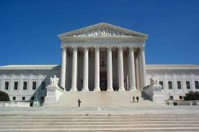
Districting Rules and Goals
1. Federal Laws
2. California Criteria for Cities
3. Other Traditional Redistricting Principles
Equal Population
Federal Voting Rights Act
No Racial Gerrymandering
Geographically contiguous
Undivided neighborhoods and “communities of interest”
Easily identifiable boundaries
Compact
Prohibited: “Shall not favor or discriminate against a political party.”
Respect voters’ choices / continuity in office
Future population growth

Slide 5
8 Public Maps submitted: Leary, Dooley (+9 identical maps), Kempenaar, Cline, Goss, Johnson, Gorton, Efros 5 Paper maps submitted: Bulga, Nordheim, Ferrari, Reid, Normington (2). 2 Submissions not compliant: Harrison, Chance
January 3, 2022

Slide 6
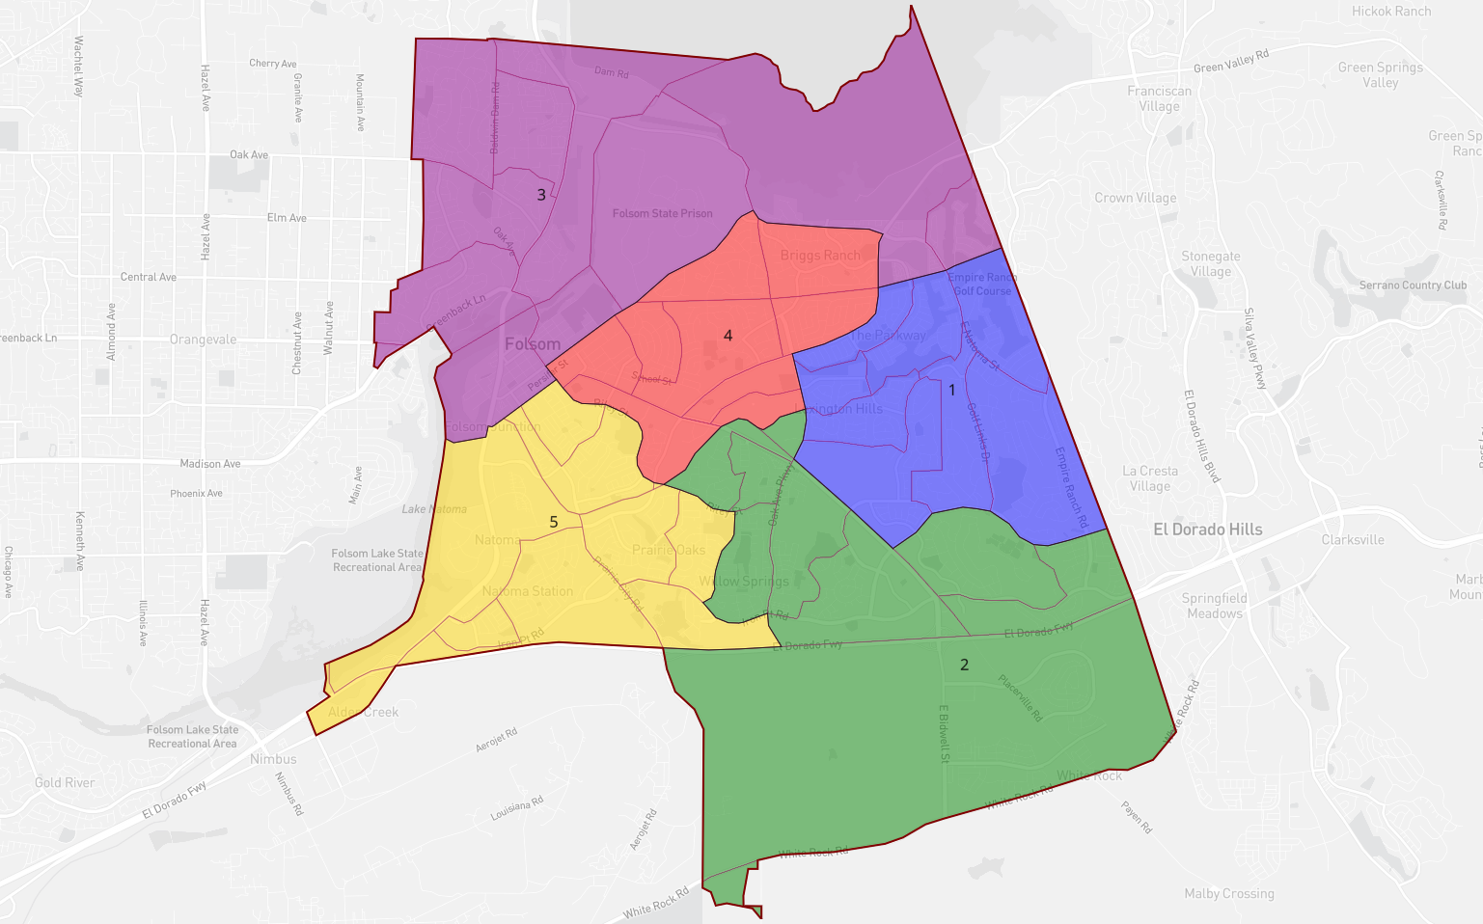
Cline Submission

Slide 7
The 9.29% population deviation is within the 10% threshold tolerated by the courts.
Extensive explanation submitted. Focus on major streets, keeping communities together, extensive analysis of South of 50 planning and growth patterns.
 | Population |  | Shapes |  | Partisan Lean |  |  | Demographics (CVAP)DOWNLOAD
ID | Total | +/- |  |  | Dem | Rep | Oth | Total | White | Minority | Hispanic | Black | Asian | Native | Pacific
Un | 0 |  |  |  | 0.00% | 0.00% | 0.00% | 0 | 0.00% | 0.00% | 0.00% | 0.00% | 0.00% | 0.00% | 0.00%
1 | 15,524 | 3.44% |  |  |  |  |  |  | 70.17% | 29.83% | 8.66% | 0.87% | 19.71% | 0.38% | 0.00%
2 | 14,130 | -5.85% |  |  |  |  |  |  | 68.98% | 31.02% | 8.18% | 1.64% | 18.79% | 1.02% | 0.85%
3 | 15,061 | 0.35% |  |  |  |  |  |  | 64.02% | 35.98% | 13.24% | 12.93% | 7.81% | 1.63% | 0.44%
4 | 15,037 | 0.19% |  |  |  |  |  |  | 78.72% | 21.28% | 12.04% | 1.55% | 4.85% | 2.19% | 0.56%
5 | 15,286 | 1.85% |  |  |  |  |  |  | 67.41% | 32.59% | 10.09% | 2.00% | 18.53% | 0.86% | 0.82%
 | 15,008 | 9.29% |  |  |  |  |  |  | 69.37% | 30.63% | 10.86% | 4.90% | 12.88% | 1.29% | 0.52
 | Map Statistics Analyze Compare Advanced
Cline Statistics

Slide 8
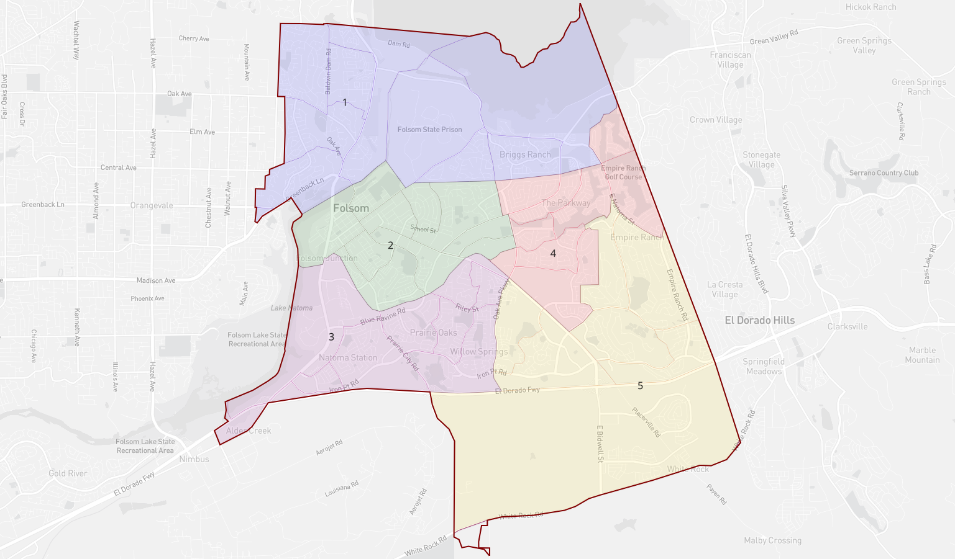
Leary Submission

Slide 9
The 10.81% population deviation is greater than the 10% threshold tolerated by the courts.
Focus on age of homes, and underpopulate district South of 50
Population |  | Shapes |  | Partisan Lean |  |  | Demographics (CVAP)DOWNLOAD
ID | Total | +/- |  |  | Dem | Rep | Oth | Total | White | Minority | Hispanic | Black | Asian | Native | Pacific
Un | 0 |  |  |  | 0.00% | 0.00% | 0.00% | 0 | 0.00% | 0.00% | 0.00% | 0.00% | 0.00% | 0.00% | 0.00%
1 | 15,301 | 1.95% |  |  |  |  |  |  | 65.06% | 34.94% | 14.69% | 12.86% | 5.80% | 1.27% | 0.44%
2 | 15,375 | 2.45% |  |  |  |  |  |  | 76.14% | 23.86% | 9.08% | 1.43% | 10.05% | 2.63% | 0.56%
3 | 15,595 | 3.91% |  |  |  |  |  |  | 67.47% | 32.53% | 10.77% | 2.19% | 17.13% | 0.95% | 1.08%
4 | 14,795 | -1.42% |  |  |  |  |  |  | 72.09% | 27.91% | 8.53% | 1.24% | 17.24% | 0.75% | 0.00%
5 | 13,972 | -6.90% |  |  |  |  |  |  | 67.81% | 32.19% | 8.37% | 1.20% | 20.87% | 0.58% | 0.60%
 | 15,008 | 10.81% |  |  |  |  |  |  | 69.37% | 30.63% | 10.86% | 4.90% | 12.88% | 1.29% | 0.52%
Leary Statistics

Slide 10
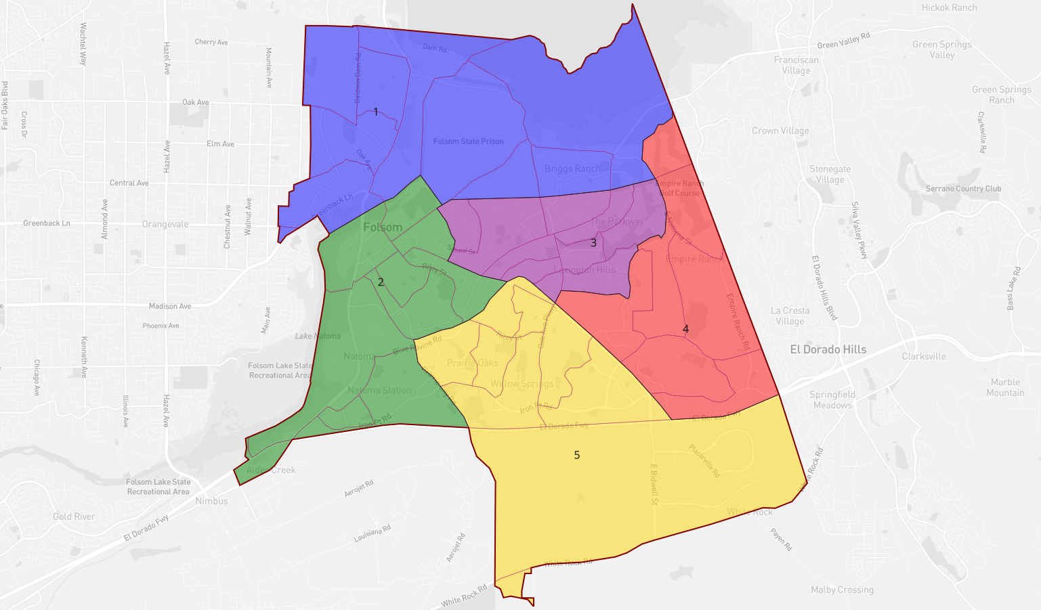
Dooley Submission

Slide 11
Identical to 9 other maps 7.48% Total Deviation
Population |  | Shapes |  | Partisan Lean |  |  | Demographics (CVAP)DOWNLOAD
ID | Total | +/- |  |  | Dem | Rep | Oth | Total | White | Minority | Hispanic | Black | Asian | Native | Pacific
Un | 0 |  |  |  | 0.00% | 0.00% | 0.00% | 0 | 0.00% | 0.00% | 0.00% | 0.00% | 0.00% | 0.00% | 0.00%
1 | 15,301 | 1.95% |  |  | % | % | % |  | 65.06% | 34.94% | 14.69% | 12.86% | 5.80% | 1.27% | 0.44%
2 | 14,792 | -1.44% |  |  | % | % | % |  | 74.13% | 25.87% | 10.60% | 2.08% | 11.43% | 1.03% | 0.60%
3 | 15,416 | 2.72% |  |  | % | % | % |  | 75.79% | 24.21% | 8.42% | 1.60% | 11.56% | 2.47% | 0.00%
4 | 14,294 | -4.76% |  |  | % | % | % |  | 65.75% | 34.25% | 8.47% | 0.86% | 24.17% | 0.52% | 0.00%
5 | 15,235 | 1.51% |  |  | % | % | % |  | 67.68% | 32.32% | 9.33% | 1.44% | 18.25% | 1.00% | 1.63%
 |  | 7.48% |  |  | % | % |  |  | 69.37% | 30.63% | 10.86% | 4.90% | 12.88% | 1.29% | 0.52%
Dooley Statistics

Slide 12
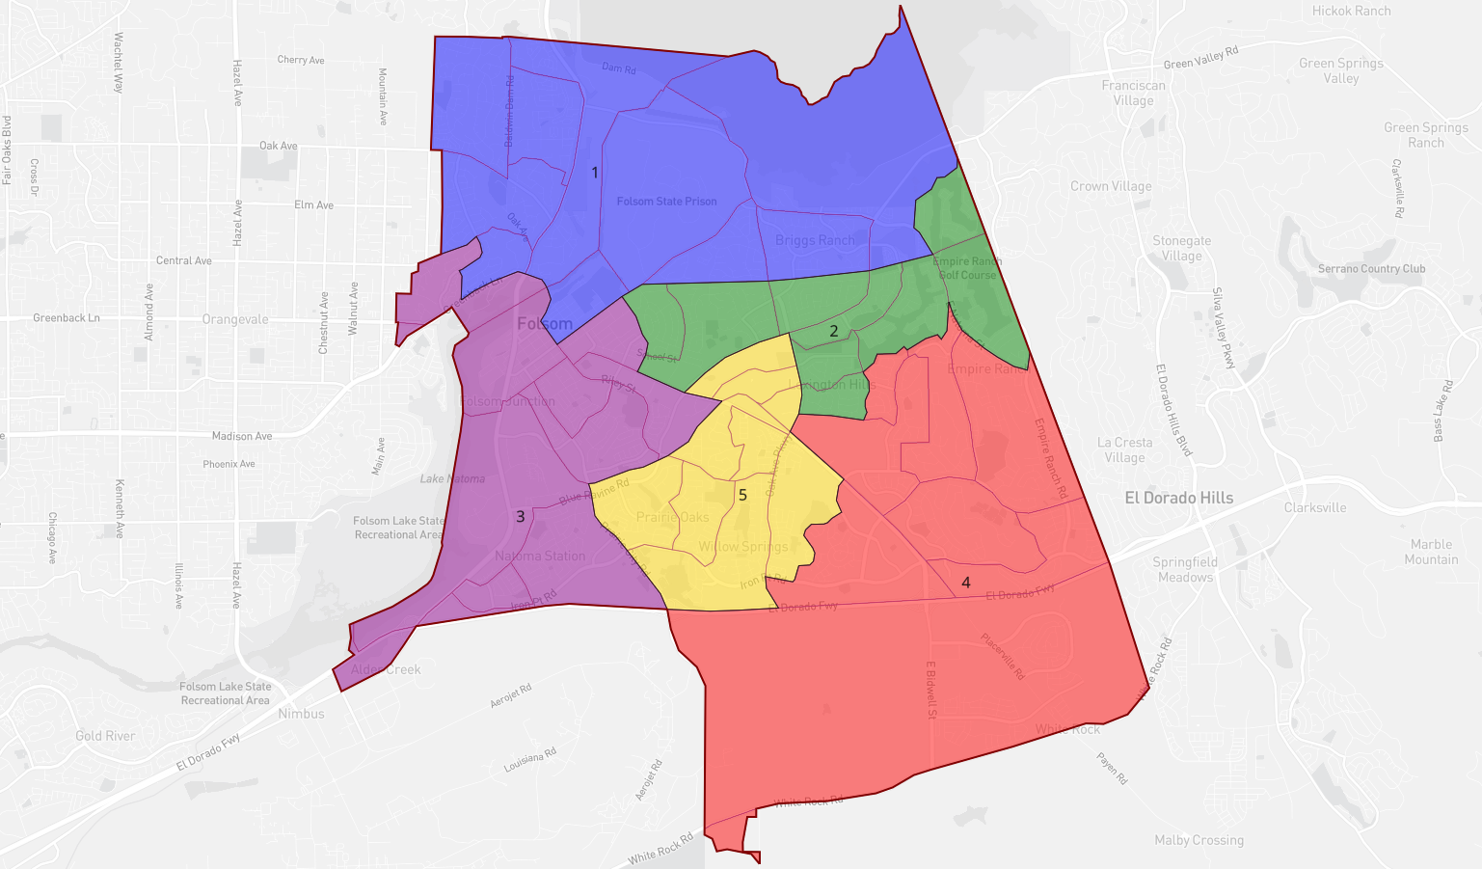
Kempenaar Submission

Slide 13
Nearly perfect deviations 1.32% Total Deviation
PopulationN |  | Shapes |  | Partisan Lean |  |  | Demographics (CVAP)DOWNLOAD
ID | Total | +/- |  |  | Dem | Rep | Oth | Total | White | Minority | Hispanic | Black | Asian | Native | Pacific
Un | 0 |  |  |  | 0.00% | 0.00% | 0.00% | 0 | 0.00% | 0.00% | 0.00% | 0.00% | 0.00% | 0.00% | 0.00%
1 | 14,959 | -0.33% |  |  | % | % | % | 15,614 | 64.81% | 35.19% | 14.26% | 13.14% | 6.05% | 1.36% | 0.45%
2 | 15,006 | -0.01% |  |  | % | % | % | 10,390 | 75.68% | 24.32% | 7.31% | 1.29% | 14.23% | 1.42% | 0.00%
3 | 15,134 | 0.84% |  |  | % | % | % | 10,448 | 74.15% | 25.85% | 11.39% | 2.08% | 10.84% | 0.90% | 0.57%
4 | 14,936 | -0.48% |  |  | % | % | % | 8,295 | 67.55% | 32.45% | 8.92% | 0.98% | 21.01% | 0.71% | 0.36%
5 | 15,003 | -0.03% |  |  | % | % | % | 9,005 | 66.13% | 33.87% | 10.22% | 1.70% | 18.03% | 2.02% | 1.33%
 |  |  |  |  | % | % | % | 10,750 | 69.37% | 30.63% | 10.86% | 4.90% | 12.88% | 1.29% | 0.52%
Kempenaar Statistics

Slide 14
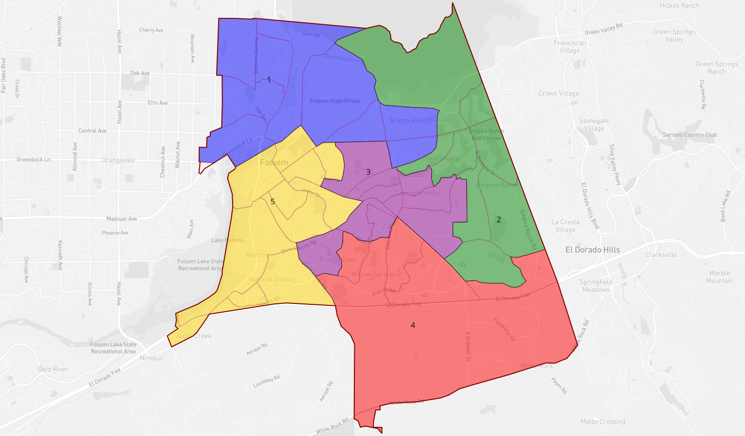
Goss Submission

Slide 15
District 4 purposely underpopulated. Not compliant with equal population standard.
 | Population |  | Shapes |  | Partisan Lean |  |  | Demographics (CVAP)DOWNLOAD
ID | Total | +/- |  |  | Dem | Rep | Oth | Total | White | Minority | Hispanic | Black | Asian | Native | Pacific
Un | 0 |  |  |  | % | % | 0.00% | 10 | 60.00% | 40.00% | 20.00% | 0.00% | 10.00% | 0.00% | 0.00%
1 | 15,627 | 4.12% |  |  | % | % | % | 16,970 | 66.83% | 33.17% | 14.56% | 12.22% | 4.92% | 1.15% | 0.41%
2 | 15,133 | 0.83% |  |  | % | % | % | 8,493 | 67.63% | 32.37% | 7.05% | 0.80% | 24.02% | 0.35% | 0.00%
3 | 15,006 | -0.01% |  |  | % | % | % | 10,049 | 71.39% | 28.61% | 8.91% | 1.47% | 14.88% | 2.02% | 0.85%
4 | 12,843 | -14.43% |  |  | % | % | % | 7,060 | 66.71% | 33.29% | 9.49% | 1.91% | 19.46% | 1.03% | 0.92%
5 | 16,429 | 9.47% |  |  | % | % | % | 11,170 | 74.42% | 25.58% | 10.75% | 1.89% | 10.55% | 1.75% | 0.54%
 |  | 23.90% |  |  | % | % | % | 10,750 | 69.37% | 30.63% | 10.86% | 4.90% | 12.88% | 1.29% | 0.5
 | Map Statistics Analyze Compare Advanced
Goss Statistics

Slide 16
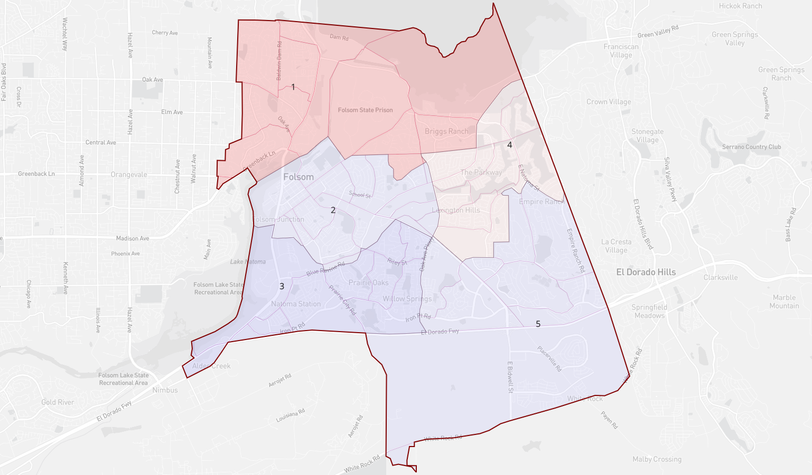
Johnson Submission

Slide 17
The 8.84% population deviation is within the 10% threshold tolerated by the courts.
Focus on major streets, creeks and other geographic boundaries.
Population |  | Shapes |  | Partisan Lean |  |  | Demographics (CVAP)DOWNLOAD
ID | Total | +/- |  |  | Dem | Rep | Oth | Total | White | Minority | Hispanic | Black | Asian | Native | Pacific
Un | 0 |  |  |  | 0.00% | 0.00% | 0.00% | 0 | 0.00% | 0.00% | 0.00% | 0.00% | 0.00% | 0.00% | 0.00%
1 | 14,938 | -0.47% |  |  | % | % | % |  | 65.96% | 34.04% | 14.61% | 12.78% | 5.11% | 1.25% | 0.43%
2 | 15,585 | 3.84% |  |  | % | % | % |  | 75.01% | 24.99% | 9.40% | 1.57% | 10.51% | 2.78% | 0.57%
3 | 15,568 | 3.73% |  |  | % | % | % |  | 67.47% | 32.53% | 10.78% | 2.19% | 17.13% | 0.95% | 1.08%
4 | 14,688 | -2.13% |  |  | % | % | % |  | 72.33% | 27.67% | 7.77% | 1.02% | 18.05% | 0.69% | 0.00%
5 | 14,259 | -4.99% |  |  | % | % | % |  | 67.69% | 32.31% | 8.87% | 1.14% | 20.63% | 0.56% | 0.57%
 | 15,008 | 8.84% |  |  | % | % | % | 0 | 69.37% | 30.63% | 10.86% | 4.90% | 12.88% | 1.29% | 0.52
Johnson Statistics

Slide 18
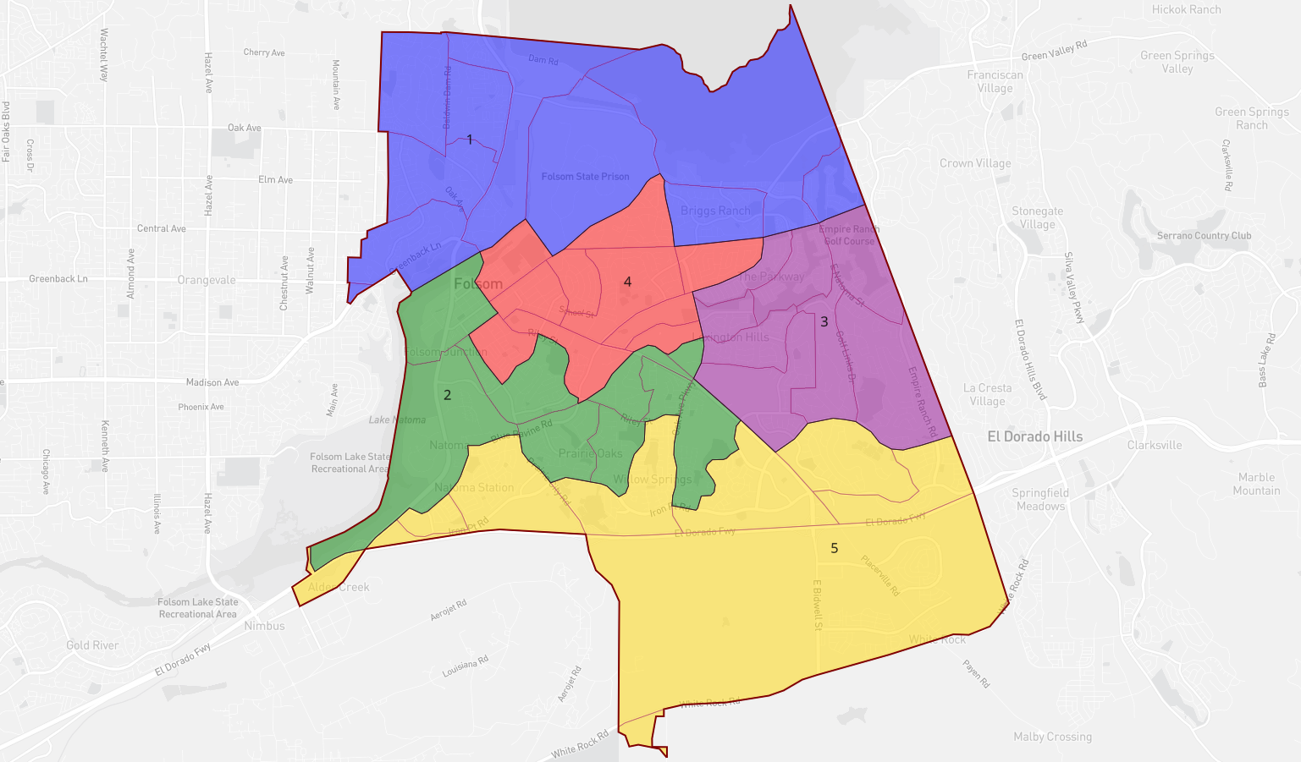
Gorton Submission

Slide 19
The 10.41% population deviation is greater than the 10% threshold tolerated by the courts.
Population |  | Shapes |  | Partisan Lean |  |  | Demographics (CVAP)DOWNLOAD
ID | Total | +/- |  |  | Dem | Rep | Oth | Total | White | Minority | Hispanic | Black | Asian | Native | Pacific
Un | 0 |  |  |  | 0.00% | 0.00% | 0.00% |  | 0.00% | 0.00% | 0.00% | 0.00% | 0.00% | 0.00% | 0.00%
1 | 15,450 | 2.95% |  |  | % | % | % |  | 63.80% | 36.20% | 13.78% | 12.80% | 7.87% | 1.40% | 0.44%
2 | 15,050 | 0.28% |  |  | % | % | % |  | 70.07% | 29.93% | 9.57% | 1.71% | 15.86% | 1.08% | 1.05%
3 | 15,524 | 3.44% |  |  | % | % | % |  | 70.17% | 29.83% | 8.66% | 0.87% | 19.71% | 0.38% | 0.00%
4 | 15,053 | 0.30% |  |  | % | % | % |  | 77.15% | 22.85% | 11.02% | 1.58% | 7.36% | 2.27% | 0.56%
5 | 13,961 | -6.98% |  |  | % | % | % |  | 68.46% | 31.54% | 8.90% | 2.00% | 18.75% | 1.09% | 0.61%
 | 15,008 | 10.41% |  |  | % | % | % |  | 69.37% | 30.63% | 10.86% | 4.90% | 12.88% | 1.29% | 0.52%
Gorton Statistics

Slide 20
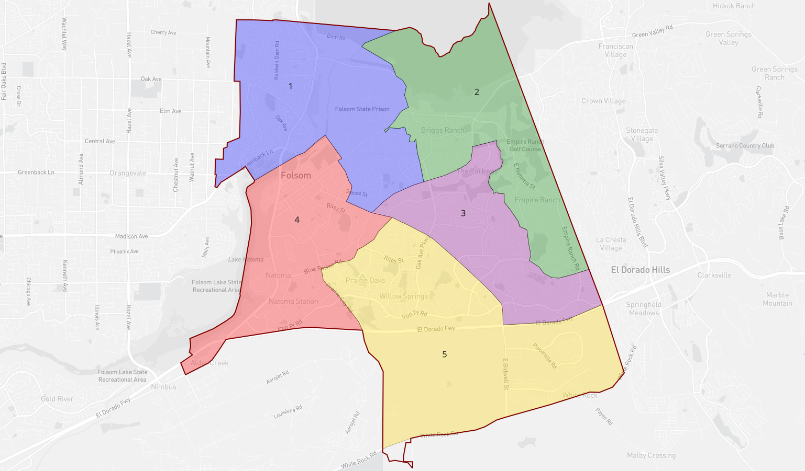
Efros Submission

Slide 21
The 3.72% population deviation is within the 10% threshold tolerated by the courts.
Based on School attendance areas
Population |  | Shapes |  | Partisan Lean |  |  | Demographics (CVAP)DOWNLOAD
ID | Total | +/- |  |  | Dem | Rep | Oth | Total | White | Minority | Hispanic | Black | Asian | Native | Pacific
Un | 0 |  |  |  | 0.00% | 0.00% | 0.00% |  | 0.00% | 0.00% | 0.00% | 0.00% | 0.00% | 0.00% | 0.00%
1 | 15,212 | 1.36% |  |  | % | % | % |  | 66.77% | 33.23% | 13.93% | 12.51% | 4.73% | 1.81% | 0.42%
2 | 14,662 | -2.31% |  |  | % | % | % |  | 71.50% | 28.50% | 8.42% | 0.92% | 18.64% | 0.34% | 0.00%
3 | 15,151 | 0.95% |  |  | % | % | % |  | 68.58% | 31.42% | 9.33% | 1.23% | 18.69% | 1.84% | 0.00%
4 | 14,792 | -1.44% |  |  | % | % | % |  | 74.13% | 25.87% | 10.60% | 2.08% | 11.43% | 1.03% | 0.60%
5 | 15,221 | 1.42% |  |  | % | % | % |  | 67.68% | 32.32% | 9.33% | 1.44% | 18.26% | 1.00% | 1.63%
 | 15,008 | 3.72% |  |  | % | % | % |  | 69.37% | 30.63% | 10.86% | 4.90% | 12.88% | 1.29% | 0.52%
Efros Statistics

Slide 22
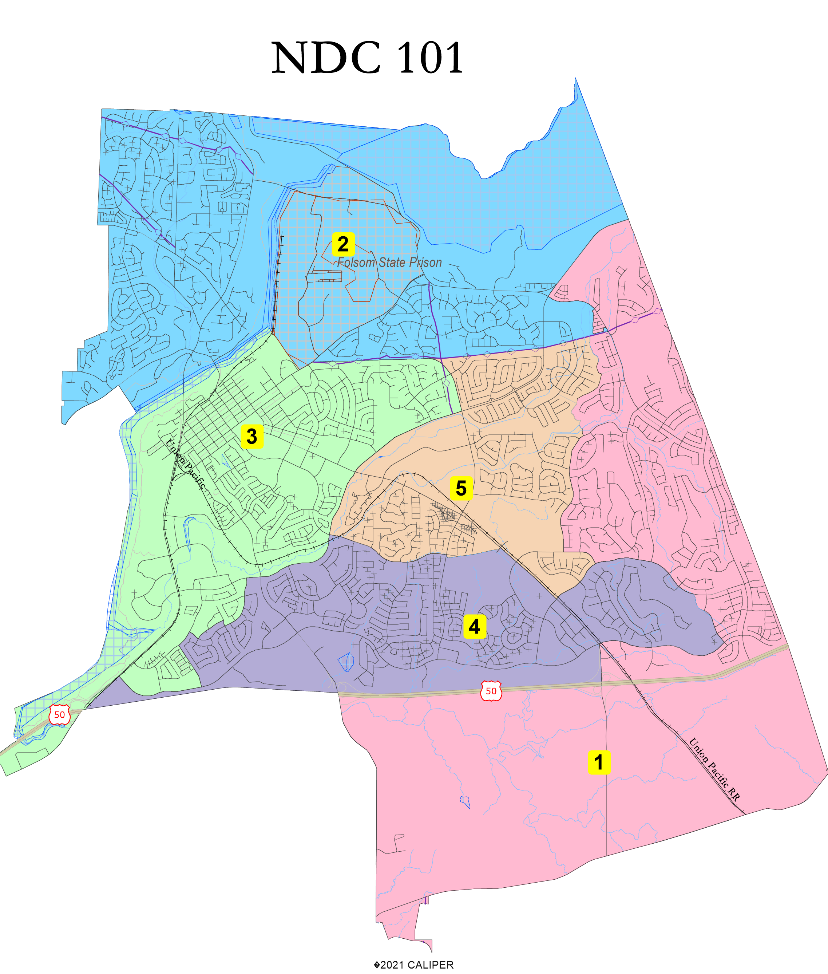

Slide 23
NDC Map 101 Statistics
District |  |  |  | 1 | 2 | 3 | 4 | 5 | Total
 |  | Total Pop |  | 14,704 | 14,747 | 15,368 | 15,273 | 14,946 | 75,038
 |  | Deviation from ideal |  | -304 | -261 | 360 | 265 | -62 | 664
 |  | % Deviation |  | -2.03% | -1.74% | 2.40% | 1.77% | -0.41% | 4.42%
Total Pop |  | % Hisp |  | 9.00% | 11% | 15% | 10% | 11% | 11%
 |  | % NH White |  | 50% | 72% | 61% | 51% | 60% | 59%
 |  | % NH Black |  | 2% | 2% | 2% | 2% | 2% | 2%
 |  | % Asian-American |  | 36% | 10% | 15% | 34% | 22% | 23%
Citizen Voting Age Pop |  | Total |  | 7,480 | 11,575 | 10,930 | 9,808 | 9,493 | 49,286
 |  | % Hisp |  | 8% | 11% | 10% | 10% | 9% | 10%
 |  | % NH White |  | 64% | 80% | 77% | 67% | 75% | 73%
 |  | % NH Black |  | 1% | 1% | 2% | 2% | 1% | 1%
 |  | % Asian/Pac.Isl. |  | 26% | 7% | 10% | 20% | 13% | 14%
NDC Map 101 Statistics

Slide 24
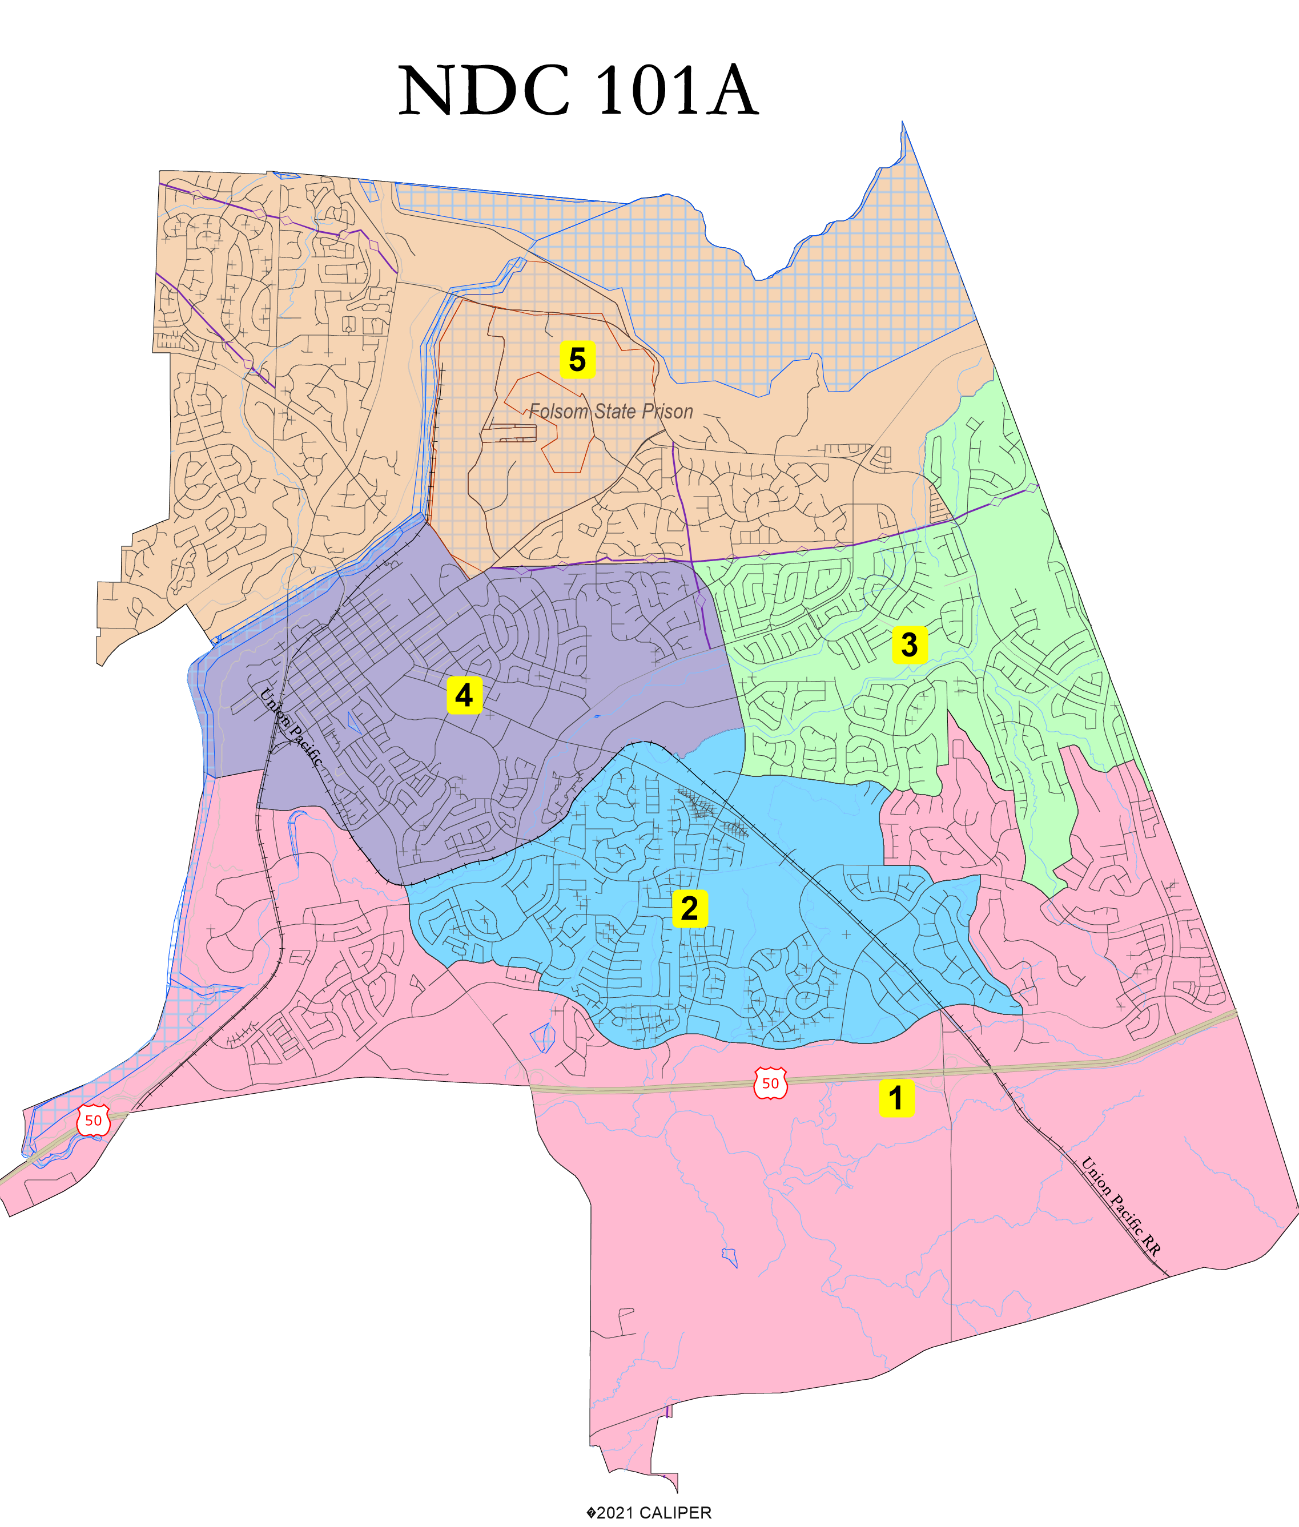

Slide 25
NDC Map 101A Statistics
District |  |  |  | 1 | 2 | 3 | 4 | 5 | Total
 |  | Total Pop |  | 14,556 | 14,668 | 15,388 | 15,125 | 15,301 | 75,038
 |  | Deviation from ideal |  | -452 | -340 | 380 | 117 | 293 | 832
 |  | % Deviation |  | -3.01% | -2.27% | 2.53% | 0.78% | 1.95% | 5.54%
Total Pop |  | % Hisp |  | 8.80% | 10% | 15% | 11% | 11% | 11%
 |  | % NH White |  | 47% | 54% | 61% | 60% | 71% | 59%
 |  | % NH Black |  | 2% | 2% | 3% | 2% | 2% | 2%
 |  | % Asian-American |  | 39% | 30% | 14% | 24% | 11% | 23%
Citizen Voting Age Pop |  | Total |  | 7,839 | 9,402 | 10,762 | 9,402 | 11,881 | 49,286
 |  | % Hisp |  | 11% | 10% | 9% | 7% | 11% | 10%
 |  | % NH White |  | 64% | 70% | 76% | 73% | 80% | 73%
 |  | % NH Black |  | 2% | 1% | 2% | 1% | 1% | 1%
 |  | % Asian/Pac.Isl. |  | 22% | 17% | 11% | 18% | 7% | 14%
NDC Map 101A Statistics

Slide 26
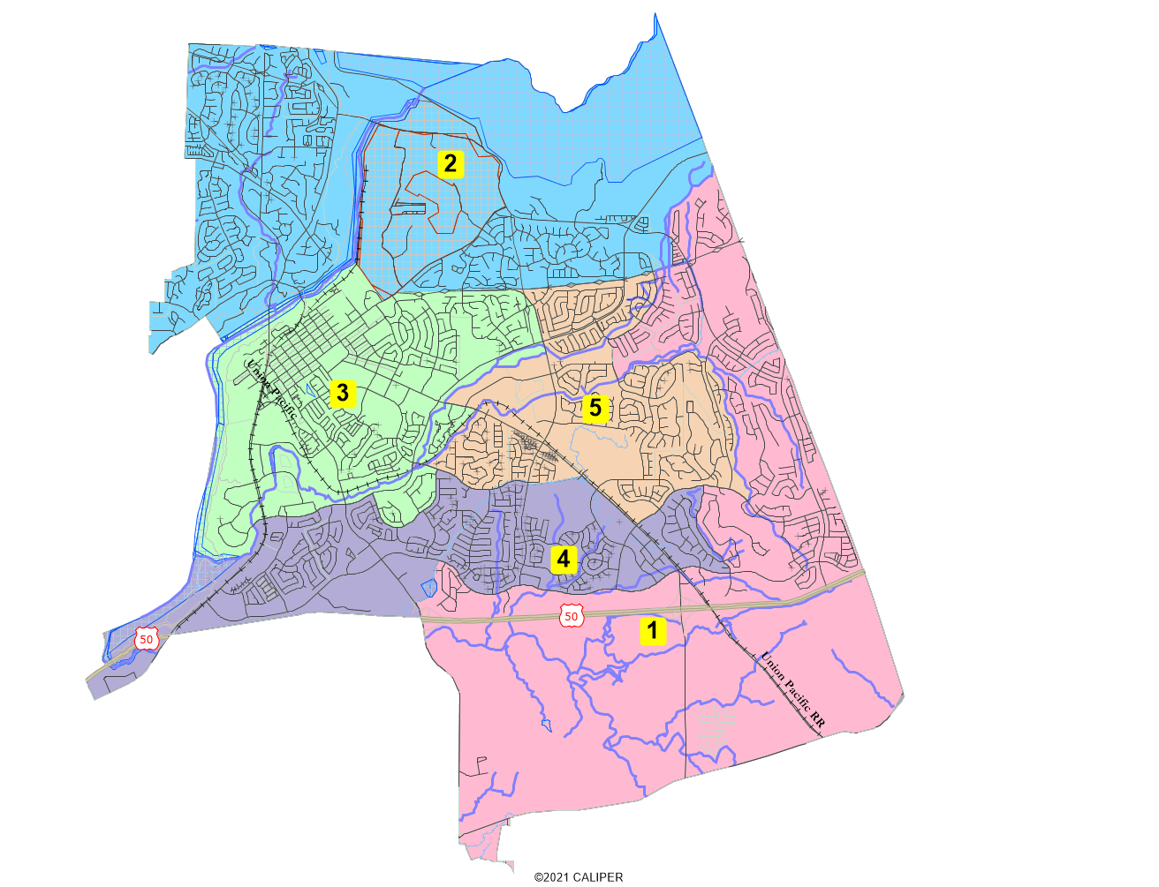
NDC Map 101B

Slide 27
NDC 101B Statistics
District |  |  |  | 1 | 2 | 3 | 4 | 5 | Total
 |  | Total Pop |  | 14,776 | 15,057 | 15,361 | 15,124 | 14,720 | 75,038
 |  | Deviation from ideal |  | -232 | 49 | 353 | 116 | -288 | 641
 |  | % Deviation |  | -1.55% | 0.33% | 2.35% | 0.77% | -1.92% | 4.27%
Total Pop |  | % Hisp |  | 8.70% | 11% | 15% | 10% | 11% | 11%
 |  | % NH White |  | 47% | 71% | 61% | 54% | 60% | 59%
 |  | % NH Black |  | 2% | 2% | 3% | 2% | 2% | 2%
 |  | % Asian-American |  | 39% | 11% | 15% | 30% | 22% | 23%
Citizen Voting Age Pop |  | Total |  | 7,486 | 11,737 | 10,730 | 9,961 | 9,371 | 49,286
 |  | % Hisp |  | 5% | 11% | 9% | 11% | 11% | 10%
 |  | % NH White |  | 63% | 80% | 76% | 70% | 74% | 73%
 |  | % NH Black |  | 1% | 1% | 1% | 3% | 1% | 1%
 |  | % Asian/Pac.Isl. |  | 30% | 7% | 11% | 15% | 12% | 14%
NDC 101B Statistics

Slide 28
Your own mapping software?
Feel free to submit using your own mapping software:
A GIS Shapefile and/or a Census Block equivalency file (w/2020 Census Blocks);
A description of the choices and key points of your map; and,
Send to the City of Folsom districting email address

Slide 29
Folsom Districting InformationWebsite: https://www.folsom.ca.us/government/city-clerk-s-office/by-district-elections-overview Phone Number: 916-461-6025 Email comments: attydept@folsom.ca.us

