Slide 1
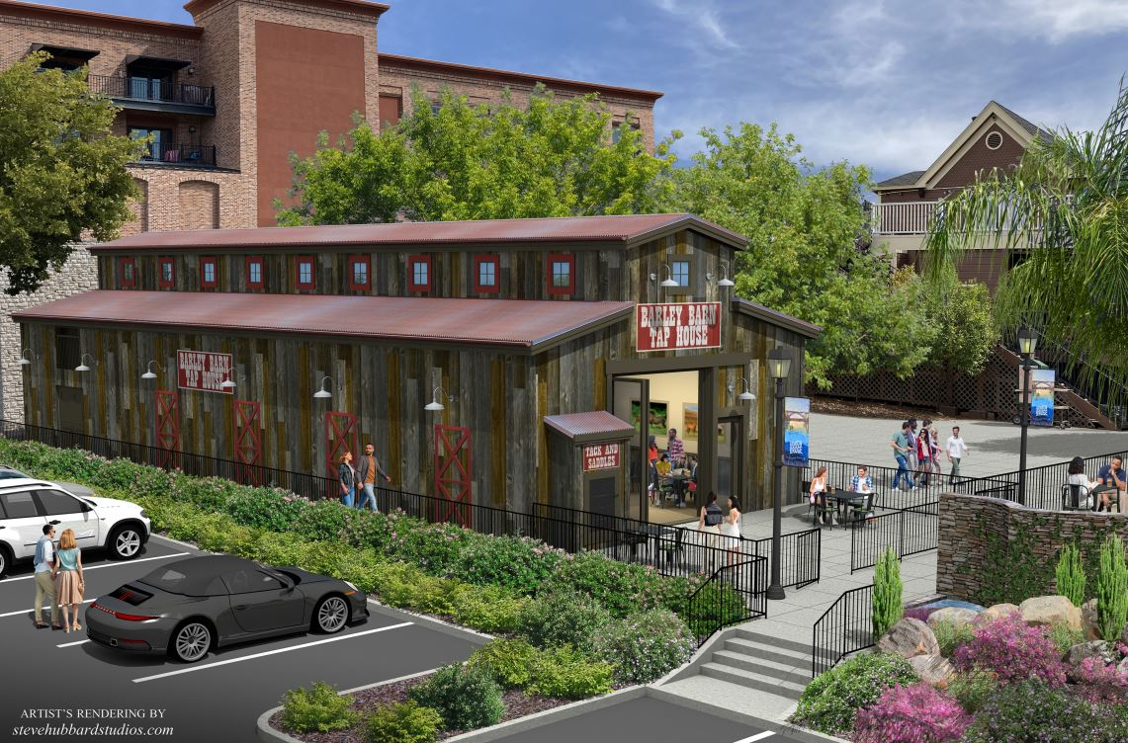
Barley Barn Tap House Appeals
Barley Barn Tap House
Appeals of Historic District Commission Decision Approving Barley Barn Tap House Project (PN 19-174)

Slide 2
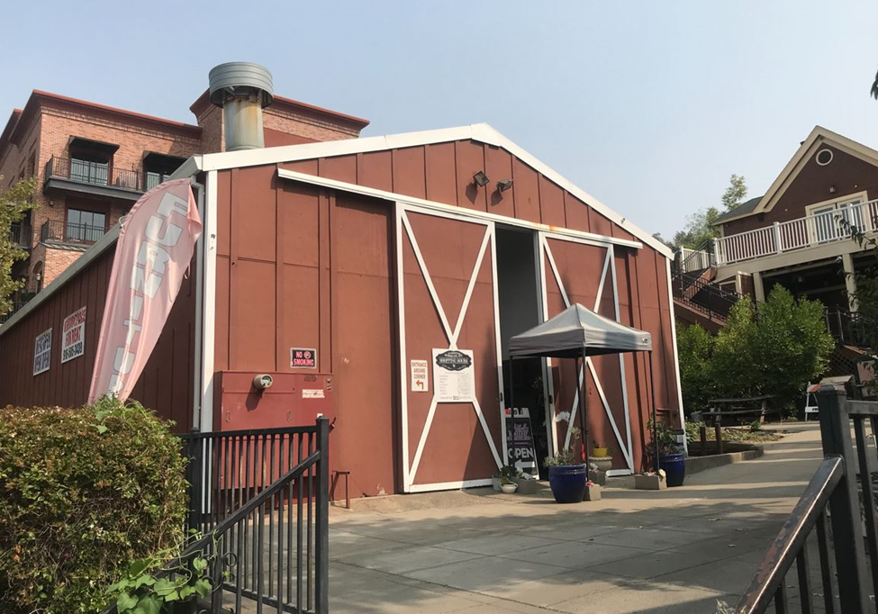
Project Background
4,377-Square-Foot Commercial Building Constructed in 1958
Constructed of Vertical Wood Slats (Painted Red)
Large Sliding Farm-Style Doors
Corrugated Metal Roof
Existing Building Not Considered Historically Significant
Existing Building Not on City’s Cultural Resource Inventory List

Slide 3
Key Project Details
Conditional Use Permit
Operation of Craft Beer Establishment within Existing Commercial Building
Serve Craft Beers and Food (Off-Site Vendors)
Live Entertainment on Limited Basis
Proposed Hours of Operation
Sunday to Wednesday: 11:00 a.m. to 10:00 p.m.
Thursday to Saturday: 11:00 a.m. to 12:30 a.m.
Design Review
Exterior/Interior Modifications to Existing Building
Rural Barn Design Theme
Building Materials (Reclaimed Wood Siding, Wood-Framed Windows, Glass Entry Doors)
Building Colors (Rustic Brown with Reddish-Gray Roof)
Interior Remodeling/Demolition (Seating Area, Bar Area, Cooler Room, Restrooms)
Second-Floor Reduced from 1,944 SF to 1,366 SF (Storage Area)
Overall Building Reduced from 4,377 SF to 3,799 SF
Site Improvements/Other Details
480 SF Outdoor Patio (Fenced with Two Access Gates)
Maintain Existing Private Walkway Between Sutter Street and Parking Lot
Parking Agreement for 15 Off-Site Parking Spaces (Eagles Lodge Site)

Slide 4
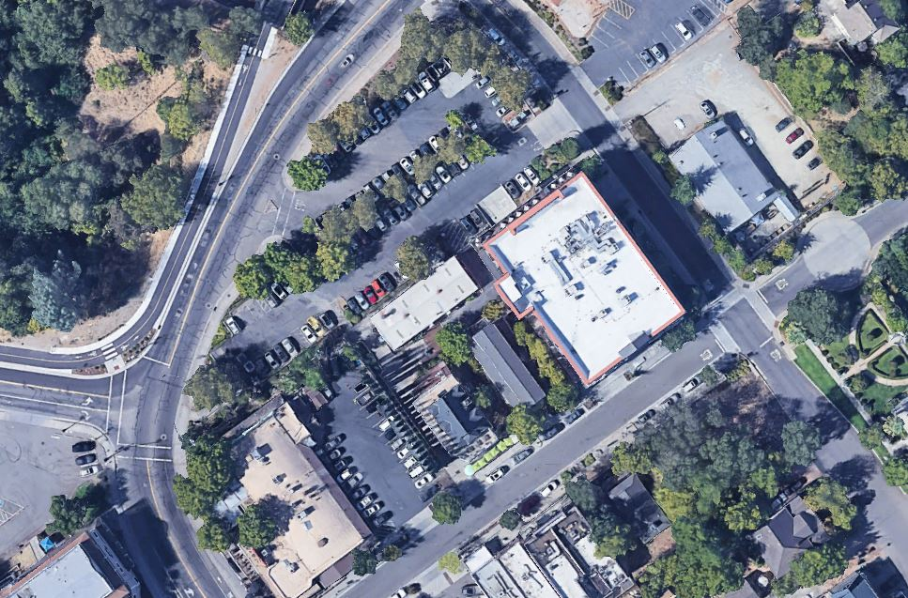
Aerial View of Project Site
Off-Site Parking
Site

Slide 5
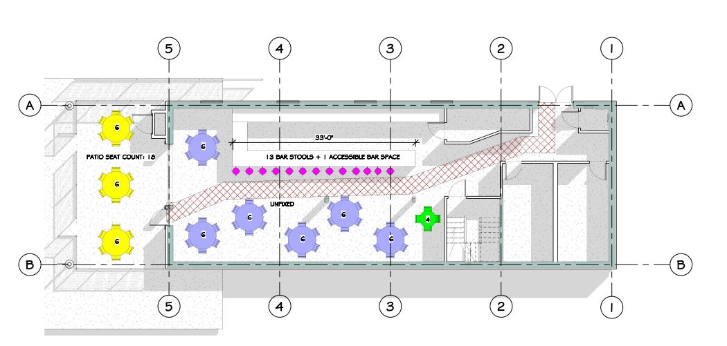
Site Plan and Building Layout

Slide 6
Building Renderings

Slide 7
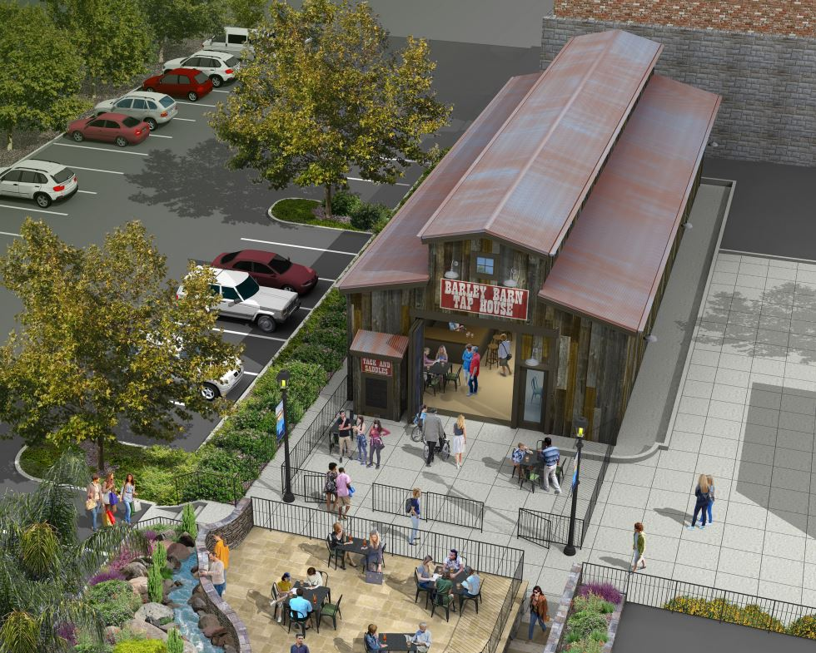
Building Renderings

Slide 8
Historic District Commission
Barley Barn Tap House Project Reviewed by Historic District
Commission at its November 18, 2021 Meeting
Significant Public Testimony
12 Individuals Spoke Expressing Concern Regarding Project
3 Individuals Spoke in Support of Project
Commission Discussion and Debate
Potential Parking Impacts
Potential Noise Impacts
Use of CEQA Exemption
Commission Action
Voted to Approve the Conditional Use Permit (4-1-2-0)
Voted to Approved Design Review (5-0-2-0)

Slide 9
Appeals of HDC Actions
City Received Three Timely Appeals of the Historic District
Commission Decisions Approving the Barley Barn Tap House Project
Appeal by Bob Delp
Appeal by Folsom Railroad Block Developer
Appeal by Historic Folsom Residents Association

Slide 10
Appeal No. 1
Bob Delp Appeal
Insufficient Information and Analysis Provided to Commission
Concern with Interpretations of Folsom Municipal Code
Project Should be Required to Provide On-Site Parking
Actual Parking Demand was not Assessed
Project does not Identify ADA Parking Spaces
Project Traffic Volumes and Impacts were not Assessed
Use of Eagles Lodge Parking Lot Spaces not Fully Vetted
Use of Eagles Lodge Parking Lot is Expansion of Use
Project does not Qualify for CEQA Exemption due to Change in Use
Project’s Economic Benefits not Provided for Public Review

Slide 11
Appeal No. 2
Folsom Railroad Block Developer Appeal
Parking Analysis and Conclusions Insufficient
Previous Parking Studies Should Have Been Provided to Commission
Historic District has Reached Saturation Point in Terms of Parking Supply
and Parking Demand

Slide 12
Appeal No. 3
Historic Folsom Residents Association
Project would be Detrimental and Injurious to Residents and Nearby Businesses Based on Parking Impacts
Historic District Commission Prevented from Fully Evaluating the Project Because Copies of the 2008, 2014, and 2018 Historic District Parking Studies were not Provided to the Commission at their November 18, 2021 meeting
City Relied on Past Practices in Evaluating the Conditional Use Permit and Specific Examples of Past Practices were not Provided to the Commission

Slide 13
Project Analysis (Parking)
Parking
No Existing On-Site Parking Spaces/No Opportunities for On-Site Parking
Existing Parking Options
Adjacent Historic District Public Parking Lot (72 Spaces)
Powerhouse Pub Private Parking Lot (21 Spaces)
Folsom Electric Building Public Parking Garage (51 Spaces)
Sutter Street/Zone 1 On-Street Public Parking Spaces (51 Spaces)
Proposed Off-Site Parking Agreement (15 spaces)
Eagles Lodge Only Open to Members (Tue-Wed-Fri 5:30 to 8:30 p.m.)
Special Events 1-2 times per month (Turkey Drive, etc.)
Parking Lot Typically Less then 25% Utilized
Parking Requirements
City Practice Regarding Projects that do not Result in Increase in in Density
City Policy Regarding New Development Projects
Project Would Require 11 Parking Spaces Based on Existing Parking Regulations
Project Parking Demand
Project Has Potential to Require more Parking Spaces than Existing Retail Use
Parking Lease Agreement (15 spaces at Eagles Lodge Site)
Complimentary Shuttle Service for Customers (Sutter Surfer)

Slide 14
Parking Exhibit
15
72
51
Site
51
21

Slide 15
Historic District Parking Studies
Historic District Parking Studies (Kimley-Horn)
January 16, 2009
January 17, 2014
October 18, 2018
General Conclusions
Currently Sufficient Parking Available in the Historic District
Weekday Peak Hour Combined Occupancy of 60%
Weekend Peak Hour Combined Occupancy of 59%
Parking Availability More Limited in 600 Block of Sutter Street (Zone 1)
Potential for Parking Saturation in Historic District in Future
Assumptions Made for Parking Studies may no Longer be Accurate
Full Development of the Historic Folsom Station Project has not Occurred
Rate of Development Activity and Growth has Changed (Covid 19)
Historic District Parking Solutions Ad Hoc Parking Committee
Parking Solutions being Implemented (Residential Parking Permits, Way Finding
Program, Etc.)

Slide 16
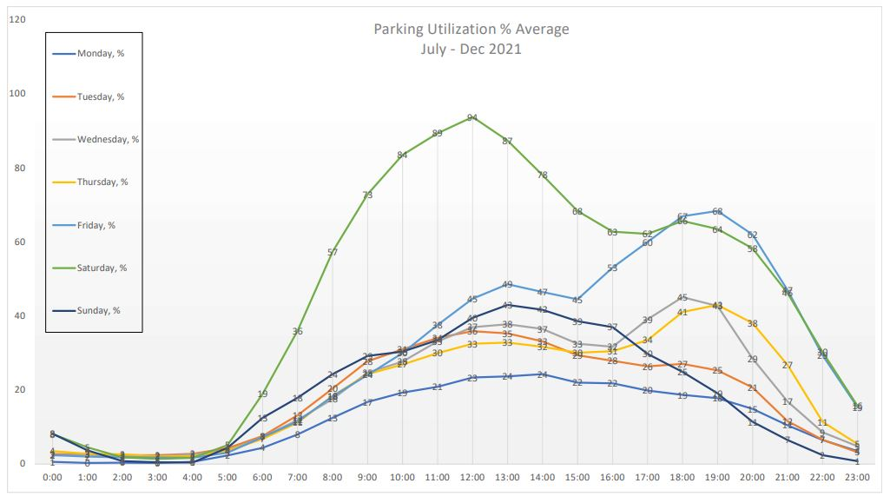
Parking Garage Utilization

Slide 17
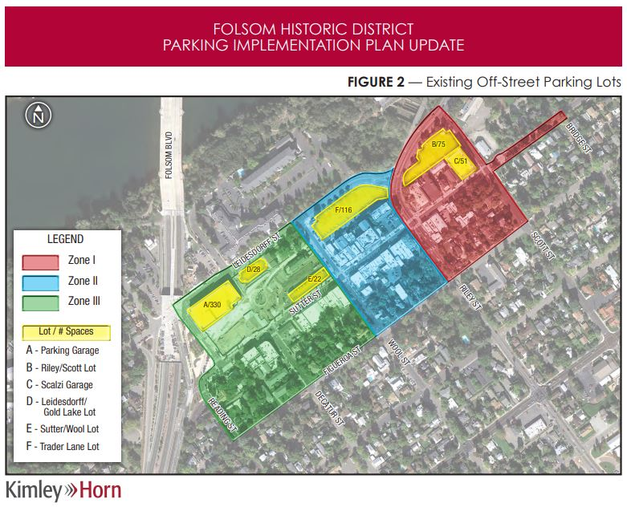
Historic District Parking Zones

Slide 18
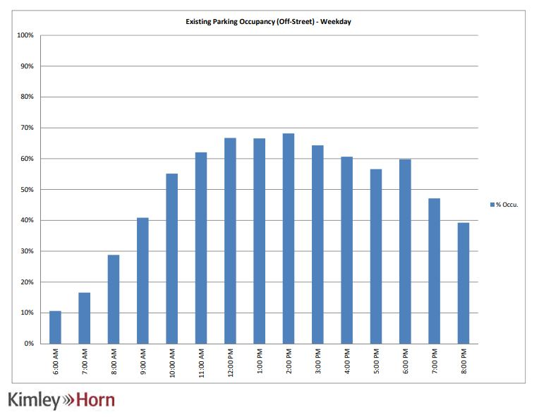
Parking Availability (Weekday)

Slide 19
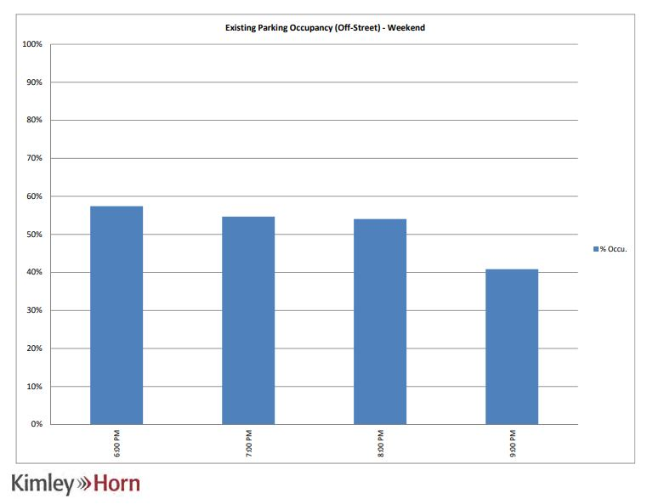
Parking Availability (Weekend)

Slide 20
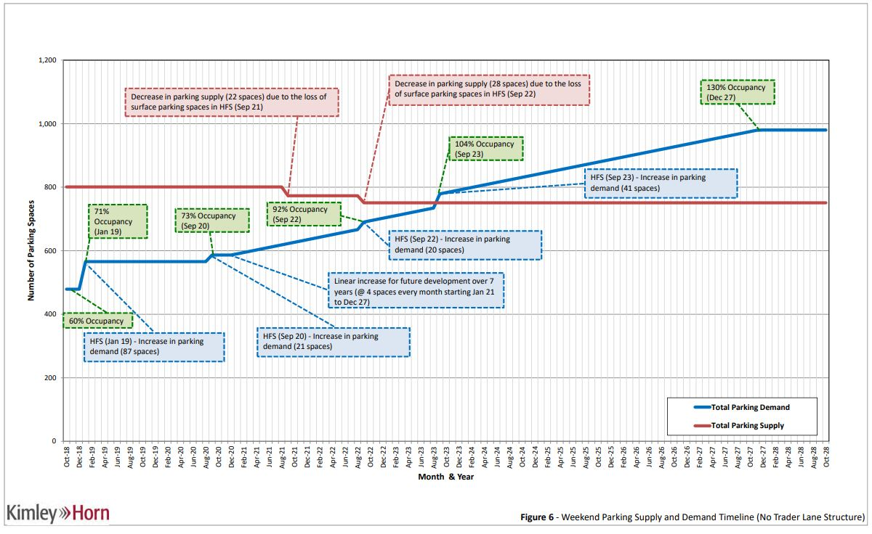
Parking Supply/Demand Timeline

Slide 21
Project Analysis (Use and Noise)
Noise
Construction-Related Noise Impacts
Operation-Related Noise Impacts
Indoor/Outdoor Noise Sources
Live Entertainment
Proposed Hours of Operation
Sunday to Wednesday: 11:00 a.m. to 10:00 p.m.
Thursday to Saturday: 11:00 a.m. to 12:30 a.m.
Business Closing Time Comparison Table

Slide 22
Project Analysis (Use and Noise)
Operation and Noise-Related Recommendations
Hours of Operation are Consistent with Similar Businesses on Sutter Street
Posting of Occupancy Required
No Intensification of Expansion of Use
Compliance with All Applicable State ABC Laws and Ordinances
Entertainment Permit Required (No Outdoor Entertainment Permitted)
Compliance with City’s Noise Control Ordinance
No Outdoor Speakers, Music, Televisions, or Screens
Doors must be Closed when Interior Music being Played
No Dancing is Permitted

Slide 23
Conclusion
Project is Consistent with City Practice Regarding Parking Requirements for Use of
Existing Buildings, Consistent with Parking Requirements of the Folsom Municipal
Code, and is Providing 15 Parking Spaces in Close Proximity to Project Site
Adequate Parking (Public and Private) is Currently Available in the Historic District
to Accommodate the Project
Existing Facilities will Adequately Accommodate Pedestrian Circulation
Use and Noise Impacts will not be Significant due to Noise Mitigation Measures
Placed on the Project, Similar to Measures Placed on other Like Projects in Area
Design of Building is Consistent with Historic District Design and Development
Guidelines and Compatible with Existing Building in the Area
Project is Categorically Exempt from CEQA (Section 15303)

Slide 24
Staff Recommendation
Staff Respectfully Requests
that the City Council Deny the Three Appeals Approving a Conditional Use Permit and Design Review for the Barley Barn Tap House Project and Determination that the Project is Exempt from CEQA

Slide 25
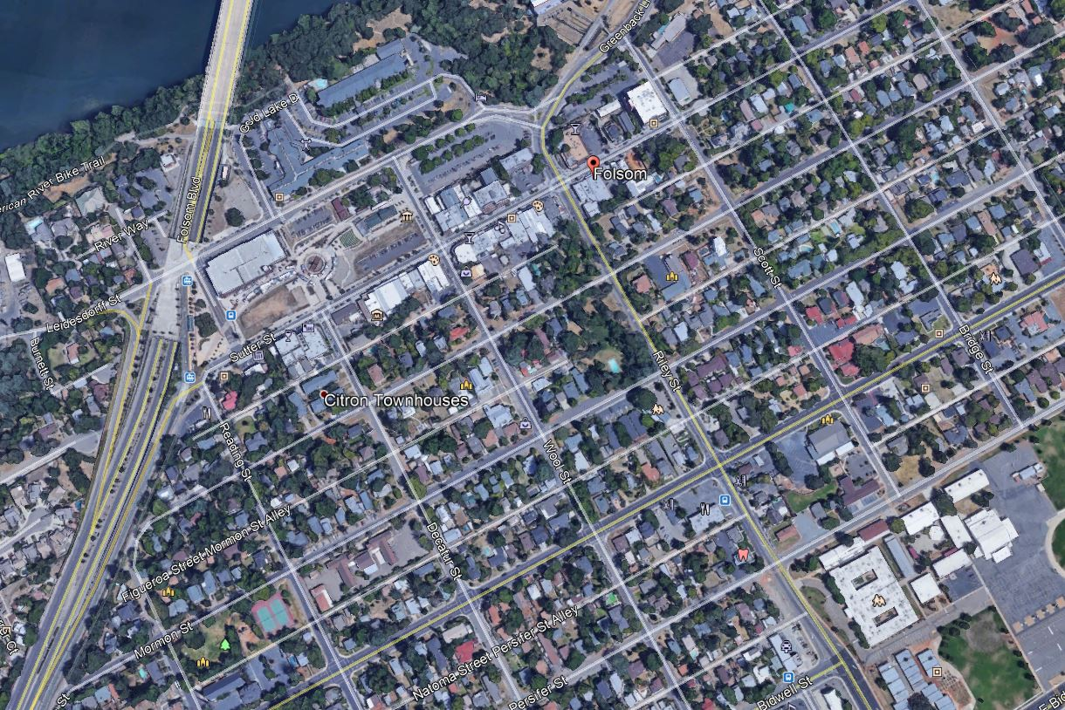
Vicinity Map
Site

Slide 26
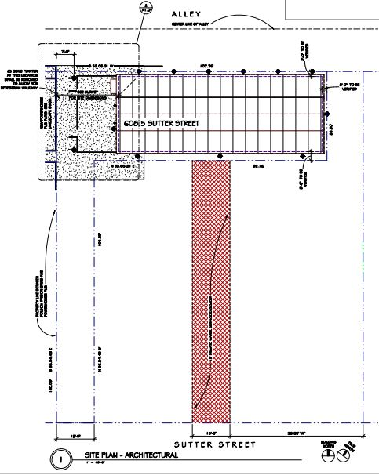
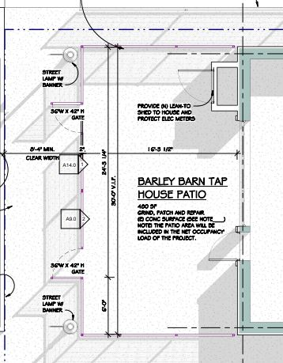
Proposed Site/Patio Plan

Slide 27
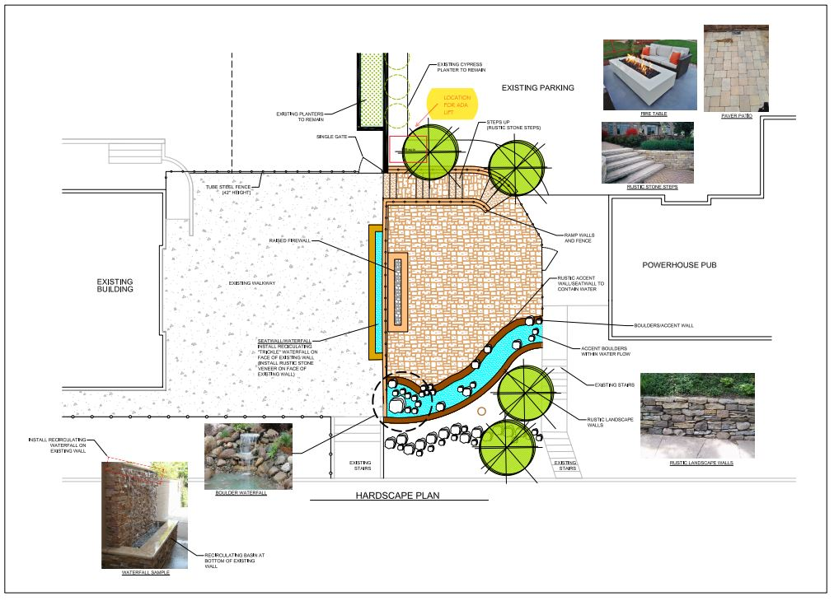
Off-Site Landscape Plan

Slide 28
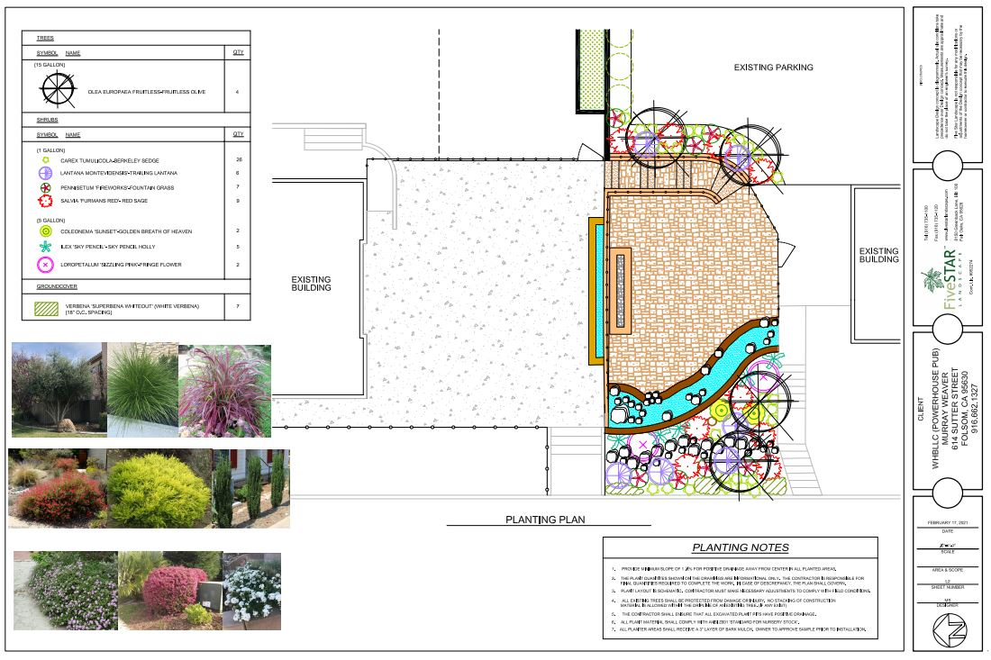
Off-Site Landscape Plan-2

Slide 29
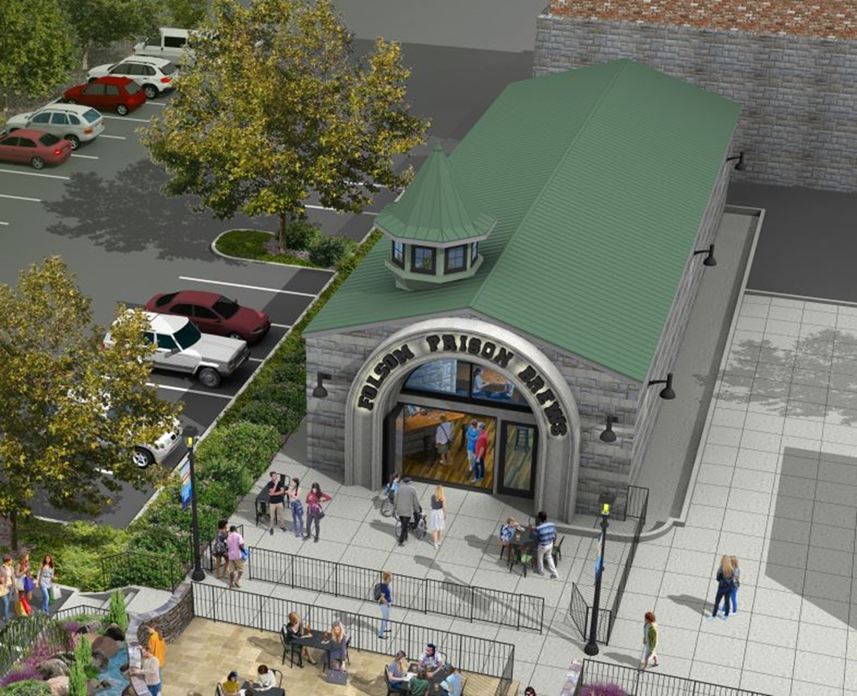
Project Background
August 4, 2020: Historic District Commission Reviews Folsom Prison Brews, Project Continued to Future Historic District Commission Meeting Due to Time Constraints.
Applicant Subsequently Modifies Project Business Plan and Building Design

Slide 30
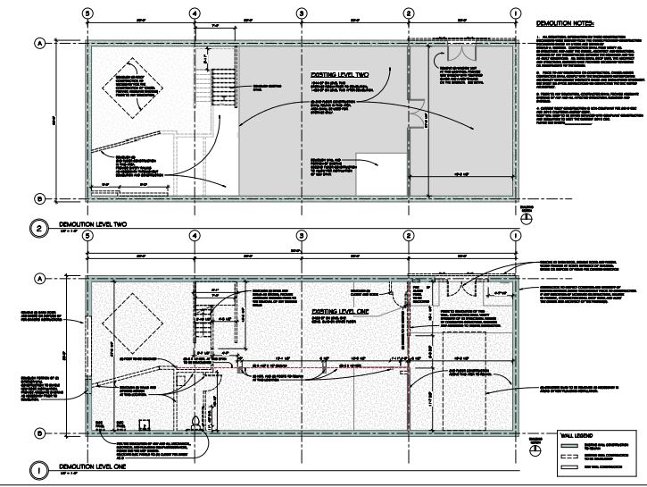
Existing Floor Plan

Slide 31
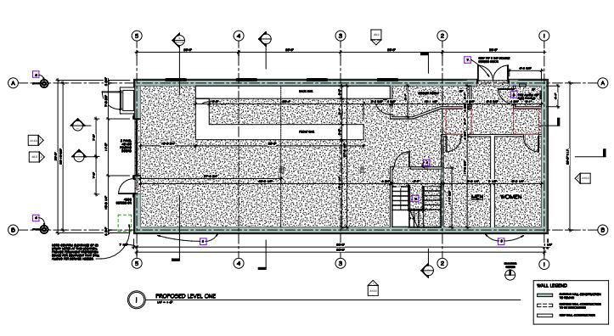
Proposed Floor Plan (Level-1)

Slide 32
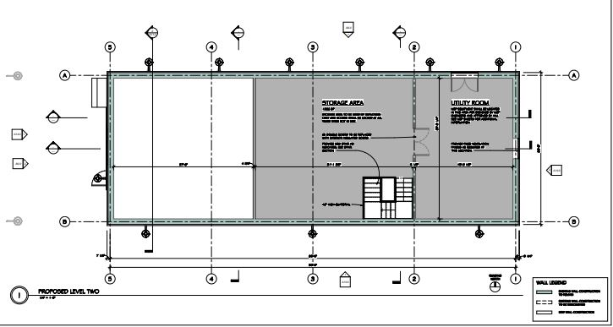
Proposed Floor Plan (Level-2)

Slide 33
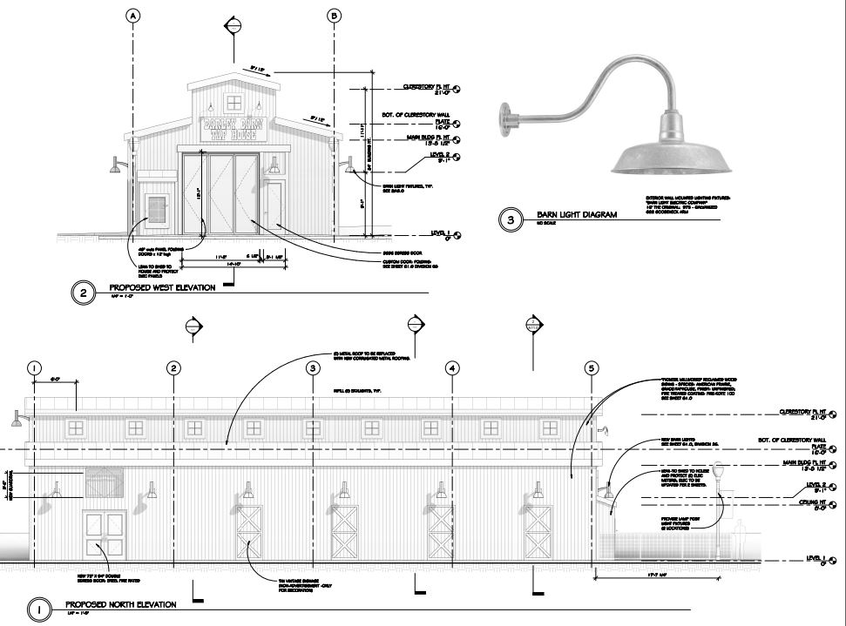
Building Elevations (West-North)

Slide 34
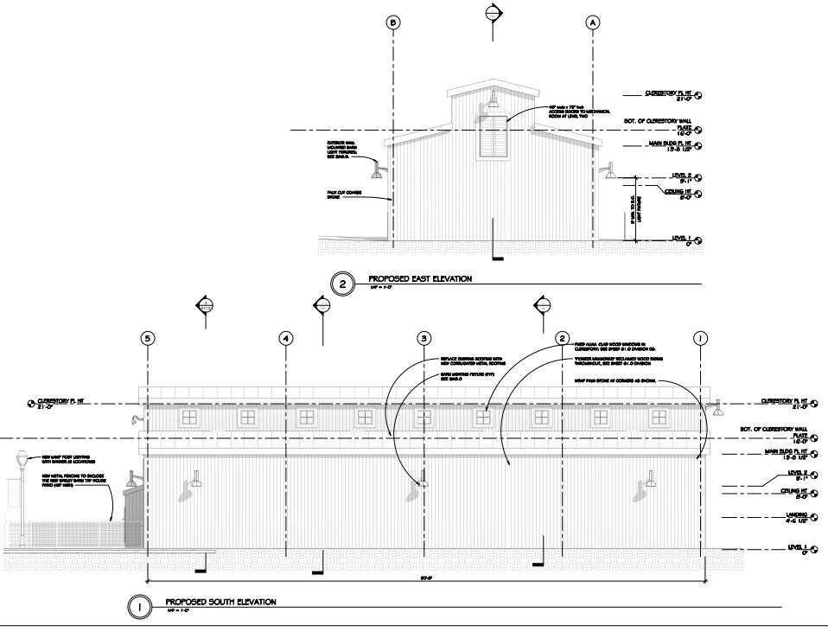
Building Elevations (East-South)

Slide 35
Project Analysis
Parking
Pedestrian Circulation
Noise
Fencing
Lighting
Trash/Recycling
Signage
Landscaping
Architecture/Design
Public Comment

Slide 36
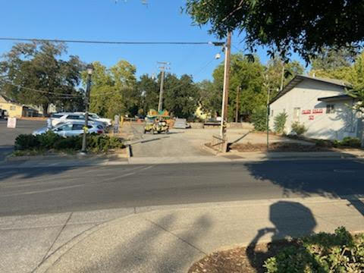
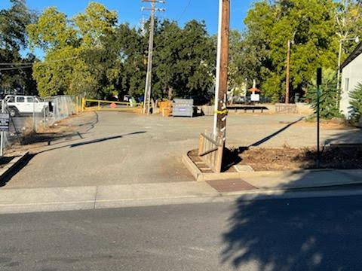
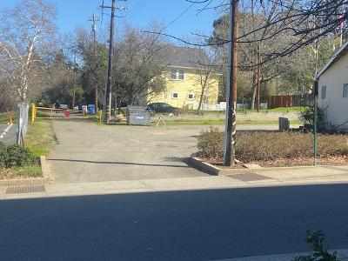
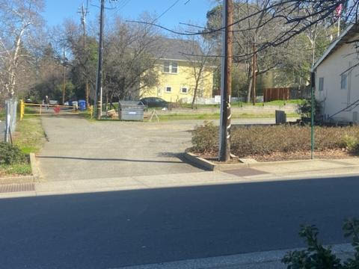
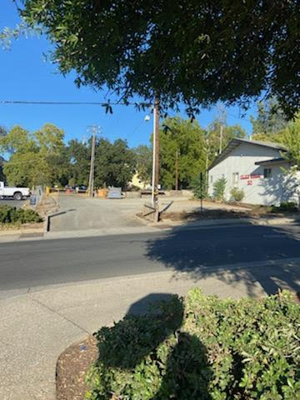
Eagles Lodge Parking Photos

Slide 37
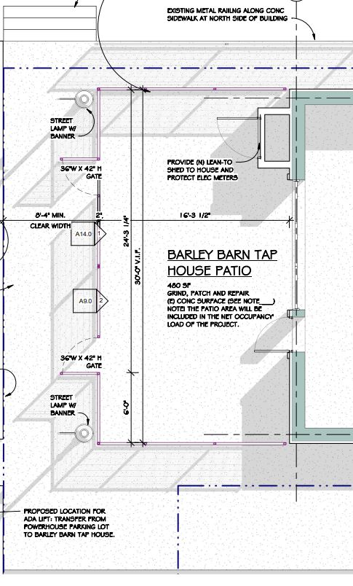
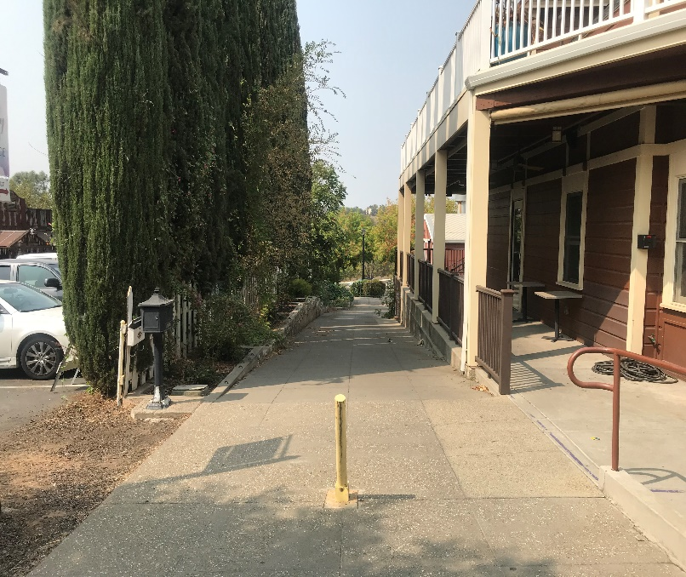
Project Analysis
Pedestrian Circulation
Access to Project Site Provided by Existing Public Sidewalks and Private
Pedestrian Pathways
Applicant Proposed to Maintain Private Pedestrian Walkway Between Sutter
Street and Historic District Parking Lot to the North

Slide 38
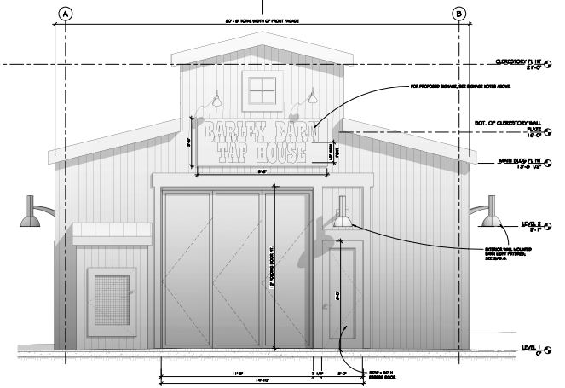
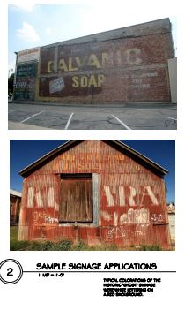
Project Analysis
Signage
Painted-On Wall Sign Proposed
Copy that Reads “Barley Barn Tap House” with 18-Inch-Tall Letters
White Letters on Red Background, Indirect Halo-Lighting
33 Square Feet of Sign Area (50 Square Feet Allowed)

Slide 39
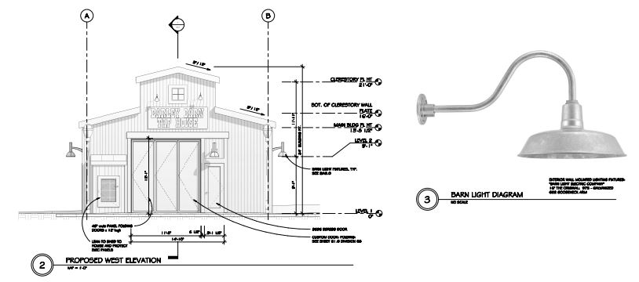
Project Analysis
Lighting
Combination of Pole-Mounted and Wall-Mounted Lighting (Gooseneck)

Slide 40
Project Analysis
Landscaping
Existing Landscape Planters will Remain
No New Landscaping Proposed
Applicant Required to Maintain Existing Landscaping
Trash/Recycling
Existing Trash/Recycling Dumpsters Located in Public Parking Lot
Applicant Proposed to Utilize Existing Trash/Recycling Enclosures
Sufficient Capacity to Serve Proposed Project
Fencing
42-Inch-Tall Metal View Fencing with Gates Proposed Around Patio Area

Slide 41
Project Analysis
Architecture/Design
Rural Design Theme Reminiscent of Historic California Barns
Architectural Features and Materials
Clerestory with Windows on Upper Portion of Building (Natural Light)
Custom Folding Entry Doors
Faux Stable Dutch Doors (Horse Stable)
Vintage Signage Panels
Vertical Reclaimed Wood Siding
Aluminum Clad Wood-Framed Windows and Doors
Galvanized Metal Gooseneck Light Fixtures
Corrugated Metal Roofing

Slide 42
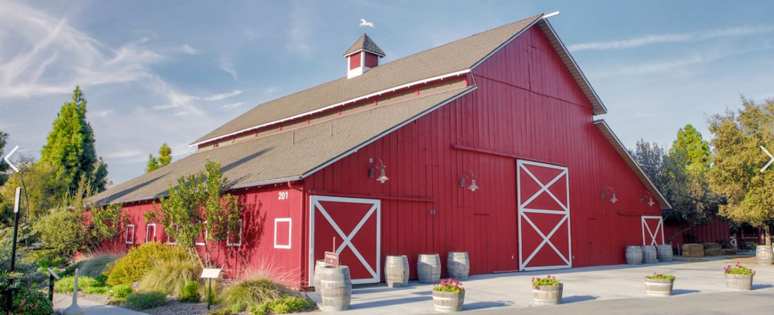
Camarillo Ranch House (1850’s)

Slide 43
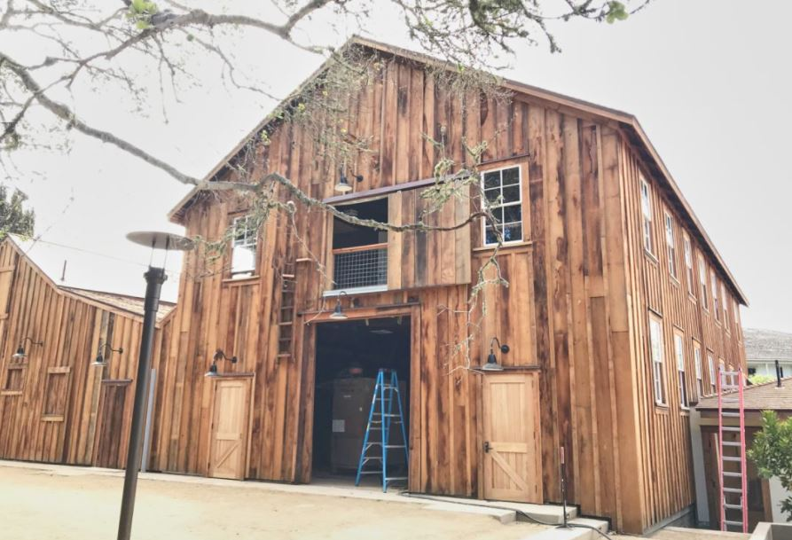
Cooper Molera Barn (1905)

Slide 44
Building Elevations (West-North)

Slide 45
Building Elevations (East-South)

Slide 46
Building Renderings

Slide 47
Building Renderings

Slide 48
Project Analysis
Folsom Municipal Code (FMC 17.52 Historic District)
The purpose and intent of Chapter 17.52 (Historic District) of the Folsom Municipal Code is to preserve and enhance the historic, small-town atmosphere of the historic district as it developed between the years 1850 and 1950; maintain, restore, and reconstruct historic structures and sites within the historic district; encourage an active business climate which promotes the development of a diverse range of businesses compatible with the historic district as it developed between the years 1850 and 1950; ensure that new residential and commercial development is consistent with the historical character of the historic district as it developed between the years 1850 and 1950; and increase the awareness, understanding, and appreciation of the history of the city
Historic District Design and Development Guidelines
Purpose and Intent is to limit new construction in the Historic District to architectural styles extant in California from 1850 to 1950, a limitation intended to encourage the diversity which is the charm of old Folsom while preventing construction of modern buildings which would be discordant. The overall concept is to maintain a traditional small town at the heart of a modern, developing City.

Slide 49
Project Analysis
Design Guidelines Goals and Policies
Goal 1 (Community Identity): Preserve and enhance the historic, small-town
atmosphere of the 98-block Historic District area
Policy 1.1
External design features, both public and private, shall be consistent with design of the time period from 1850 to 1950
Goal 2 (Preservation of Historic Sites): Maintain, restore, and reconstruct sites
which represent the history of the Folsom area
Policy 1.1
Facets of Folsom’s history which should be portrayed and interpreted within the Historic District include, but are not limited to: Railroading, Maidu encampment, Chinese settlement, Negro Bar mining, dredging, mine tunnels, Pony Express, water delivery, Powerhouse and related structures, Folsom Prison, and Rainbow Bridge

Slide 50
Project Analysis
Design Guidelines Goal of Any Remodeling Project
The property owner’s and community’s benefit
The structures architectural and cultural value
Project Benefits
Introduction of Unique Business Model (Craft Beer Establishment) to the Historic District
Allow Local Producers Opportunity to Exhibit and Sell their Products
Acknowledge and Recognize Folsom’s Ranching History (Broder Ranch-1878)
Existing Structure’s Architectural and Historic Value
Existing Building Not Considered Historically Significant
Existing Building Not on City’s Cultural Resource Inventory List
Proposed Rural Farmhouse Design Similar to Existing Building Design (1958)

Slide 51
Project Analysis
Design Guidelines Recommendations Relative to Architecture,
Building Materials, and Colors
Architectural Design Features
Project Maintains Existing Shapes and Forms (Clerestory Addition is Exception)
Distinct Architectural Features (Large Folding Entry Doors, Faux Stable Dutch Doors, Vintage Signage Panels, Gooseneck Light Fixtures, Lean-to-Shed)
Building Materials
Vertical Reclaimed Wood Siding (Common Historic Building Material)
Aluminum Clad Wood-Framed Windows and Doors
Corrugated Metal Roofing is a Historically Accepted Building Material
Building Colors
Rustic Brown Primary Building Color and is Historically Appropriate
Reddish-Gray is Secondary Building Color Utilized on the Roof and is Historically Appropriate Accent Color

Slide 52
Staff Design Recommendations
The Design of the Glass Front Entry Door on the West Building Elevation Shall be Modified to Reflect a More Historic Appearance by Limiting Glass to the Upper Half of the Door with the Bottom Half of the Door being a Solid Material to the Satisfaction of the Community Development Department.
The Owner/Applicant Shall Create an Aged Appearance by Adding Gray Tint to the Enclosed Concrete Patio Area, Coordinate the Wrought Iron Fencing Around the Outdoor Patio Area by Installing Fencing Panels Between Wood Posts, and Preserve to the Greatest Extent Possible the Decorative Wall Tile on the Retaining Wall Located along the Private Walkway and Incorporate these Walls Tiles at Another Location on the Project Site to the Satisfaction of the Community Development Department.

Slide 53
Public Comments
Letters/Emails Expressing Concerns with Project
Concern with Proposed Bar/Craft Brewery Use
Concern Regarding Parking Impacts
Concern Regarding Potential Noise and Nuisance Impacts
Concern Regarding Landscaping
Concern with Use of CEQA Exemption
Concern with Public Noticing
Concern that Traffic Safety Committee Did Not Review Project
Letters/Emails Supporting Project and Applicant
Supportive of the Design Concept
Supportive of the proposed Craft Beer Use

Slide 54
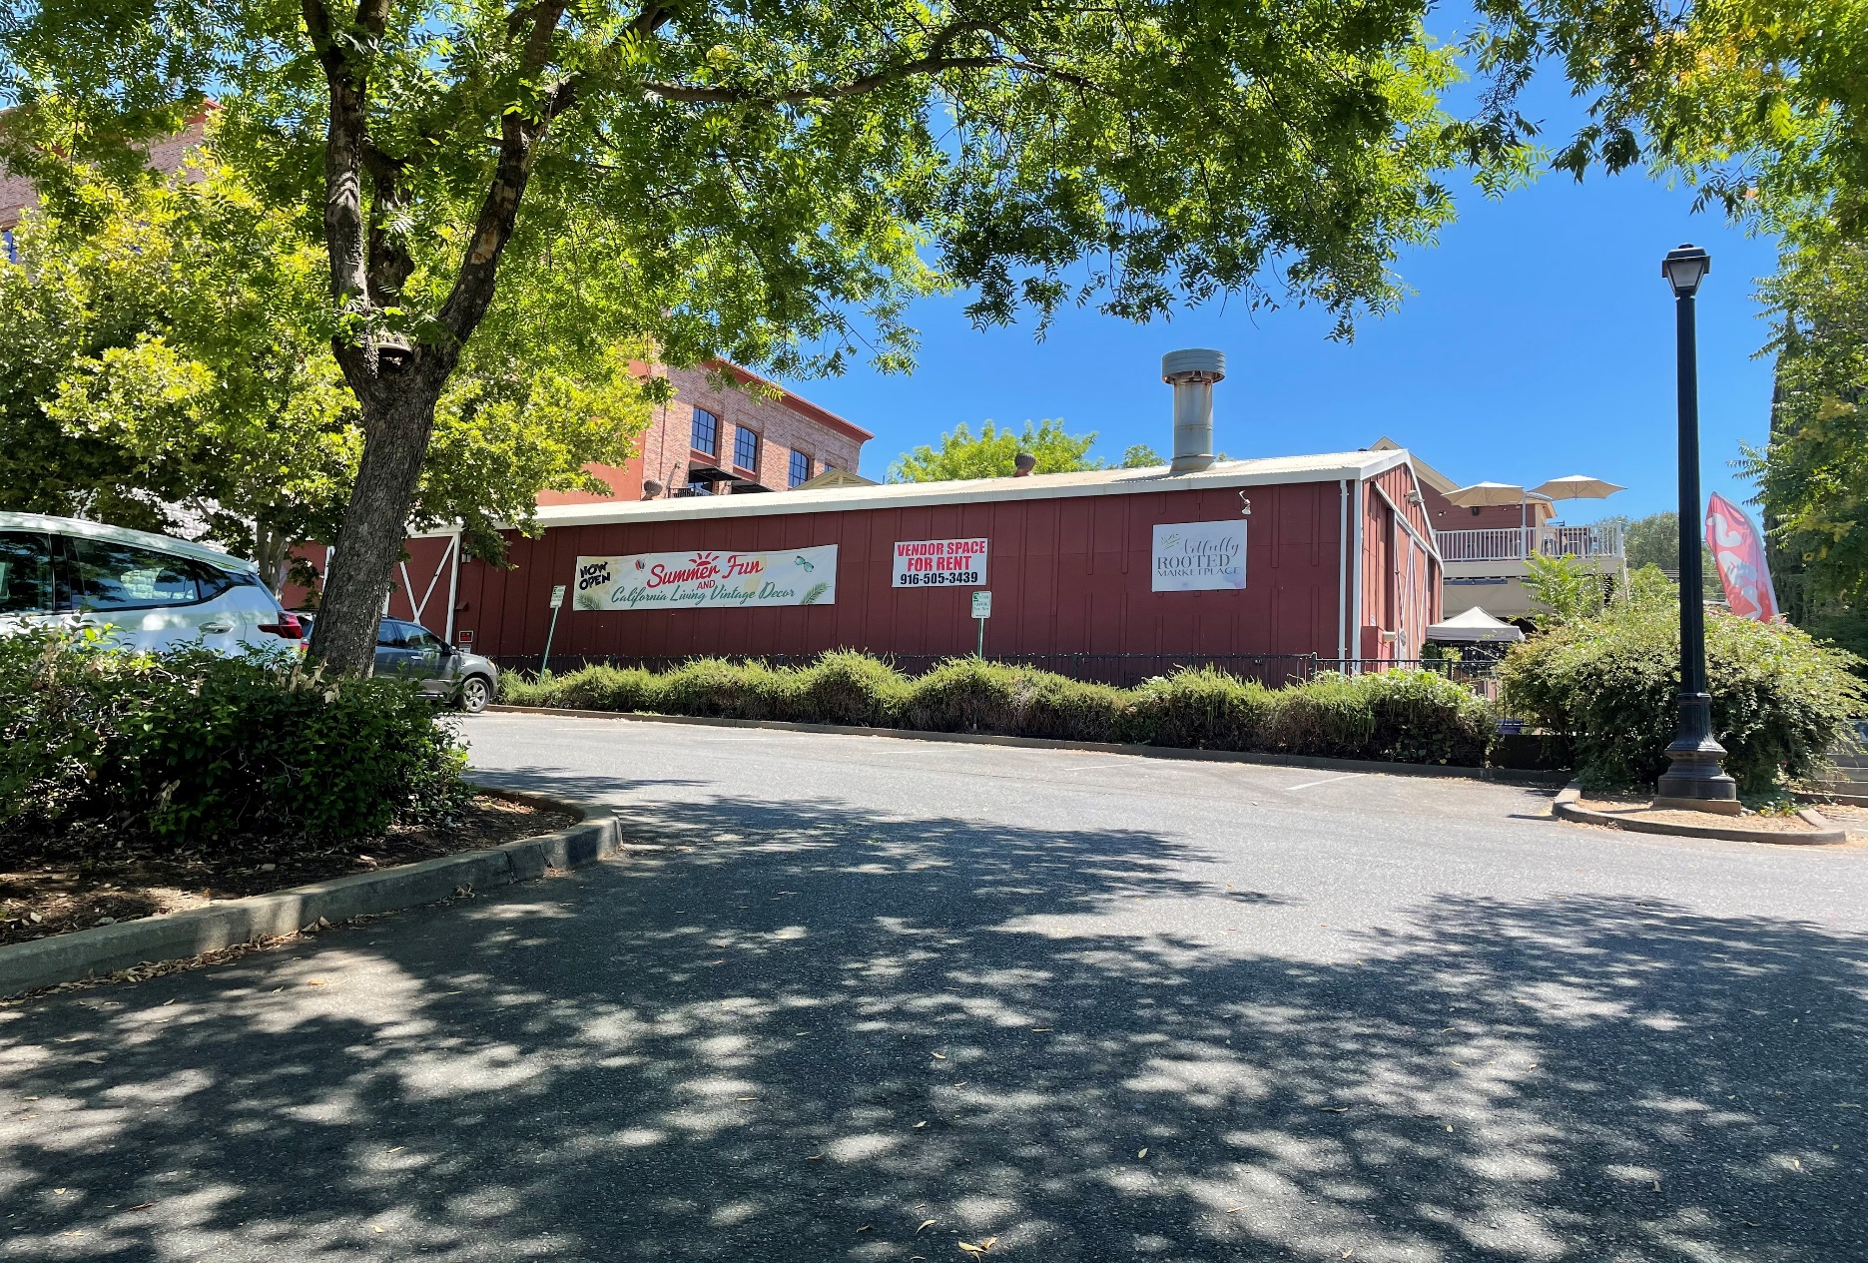
Site Photographs

Slide 55
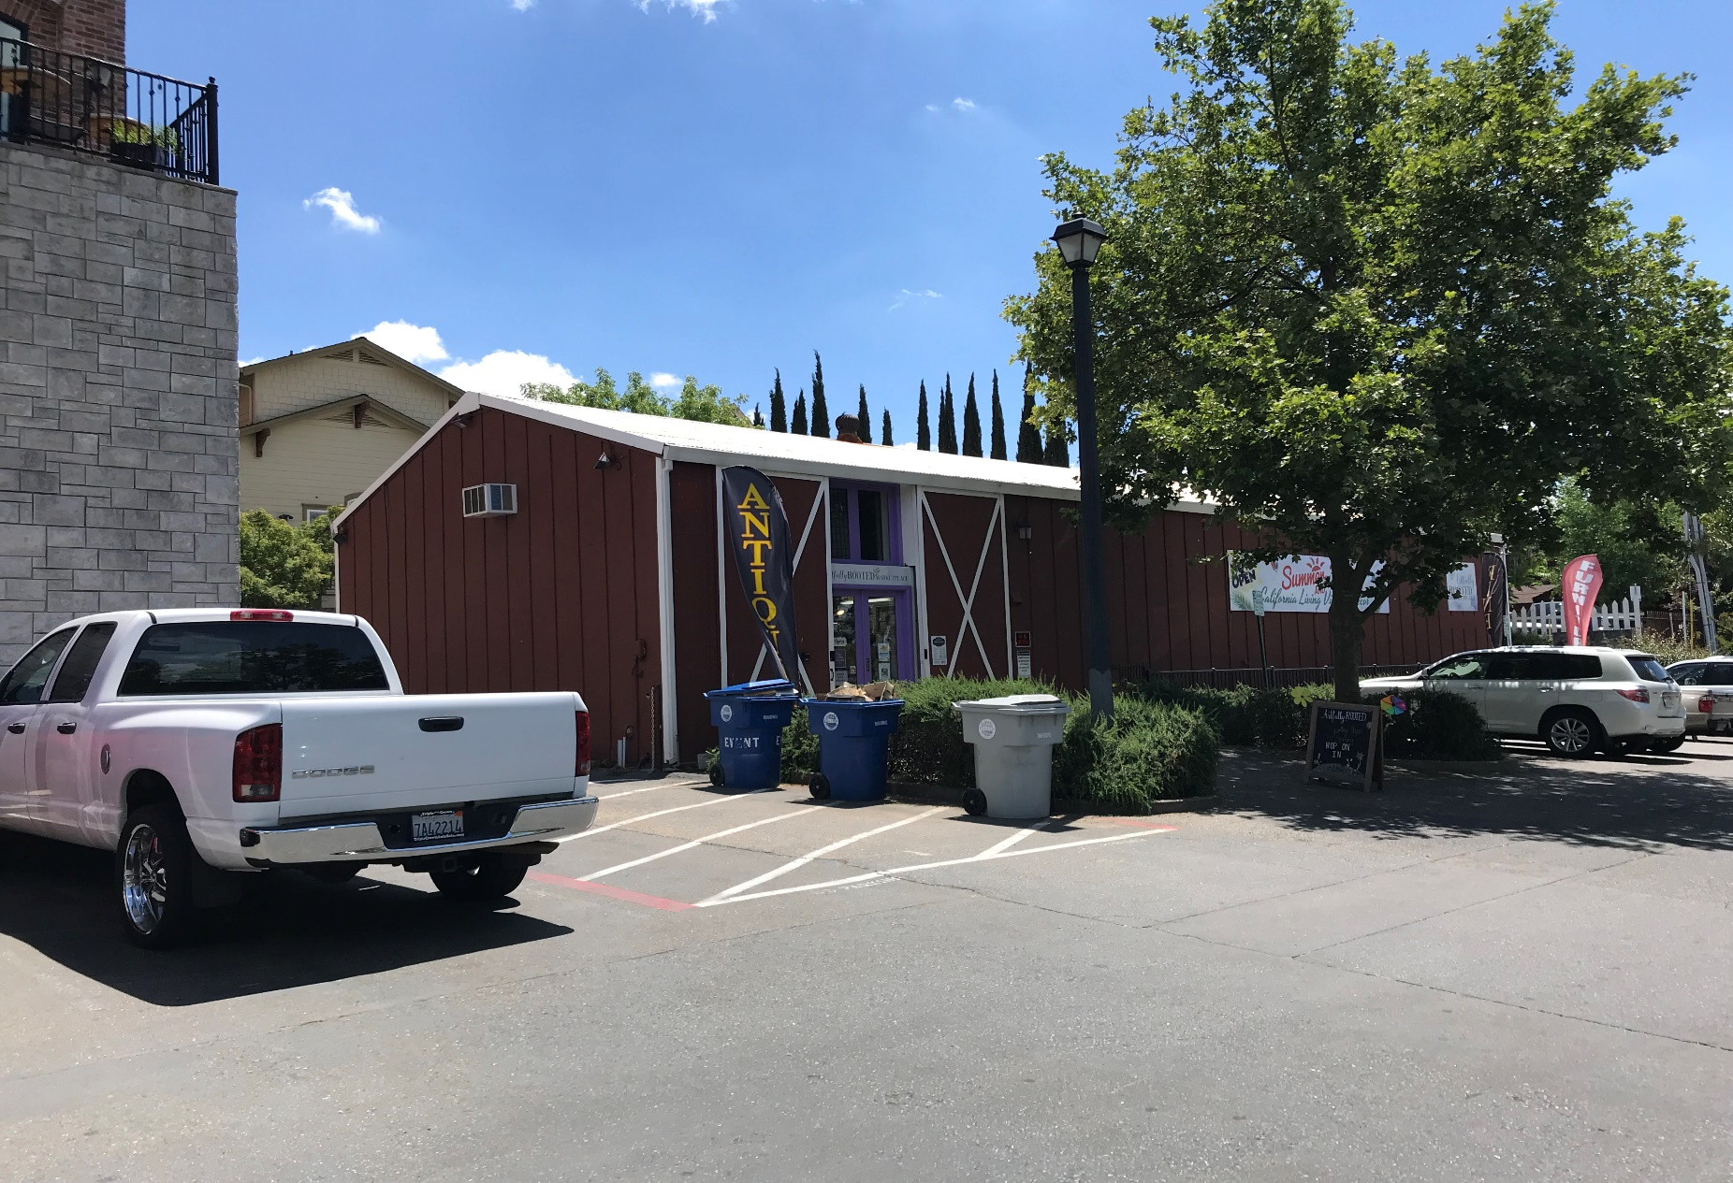
Site Photographs

Slide 56
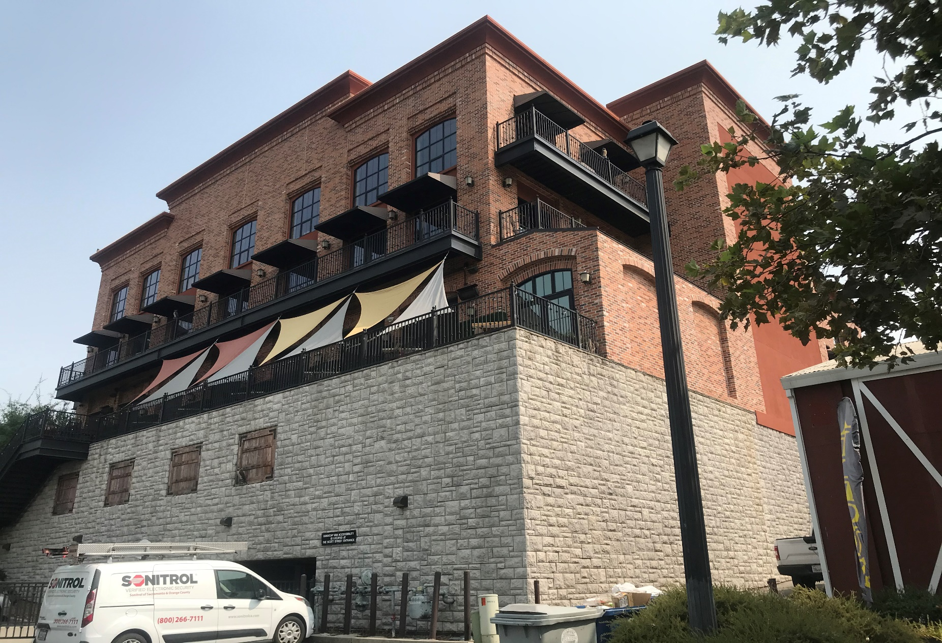
Site Photographs

Slide 57
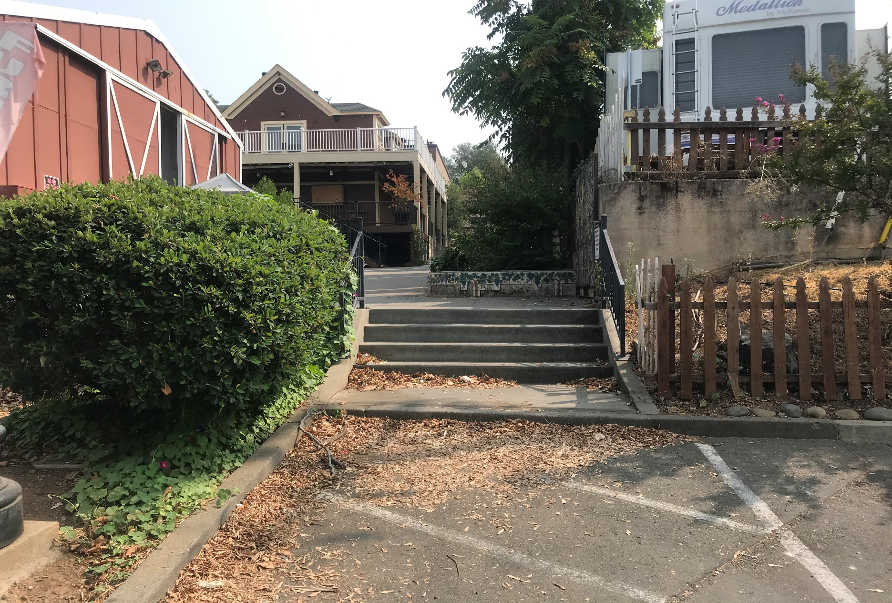
Site Photographs

Slide 58
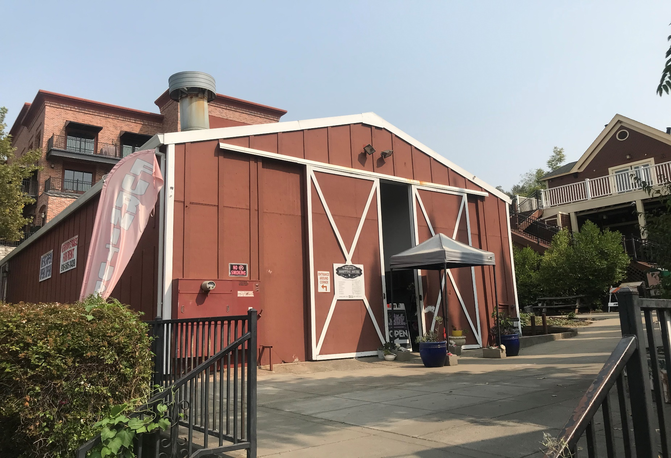
Site Photographs

Slide 59
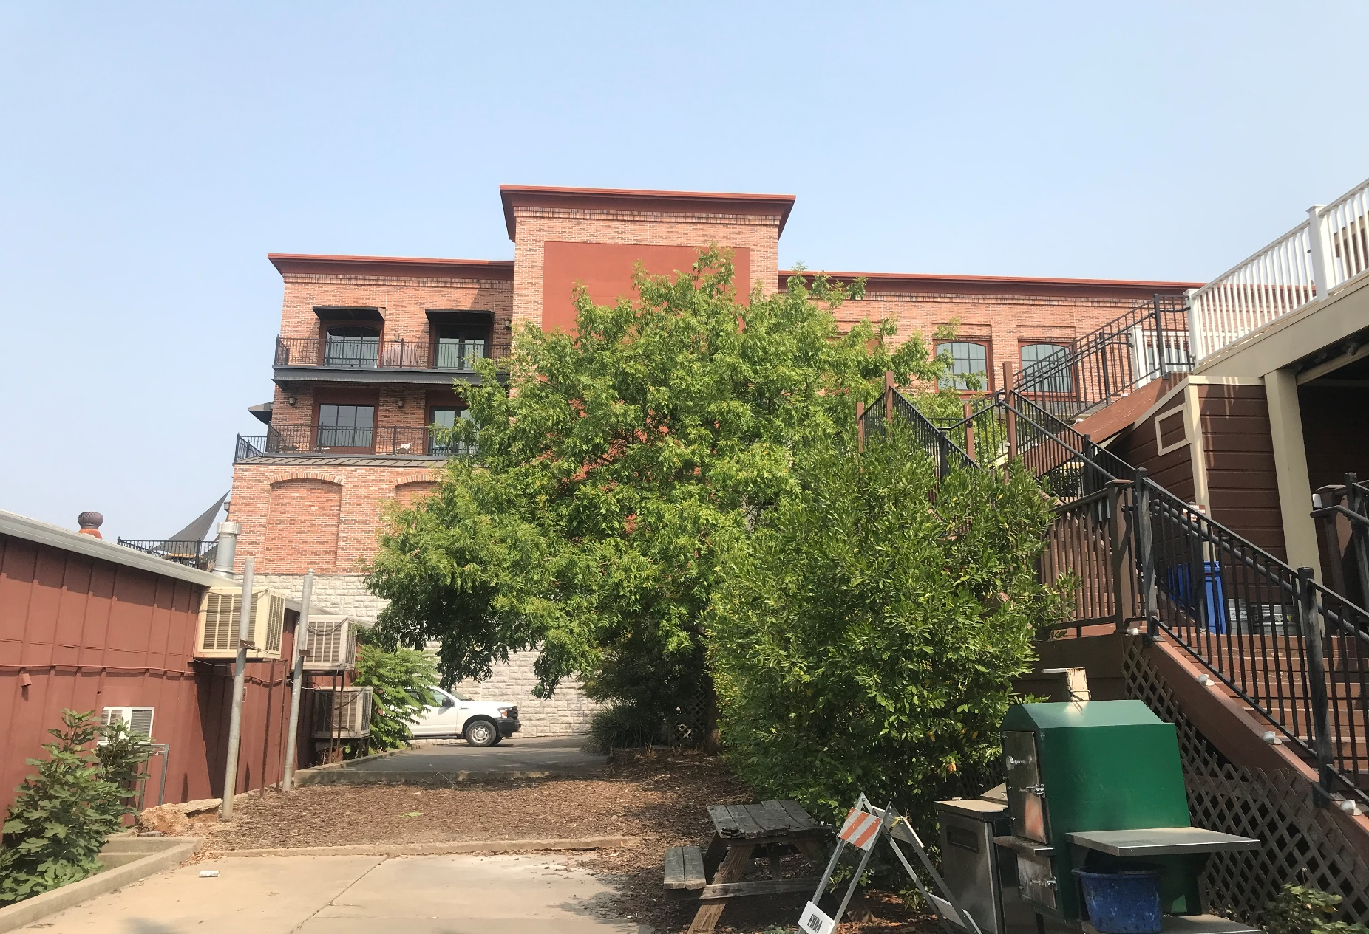
Site Photographs

Slide 60
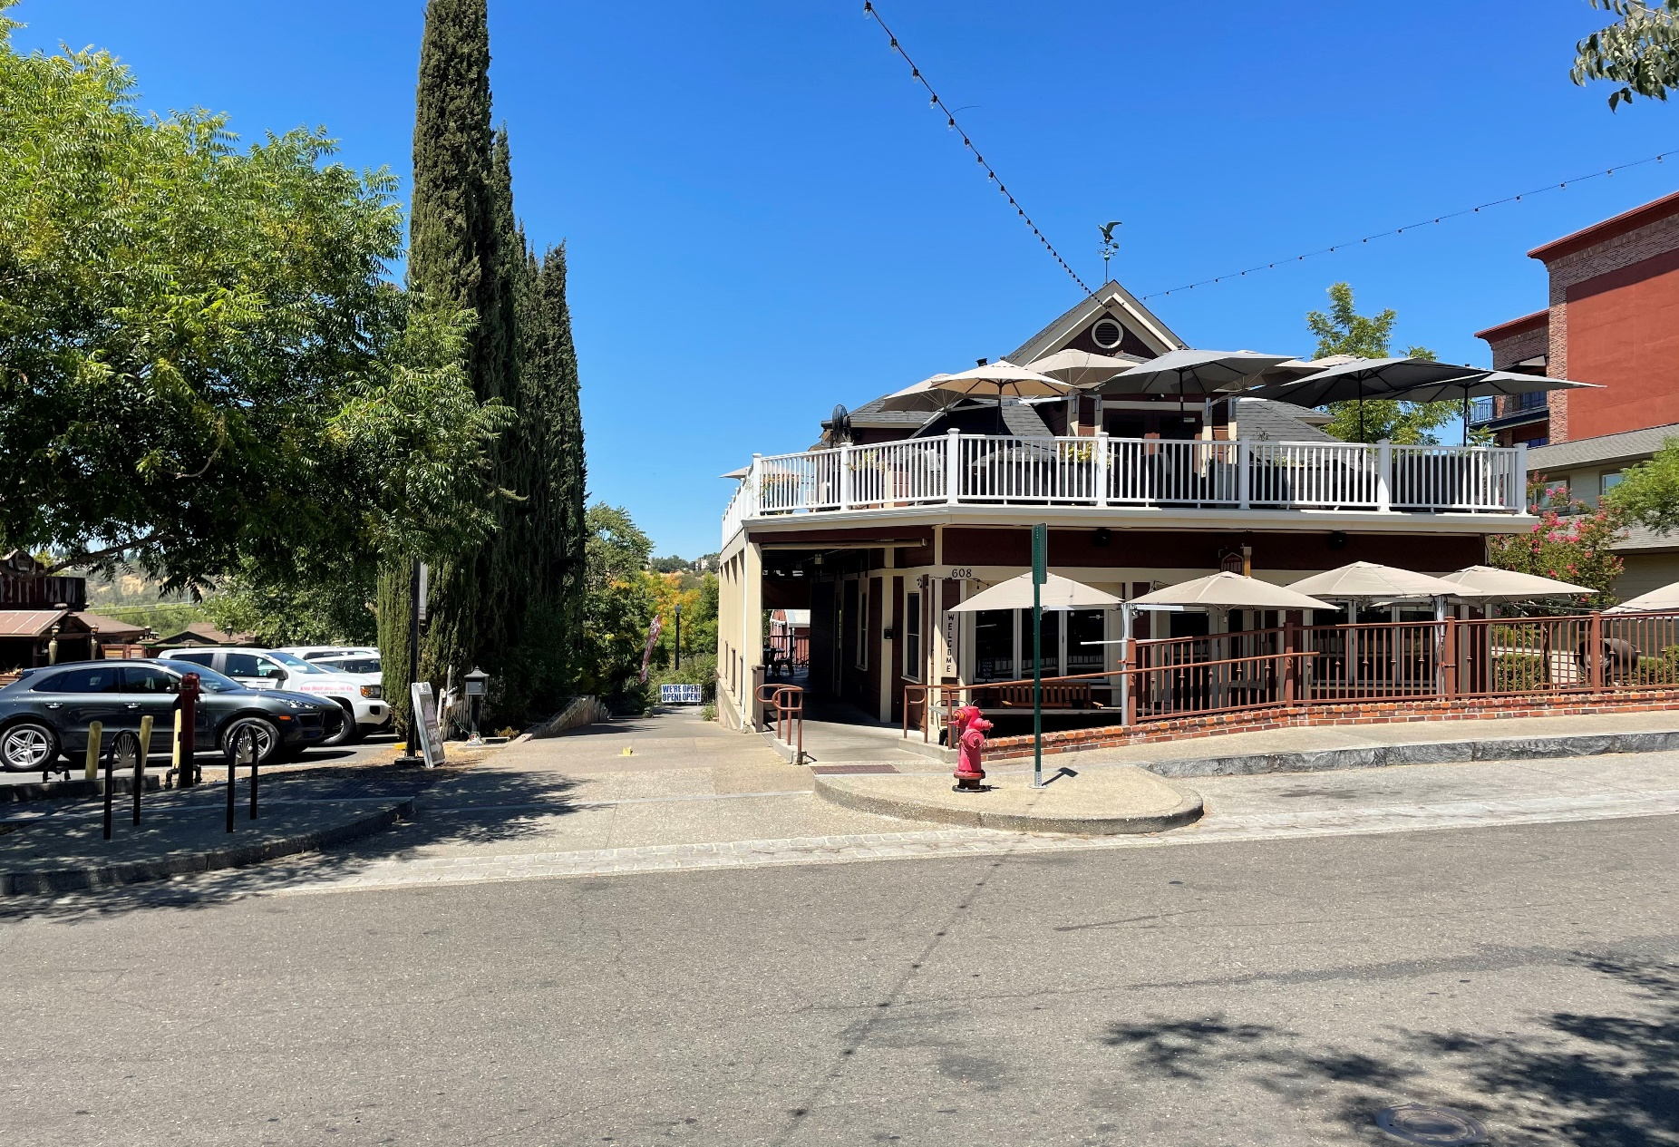
Site Photographs

Slide 61
Site Photographs

Slide 62
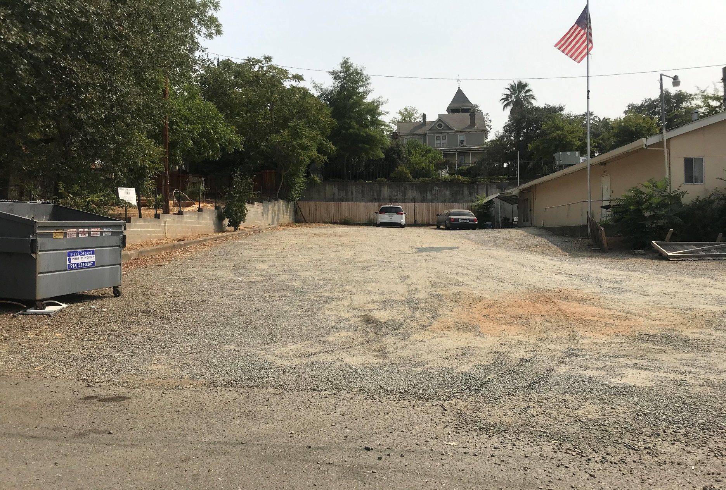
Site Photographs

